Slide 1


SESSION NO:7
CLASS :IV
SUBJECT : SOCIAL SCIENCE
CHAPTER NUMBER: 6
CHAPTER NAME : THE SOUTHERN PLATEAU
SUBTOPIC: Life in the Southern Plateau - Andhra Pradesh, Telangana

Slide 2
LEARNING OBJECTIVES:
Children will come to know -
About Andhra Pradesh, Telangana
Its crop
Festivals
Rivers

Slide 3
Warm up:
How many of you are vegetarian and Non-vegetarians?
Those who are non-vegetarian food, What do you love to eat fish?’
Do you know, From which import these fish to all states?

Slide 4
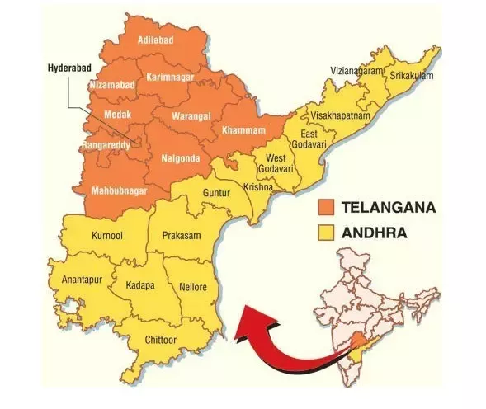

Slide 5
ANDHRA PRADESH

Slide 6
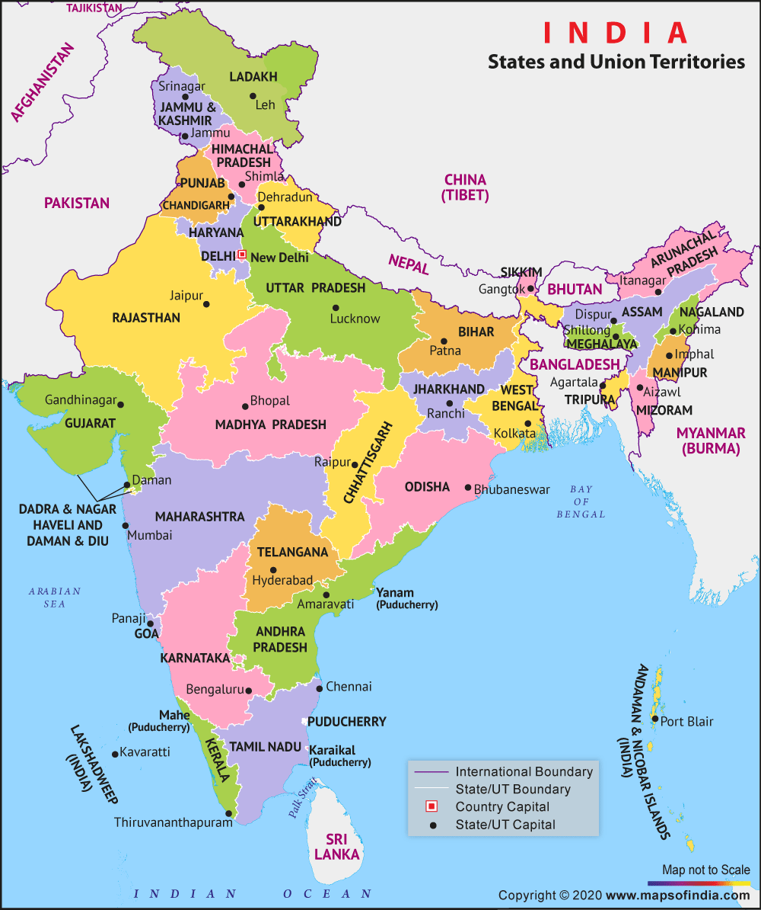
To the north-east of Karnataka is Andhra Pradesh.
Capital - Amaravati

Slide 7
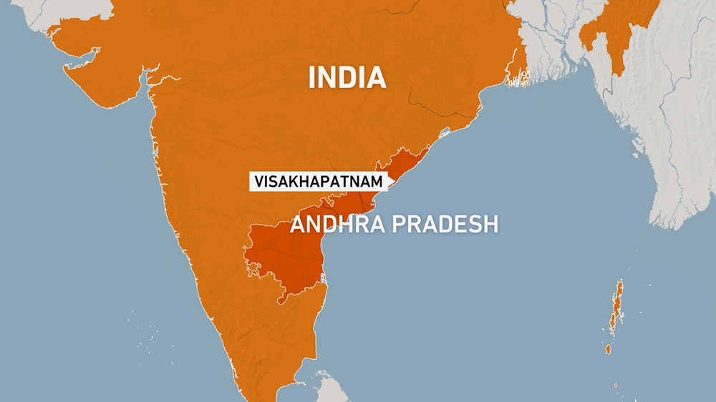
Other important city of Andhra Pradesh is
Vishakhapatnam - one of the largest producers of
rice
red chilli
tobacco
Textiles and information technology ( IT-are important industries of the state).

Slide 8
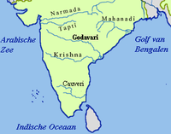
The rivers Krishna and Godavari flow through the state.

Slide 9
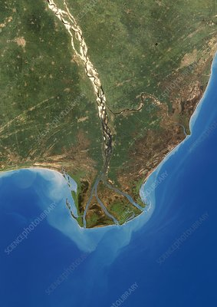
Their fertile deltas are ideal for the cultivation of rice.
This region is known as the 'rice bowl of India'.

Slide 10
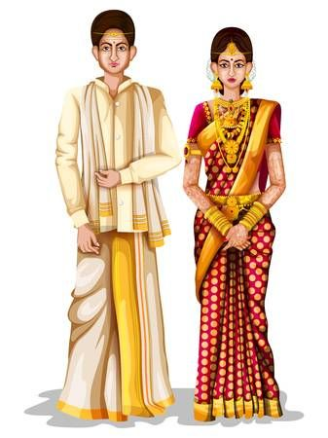
Language - Andhra Pradesh speak Telugu.
The men traditionally wear dhoti and shirt.

Slide 11
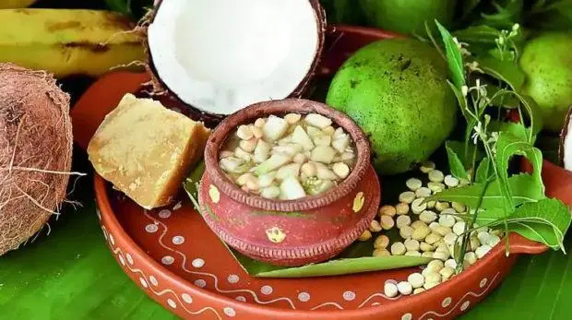



Important festivals:
Sankranti
Ugadi
Dussehra
Eid
Christmas

Slide 12
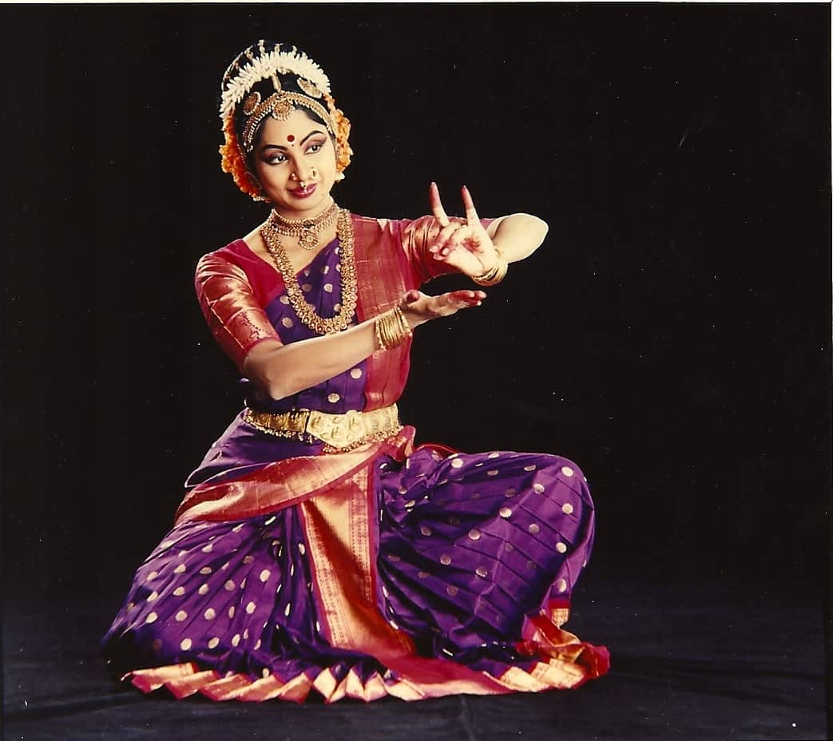
Famous dance form - Kuchipudi
Kuchipudi is one of the eight
major Indian classical dances.
It originated in a village named Kuchipudi in the
Indian state of Andhra Pradesh.

Slide 13
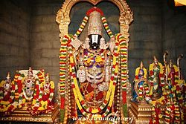
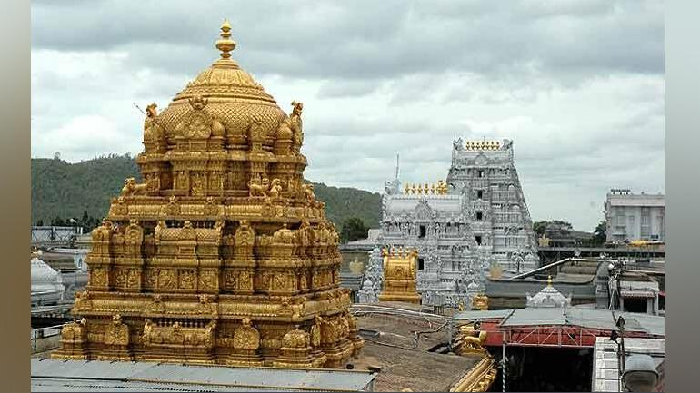
The Venkateshwara Temple in Tirupathi is visited by lakhs of devotees every year.

Slide 14
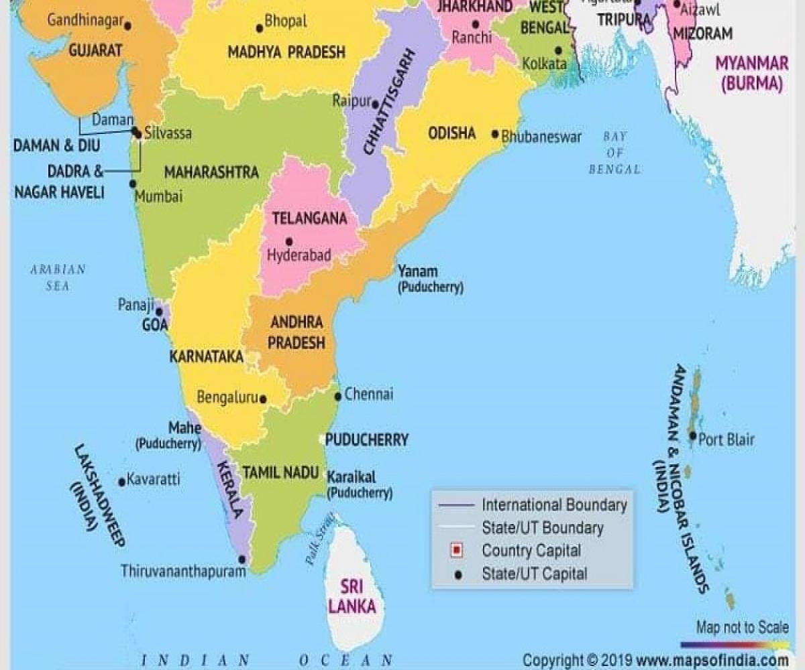
TELANGANA

Slide 15
The state of Telangana was formed in June 2014.
Capital - Hyderabad.
The other important cities of the state are:
Warangal
Karimnagar
Nizamabad
Khammam

Slide 16
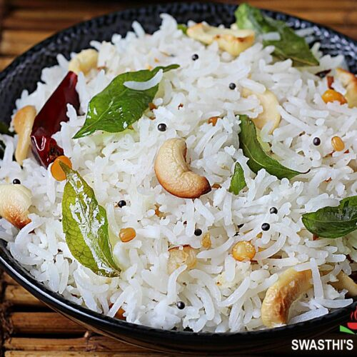
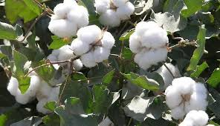
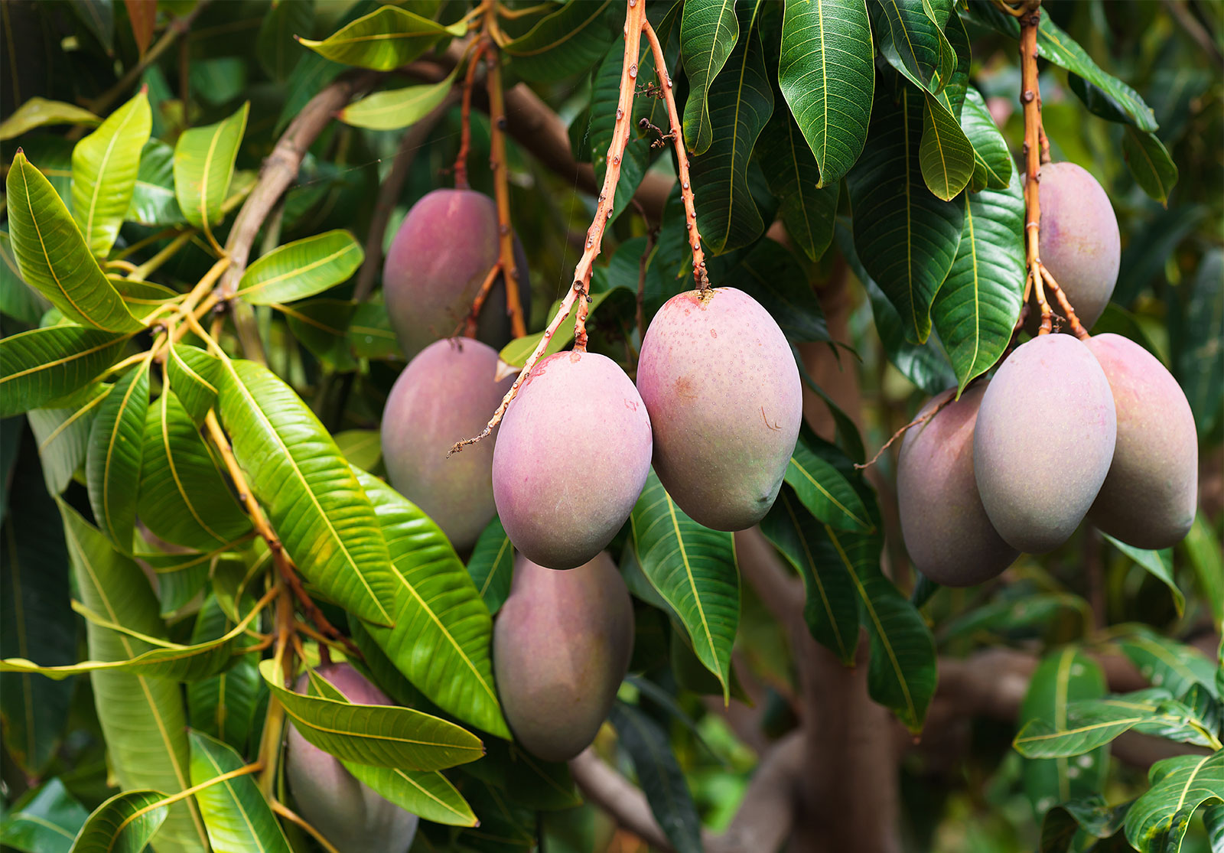
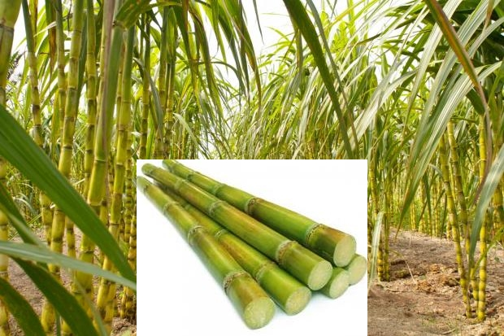
Two major rivers:
Godavari
Krishna
main occupation- Agriculture
main crops - Rice, cotton, sugar cane and mango

Slide 17
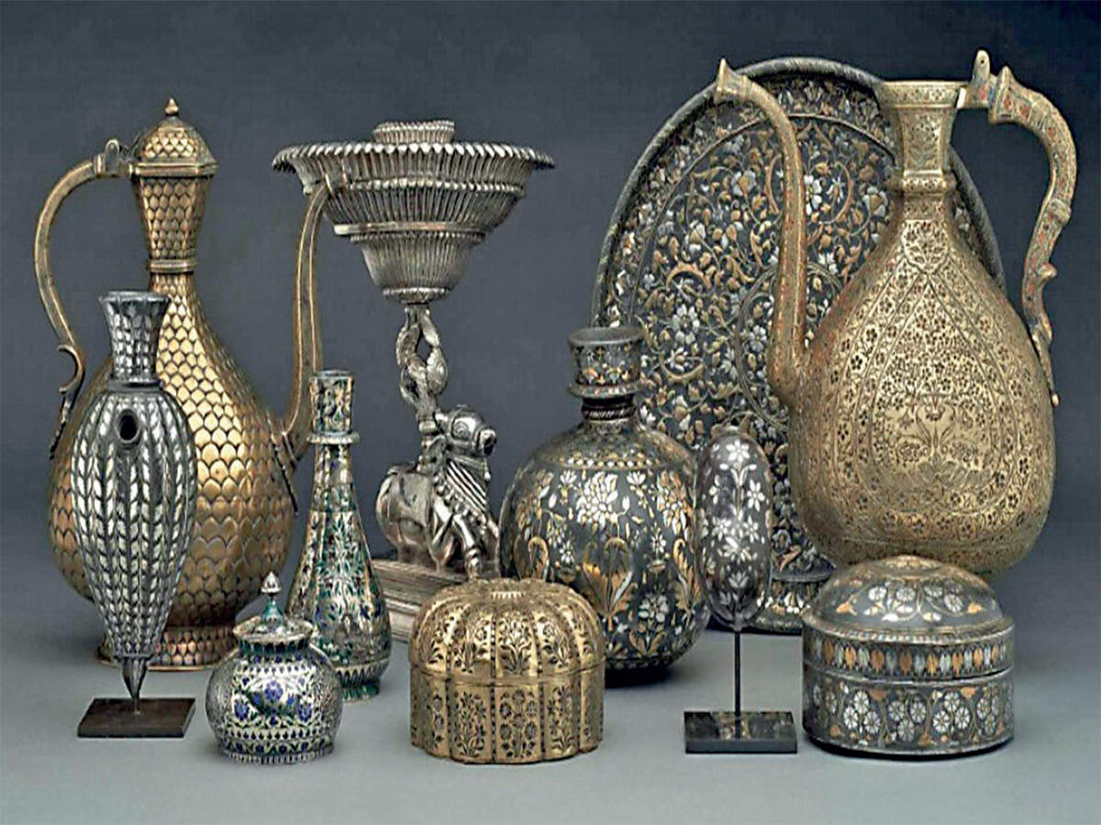
Bidriware - handicraft made here ( It is made from a mixture of zinc and copper with inlay work in silver).
main languages - Telugu and Urdu

Slide 18
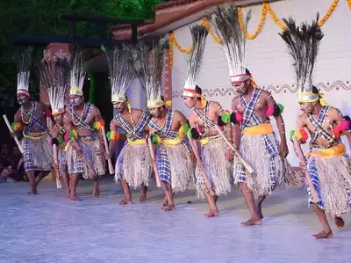
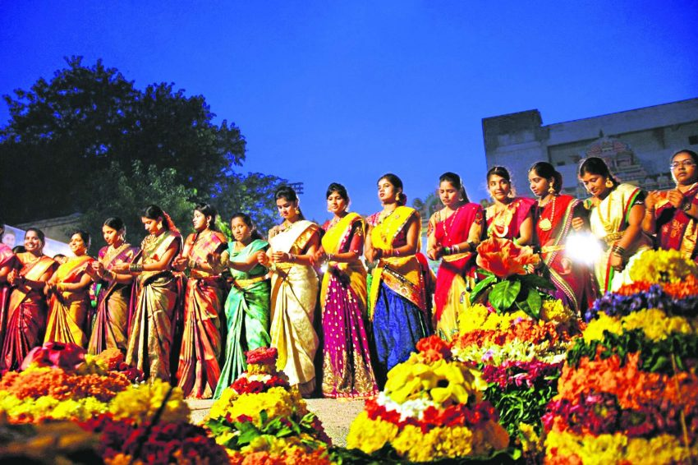
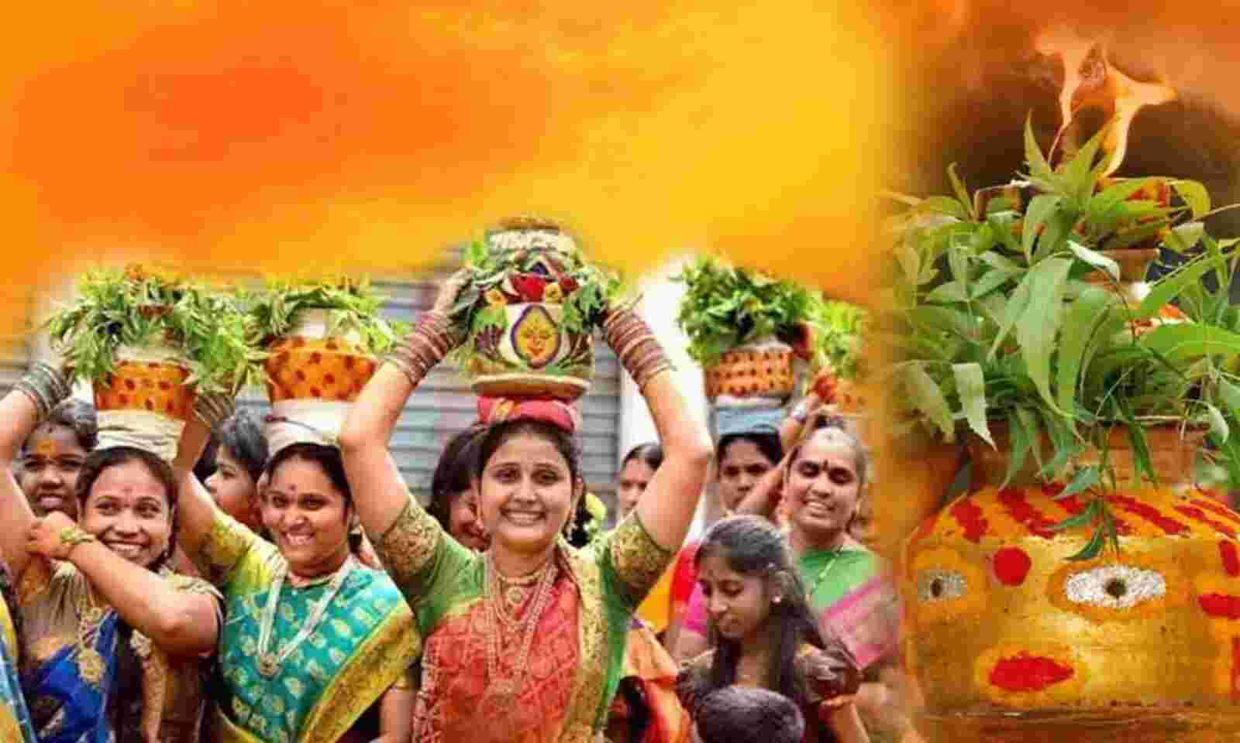
popular folk dance- Gusadi
the main festivals- Bathukamma, Bonalu and Eid

Slide 19
Answer the following questions:
4. Name three minerals found in the Southern Plateau.
Ans. Three minerals found in Southern plateau are:
a) Iron
b) Coal
c) Mica
5. Why are cotton and sugarcane grown in large areas of the Deccan Plateau?
Ans. Cotton and Sugarcane are grown in large areas of the Deccan plateau because it covers a large part of black soil which is very suitable to grow cotton and sugarcane.

Slide 20
Related video:
https://youtu.be/DFH7ZlgLrn4

Slide 21

HOMEWORK
No Homework

Slide 22
LEARNING OUTCOME:
Children will be able to - - About Andhra Pradesh, Telangana Its crop Festivals Rivers

Slide 23
THANKING YOU
ODM EDUCATIONAL GROUP

