Slide 1


REPRODUCTIVE HEALTH
STDs, INFERTILITY
SUBJECT : BIOLOGY
CHAPTER NUMBER:04
CHAPTER NAME :REPRODUCTIVE HEALTH

Slide 2
LECTURE-3
RECAPITULATION
IMR and MMR
BIRTH CONTROL METHODS
MTP
INFERTILITY
STDS
INFERTILITY

Slide 3
LEARNING OUT COME
Students will become aware of STDS.
Students will have a concept about a infertility.

Slide 4
KEY POINTS
STDS
INFERTILITY

Slide 5
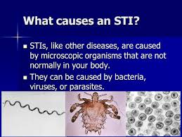
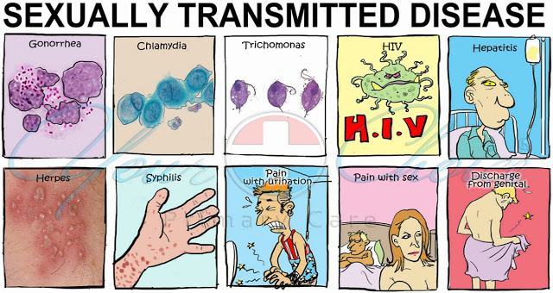
SEXUALLY TRANSMITTED DISEASES (STDs)

Slide 6
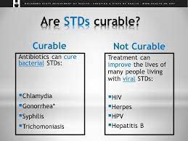

Slide 7

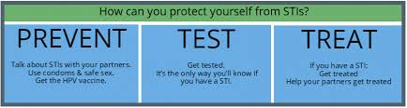

Slide 8
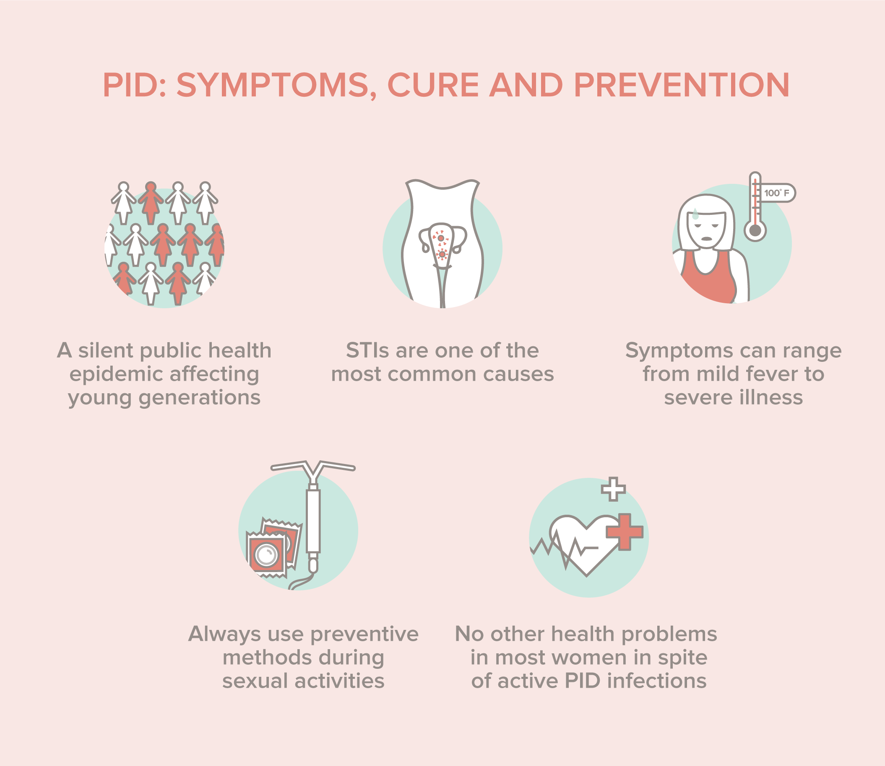
PELVIC INFLAMMATORY DISEASES (PID)

Slide 9
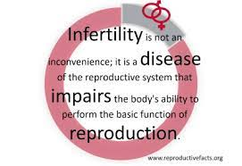
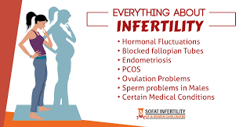
INFERTILITY

Slide 10
SUMMARY
STDS
INFERTILITY

Slide 11
HOME ASSIGNMENT
What are STDs? Mention any two of it.
Mention the various precautions one has to take in order to protect himself/herself form STDs.
Suggest some methods to assist infertile couples to have children?

Slide 12
THANKING YOU
ODM EDUCATIONAL GROUP

