Slide 1


REPRODUCTIVE HEALTH
REPRODUCTIVE HEALTH,PROBLEMS,STRATEGIES
SUBJECT : BIOLOGY
CHAPTER NUMBER:04
CHAPTER NAME :REPRODUCTIVE HEALTH

Slide 2

LECTURE-1
RECAPITULATION
HEALTH
REPRODUCTIVE HEALTH
DEFINITION OF REPRODUCTIVE HEALTH
REPRODUCTIVE HEALTH-PROBLEMS AND STRATEGIES
AMNIOCENTESIS
MMR and IMR
POPULATION EXPLOSION

Slide 3
LEARNING OUTCOME
Students will be able to know the definition of reproductive health.
Students will learn about the importance of reproductive health.
Students will be familiar with problems and strategies associated with reproductive health.
Students will get basic ideas about population explosion-causes, problems and consequences.
Students will gain the knowledge about amniocentesis.
Students will be able to get the idea about MMR and IMR.

Slide 4
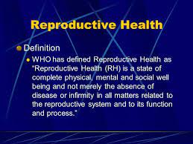
INTRODUCTION

Slide 5
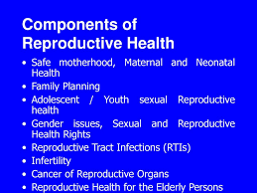

Slide 6



Slide 7
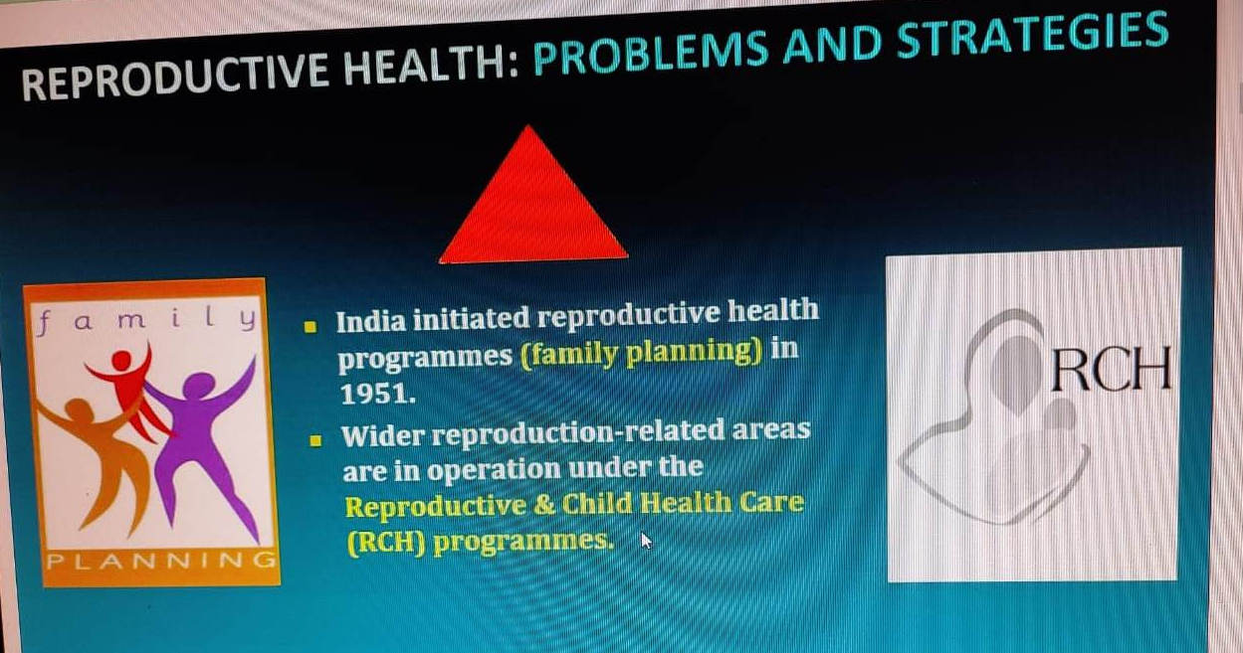
STRATEGIES

Slide 8
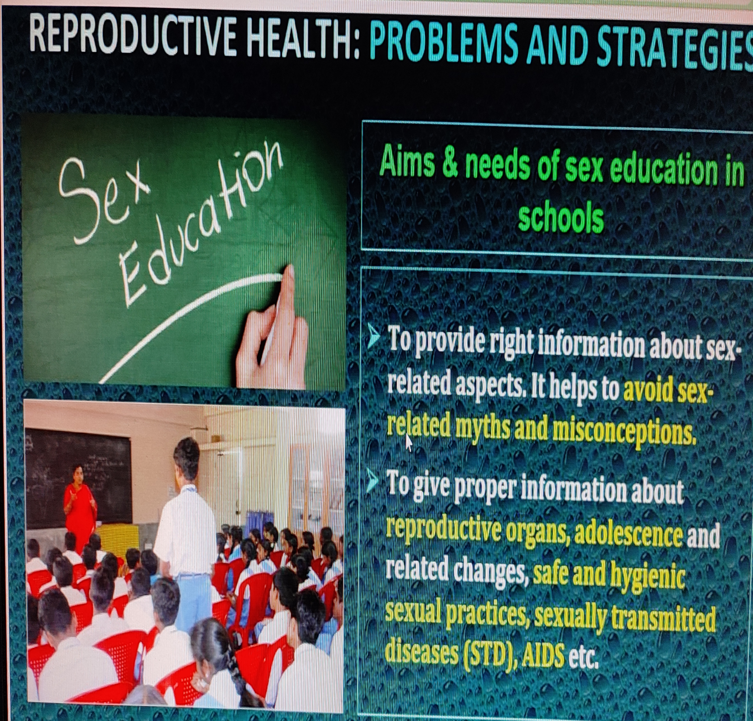

Slide 9
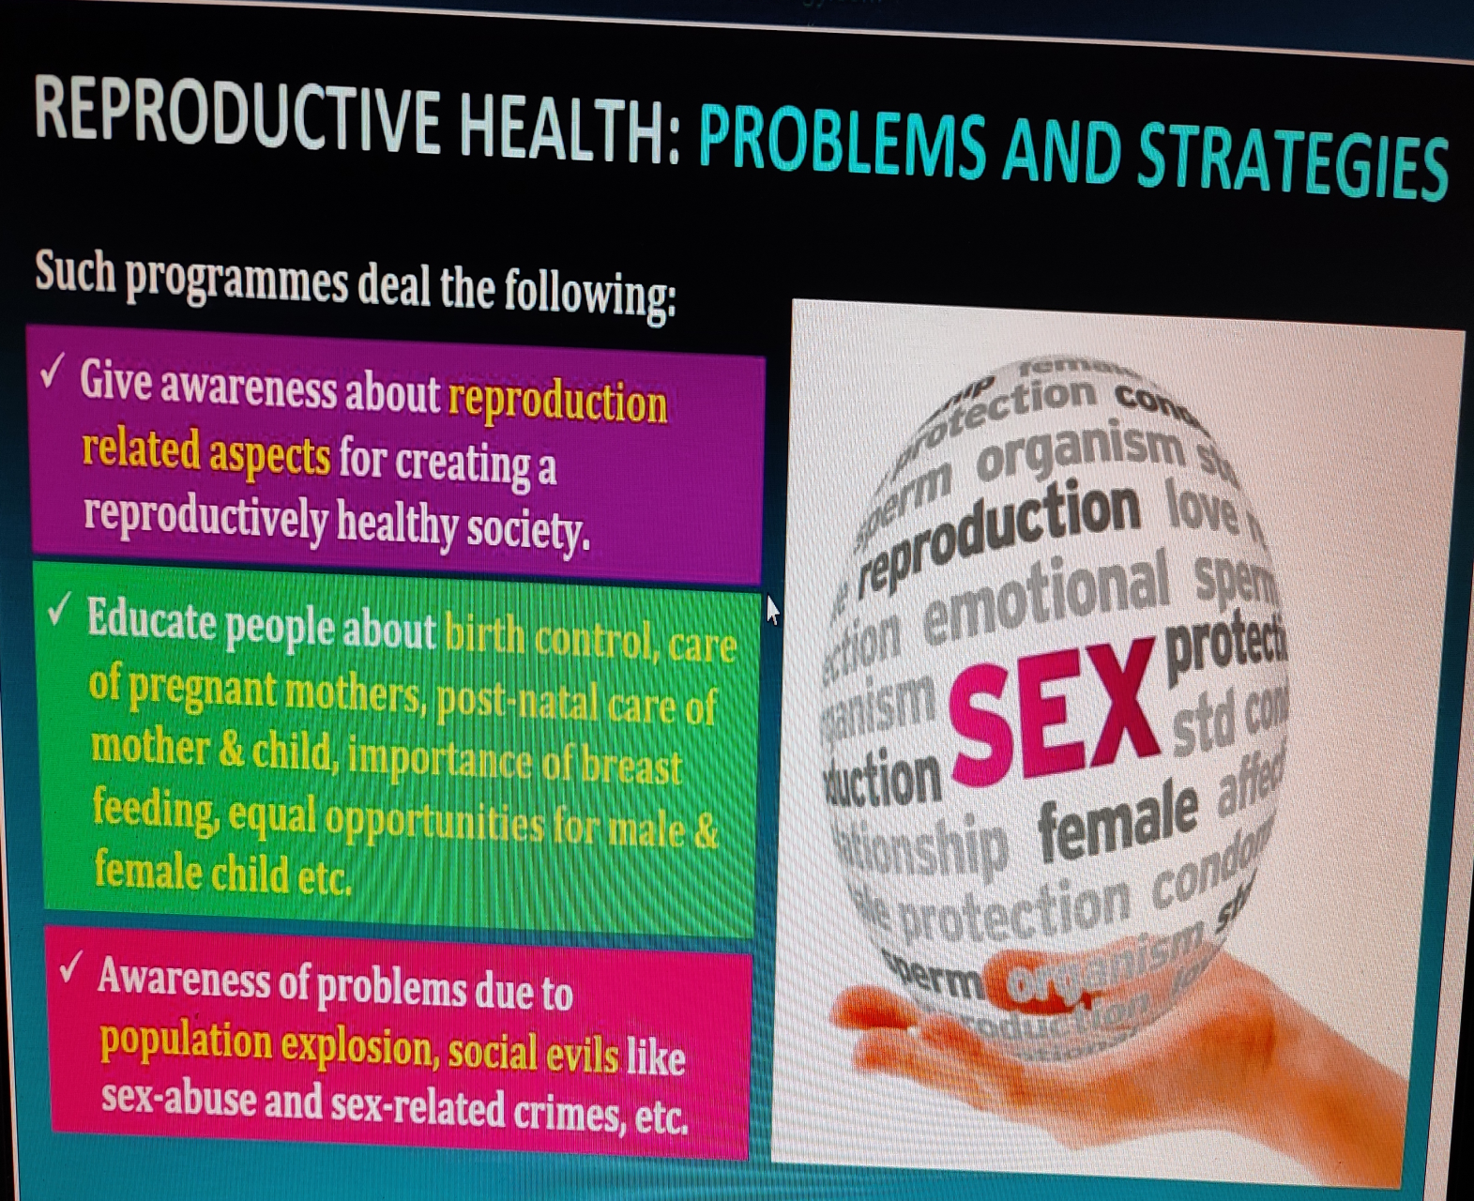

Slide 10


Slide 11
PROBLEMS
Believes – In India, religions, traditions do not allow much dissemination knowledge about reproductive health.
Early marriage – Children were often married off as soon as they attained puberty.
Personal hygiene – There is little knowledge of personal hygiene of gonads leading to STDs.
MMR & IMR - The maternal and infant mortality rates are high.
Population growth – There has been a increase in population size.

Slide 12
PARENTAL GUIDE : It is the duty of parents , elders and close relatives to provide sex related information to young ones.
SOCIAL EVILS : Sex abuse and sex related crimes can occur only due to reproductively unhealthy members of the society. Therefore spreading message of reproductive health is important .
INFRA-STRUCTURE : Strong infrastructure facilities, professional expertise and material support are required to attain proper reproductive health through providing assistance in reproductive health related problems like pregnancy, delivery, contraception, abortions .
FAMILY WELFARE INFORMATION : All other persons of marriageable age must be educated about available birth control options, reasons for fertility control, post natal care of child, importance of breast feeding.
UNCONTROLLED POPULATION : The harmful effect of
uncontrolled population explosion must be known to everybody
so that one should not only feel responsible but also act responsible.

Slide 13

RESEARCH : Research into improved techniques of contraception is a continuing process. ‘Saheli’ - a new oral contraception for the females was developed by scientists at Central Drug Research Institute (CDRI) in Lucknow.

Slide 14
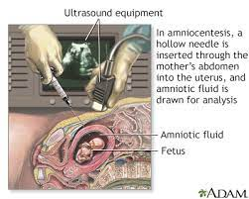
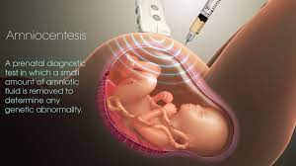
AMNIOCENTESIS : There is now a statutory ban on determination of foetal sex through this technique. Amniocentesis is a technique of foetal sex determination test based on the chromosomal pattern in amniotic fluid surrounding the developing embryo.
Legally it checks increasing female foeticides , massive child immunization etc.

Slide 15
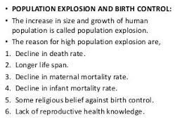
POPULATION EXPLOSION AND BIRTH CONTROL

Slide 16
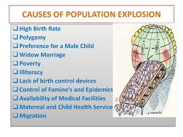
REASONS FOR HIGH POPULATION GROWTH

Slide 17
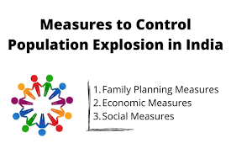

Slide 18
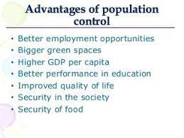
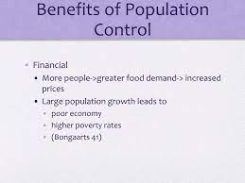

Slide 19
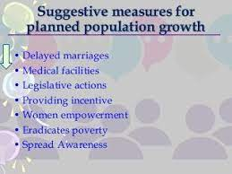
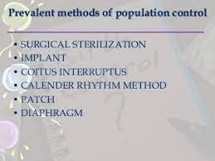

Slide 20
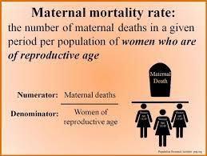
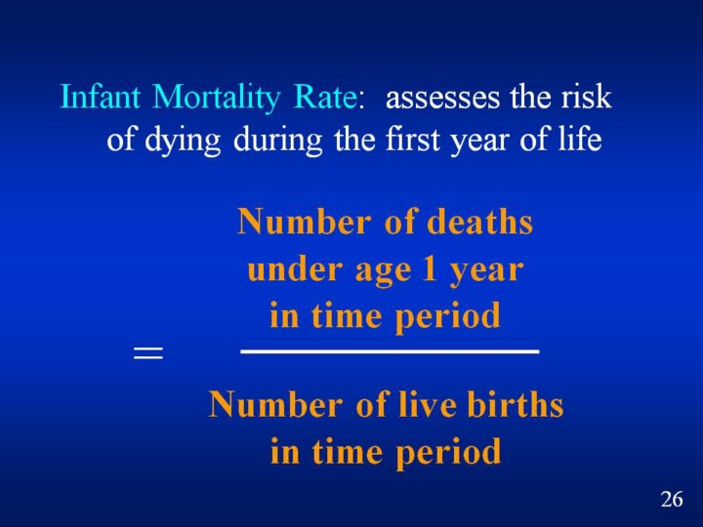
MATERNAL MOTALITY RATE(MMR)& INFANT MOTALITY RATE(IMR)
The increase in population increases unemployment, poverty, shortage in food, pollution, shortage of natural resources, demand for housing and many more.

Slide 21
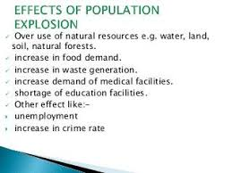
CONSEQUENCES OF POPULATION EXPLOSION

Slide 22


MOTIVATION
The most important steps to overcome this problems to motivate smaller families by using various contraceptive methods.
Many couples. mostly the young, urban working ones have even adopted on 'one child norm'.
Statutory raising of marriageable age of the female to 18 years and that of males to 21 years.
Incentives given to couples with small families is another measure taken to tackle this problem

Slide 23
https://www.who.int/southeastasia/health-topics/reproductive-health

Slide 24
SUMMARY
Definition of reproductive health.
Importance of reproductive health.
Problems and strategies associated with reproductive.
Population explosion-causes, problems and consequences.
Amniocentesis.
MMR and IMR.

Slide 25
HOME ASSIGNMENT
1.Reproductive health refers only to healthy reproductive functions. Comment.
2.Comment on the Reproductive and Child Health Care programme of the government to improve the reproductive health of the people.
3.The present population growth rate in India is alarming. Suggest ways to check it.
4. Suggest some important steps that you would recommend to be taken to improve the reproductive health standards in India.
5. Enumerate and describe any five reasons for introducing sex education to school-going children.
6. Define the terms MMR and IMR.
7. What do you mean by amniocentesis and why there is statutory ban on it?

Slide 26
THANKING YOU
ODM EDUCATIONAL GROUP

