Slide 1

READING AND BLENDING
PHONICS
SUBJECT : (ENGLISH)
UNIT-4
CHAPTER NAME : ‘i’ SOUND WORDS

Slide 2
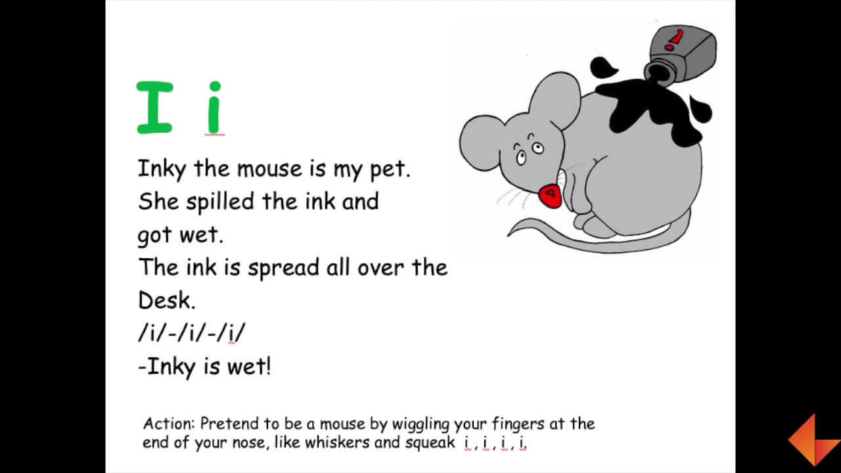

Slide 3

pin

Slide 4

tin

Slide 5

zip

Slide 6


fin

Slide 7

chin

Slide 8
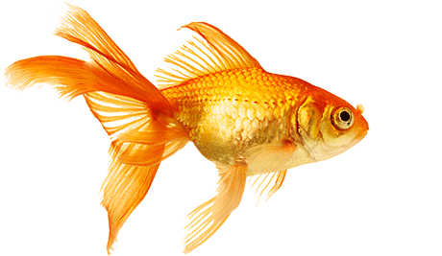
fish

Slide 9

clip

Slide 10

Listen & repeat the words
pin
tin
zip
fin
chin
fish
clip

Slide 11

THANKING YOU
ODM EDUCATIONAL GROUP

