Slide 1

WELCOME TO ONLINE CLASS
CLASS-UKG
SUBJECT-CONVERSATION
TOPIC-ONCE AGAIN
(Thank you and please)

Slide 2





WHEN SHOULD WE SAY THANK YOU?
When someone gives us a gift.
When someone appreciates us for our job.
When someone helps us.
When we are grateful to someone.
When someone wishes us ‘good luck’.

Slide 3


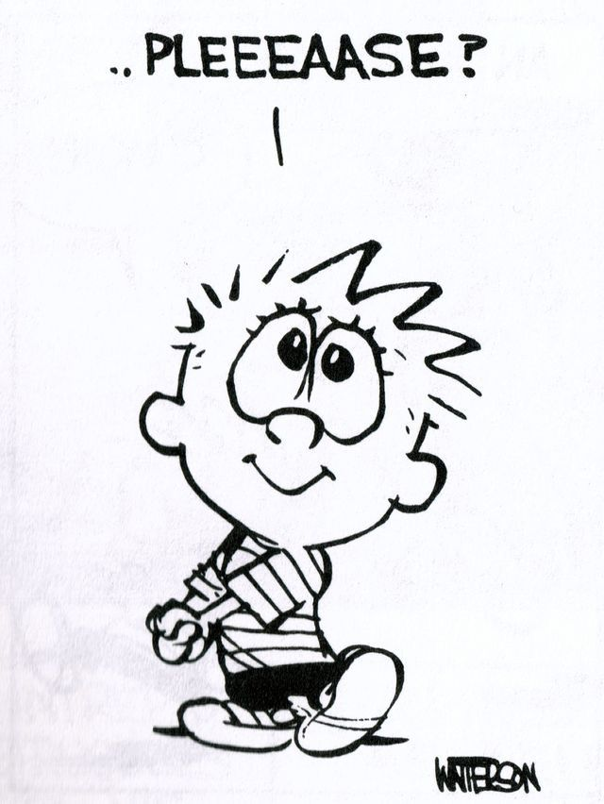
WHEN SHOULD WE SAY PLEASE?
When we want to make a request.
When we need to seek someone’s permission.
When we ask for something.
When we want to pass through in a crowd.

Slide 4
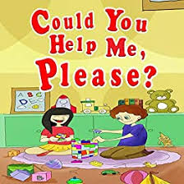
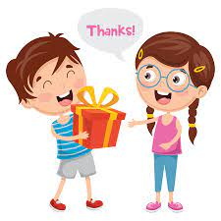
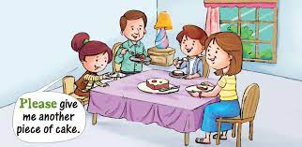
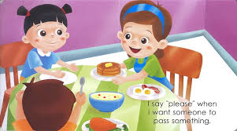
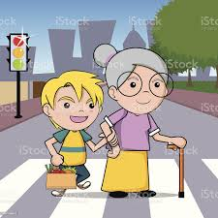
WHAT SHOULD YOU SAY?
When you want some help?
When someone gives you a gift?
PLEASE
THANK YOU
When we want something?
PLEASE
When you want someone to pass something?
When someone helps you?
PLEASE
THANK YOU

Slide 5
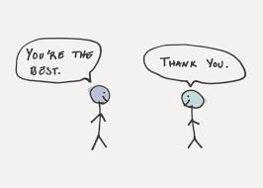
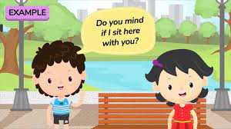
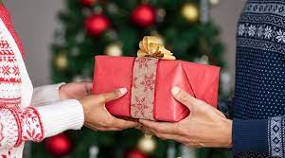
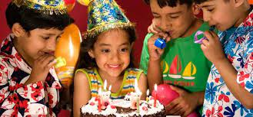
WHAT SHOULD YOU SAY?
When someone gives you a compliment?
When you want to ask someone to sit?
THANK YOU
PLEASE
When someone wishes you on your birthday?
When someone gives you a gift?
THANK YOU
THANK YOU

Slide 6
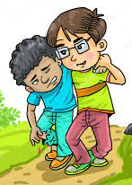
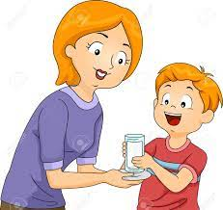
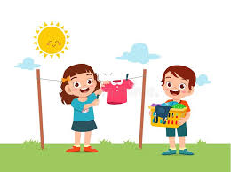
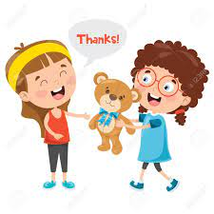
WHAT SHOULD YOU SAY?
When someone helps you?
When your Mama gives you milk before going to bed?
THANK YOU
THANK YOU
When you want to ask someone for help?
When someone gives you a gift?
PLEASE
THANK YOU

Slide 7


Slide 8

THANKING YOU
ODM EDUCATIONAL GROUP

