Slide 1

WELCOME TO ONLINE CLASS
CLASS-UKG
SUBJECT-STORY
TOPIC-THE SELFISH DOG
(DRAMATISATION)

Slide 2
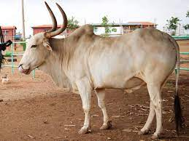
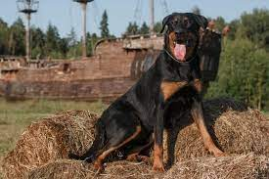
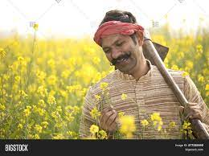
I am a farmer. I worked in the field. I have an ox and a dog.

Slide 3
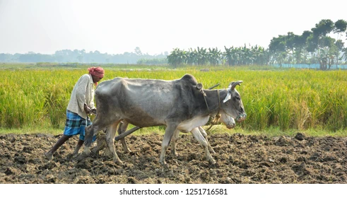
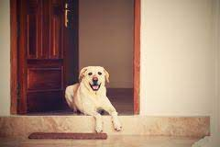
My ox Bholu helped me in the field and my dog Moti watched the house at night.

Slide 4
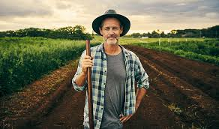
I love both of them. But was surprised by what my dog Moti did…….Let’s see.

Slide 5
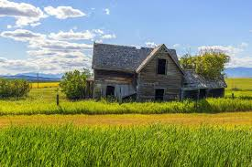
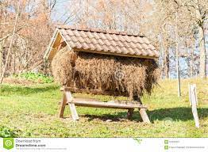
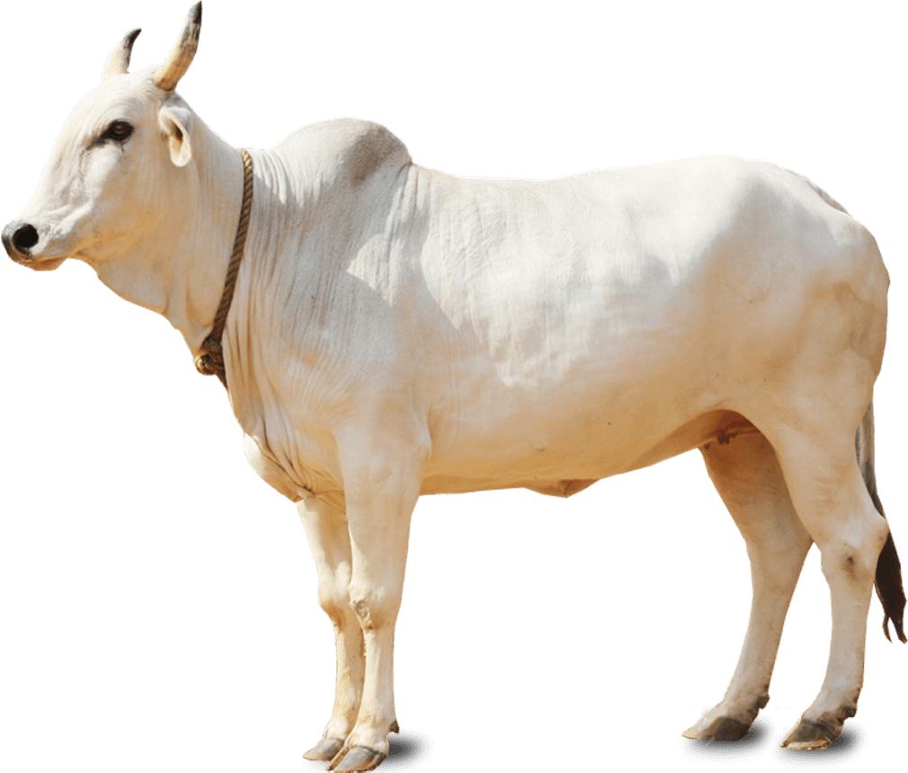
I have worked a lot .I am feeling very tired and hungry. Now I will return home and go to the manger and eat some yummy hay.

Slide 6
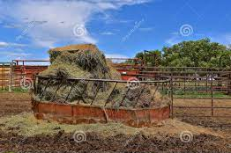
Arey! Moti you are here? Please get aside and let me eat some hay. Then we will play.
Vow.. Vow I can not let you eat the hay.
When the ox went to the manger ,it found the dog was sitting on the hay. Bholu said…

Slide 7
But Moti why? It is of no use to you. Please let me eat the hay. I am feeling very hungry.
No! Since I myself can not eat the hay I won’t allow anyone to have it.

Slide 8
But Moti did not allow the ox to eat the hay. So the ox had to go hungry that day. When I came to know the whole story, I felt sad. I was surprised to know that my dog was so selfish.

Slide 9
I know selfish person won’t let you have anything what they could not. But I am pretty sure you are not going to be selfish like my dog. You all are good kids . You will share your things with your friends, brothers or sisters.
Thank you

Slide 10

THANKING YOU
ODM EDUCATIONAL GROUP

