Slide 1

WELCOME TO ONLINE CLASS
CLASS-UKG
SUBJECT-STORY
TOPIC-THE SELFISH DOG
(English)

Slide 2

Answer the following questions with ‘yes’ & ‘no’. If yes
then repeat the answer & if no then say the answer -
yes
no

Slide 3
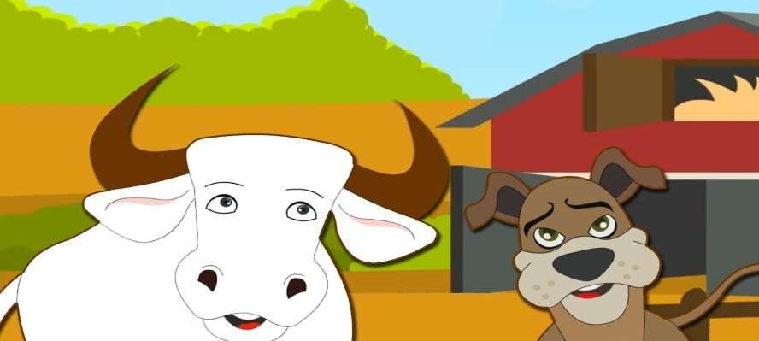
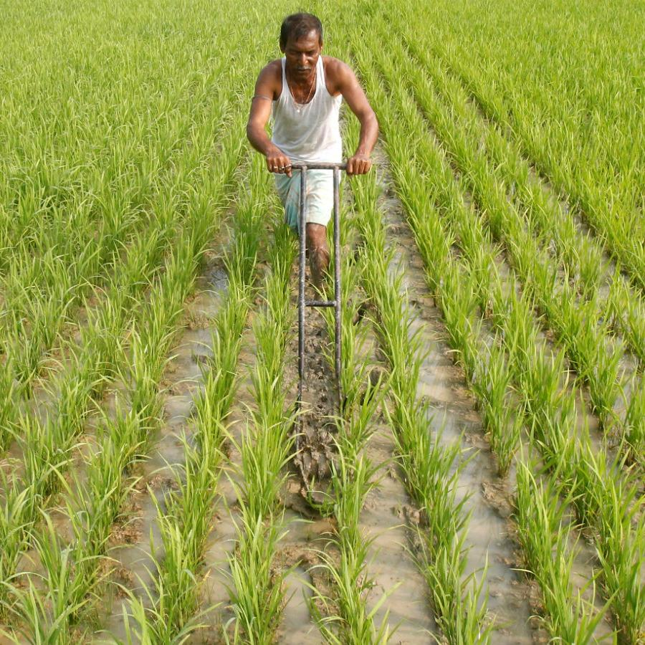
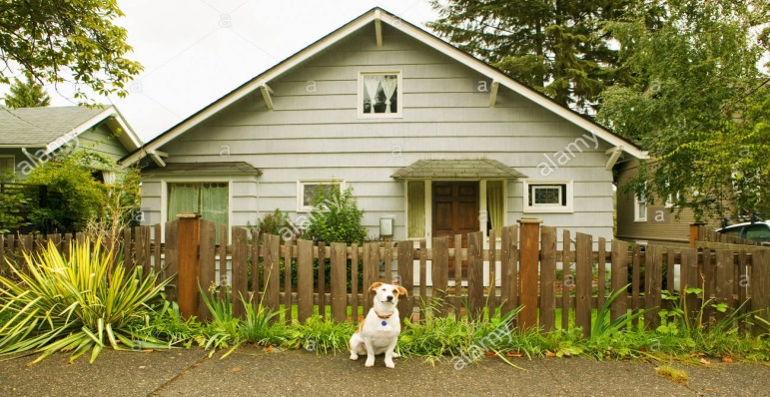
A farmer had a sheep and a bull.
The farmer worked in a school.
The dog watched the house and not let anyone
to get inside.

Slide 4
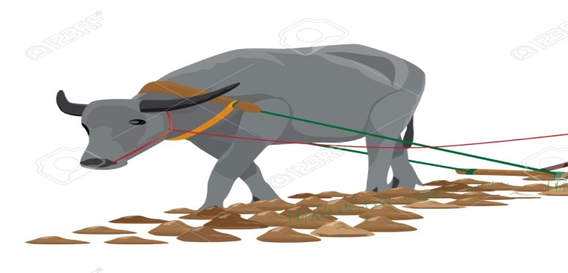
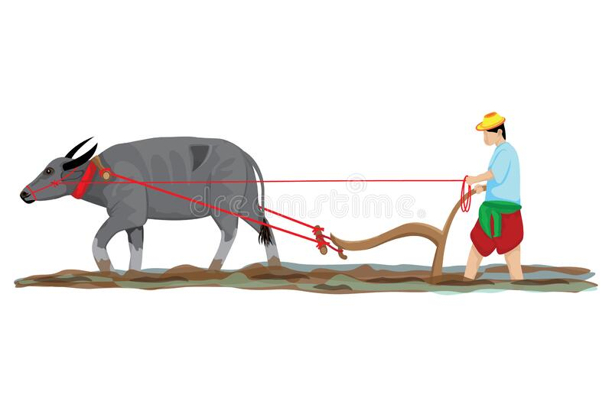
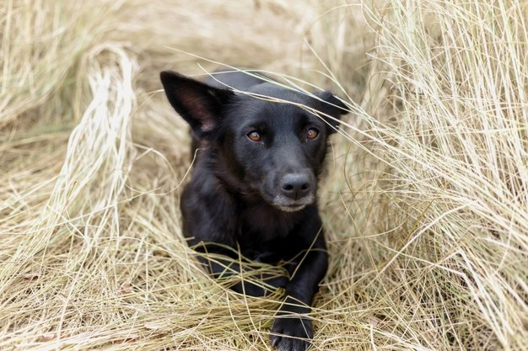
The dog was very hungry and want to eat some food.
The dog helped the farmer in his field.
The dog was sitting on a chair.

Slide 5
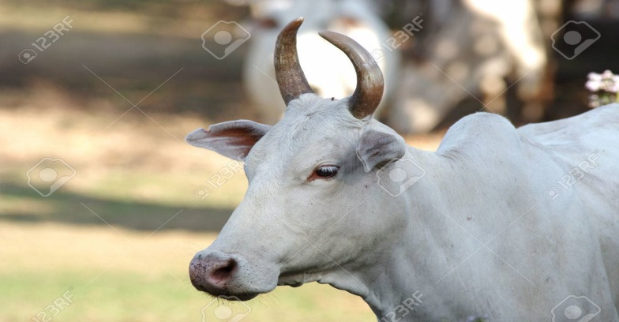
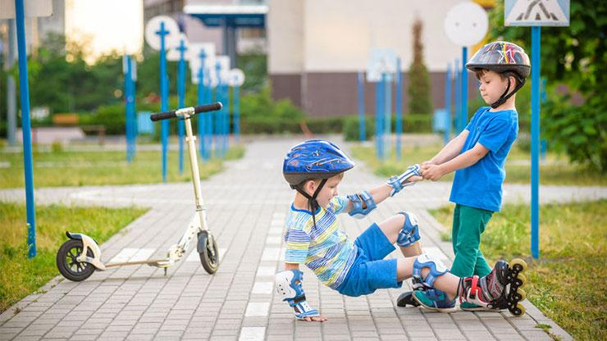
On that day the ox had a nice yummy dinner.
The moral of the story is always try to be selfish/
helpful to others.

Slide 6

THANKING YOU
ODM EDUCATIONAL GROUP

