Slide 1

WELCOME TO ONLINE CLASS
CLASS-UKG
SUBJECT-STORY
TOPIC-THE SELFISH DOG
(question cum answer)

Slide 2
Answer the questions.
Who had an ox and a dog?
Who helped the farmer in the field?
Who watched the house at night ?
What happened one evening?
The farmer had an ox and a dog.
The an ox helped the farmer in the field.
The dog watched the house at night.
One evening the ox was very tired and hungry.

Slide 3
Where did the ox returned?
What did the ox found ?
One evening the ox was returned home.
The ox found the dog was sitting on the hay.
What did the dog do when he saw the ox ?
The dog barked at him and would not let
him to eat the hay.
What did the ox said to the dog?
The ox said ‘please get aside and let me eat some hay.
It is of no use to you.

Slide 4
What was the reply of the dog ?
What happened to ox on that day?
What is the moral of the story?
But the dog replied ‘Since I myself cannot eat the
hay I will not let anyone else have it’ .
On that day the ox had to go hungry with the empty
stomach .
The moral of the story is selfish persons won’t let
you have anything what they could not.

Slide 5
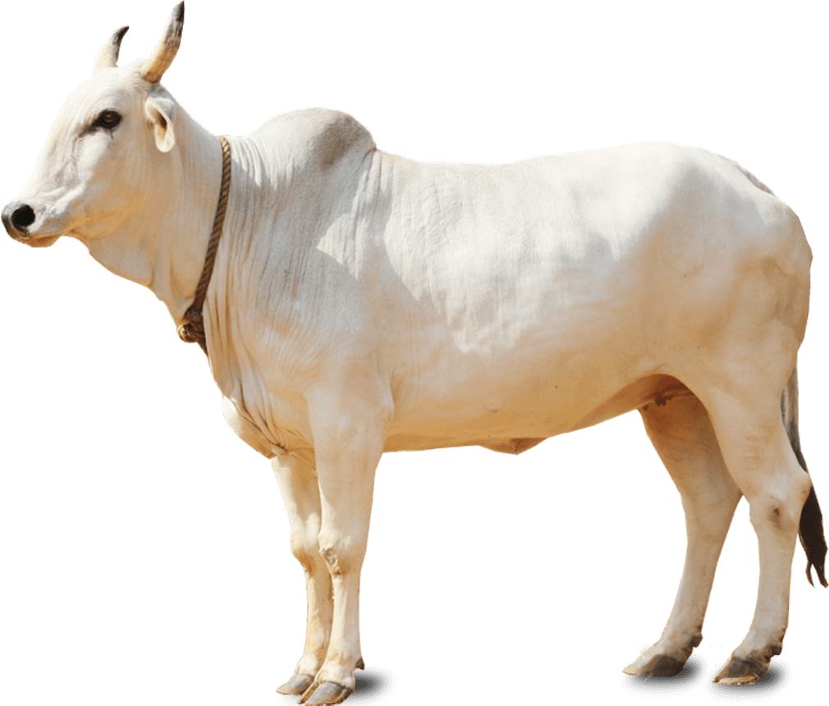
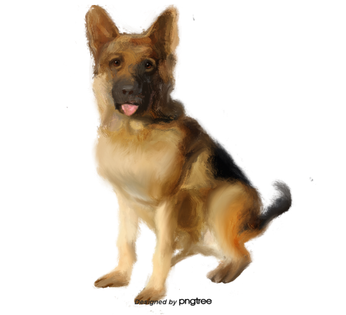
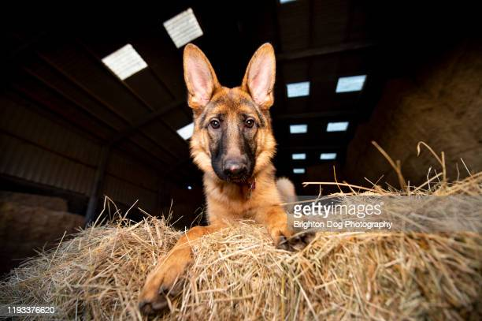
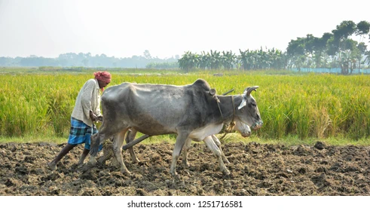

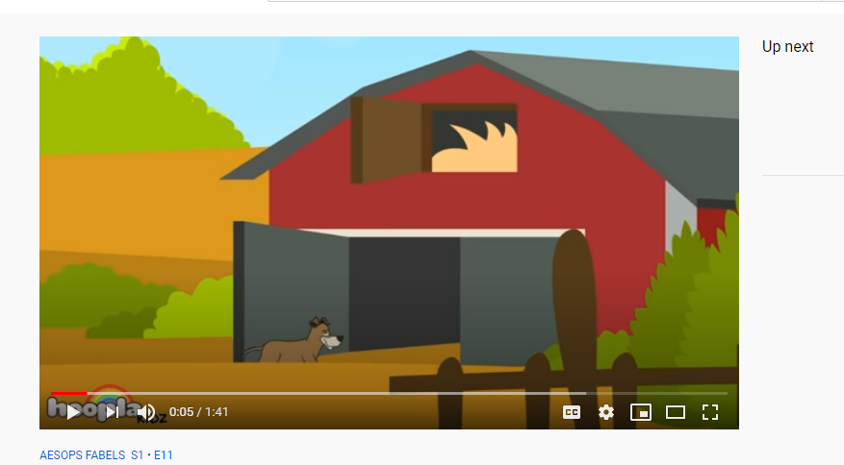
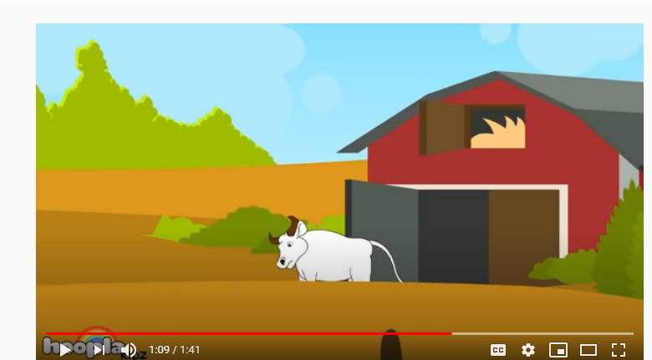
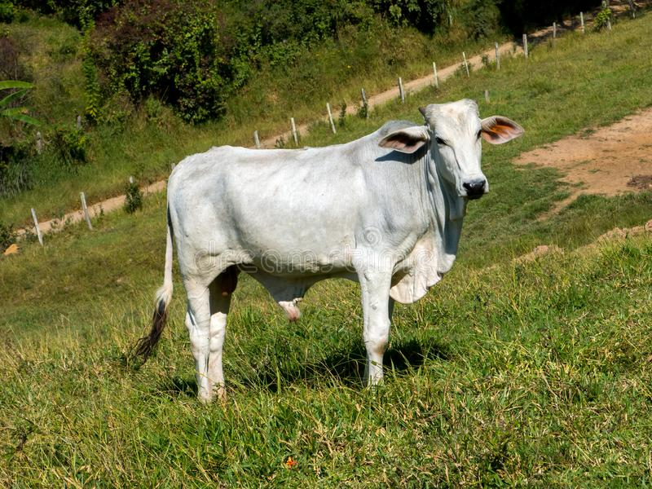

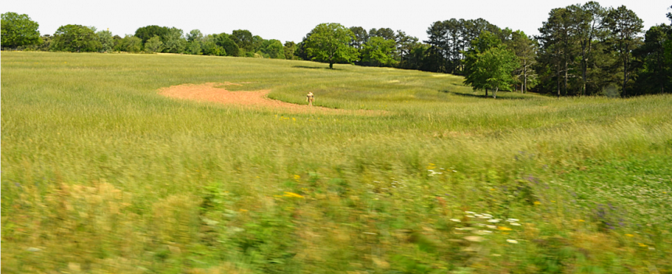

Slide 6

THANKING YOU
ODM EDUCATIONAL GROUP

