Slide 1


CLASS : UKG
SUBJECT : STORY
CHAPTER : 4
TOPIC : ‘BETTER ALONE’

Slide 2
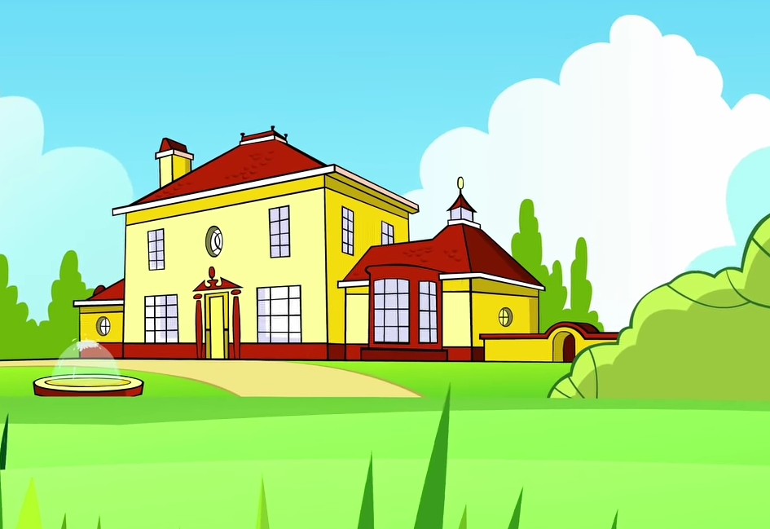
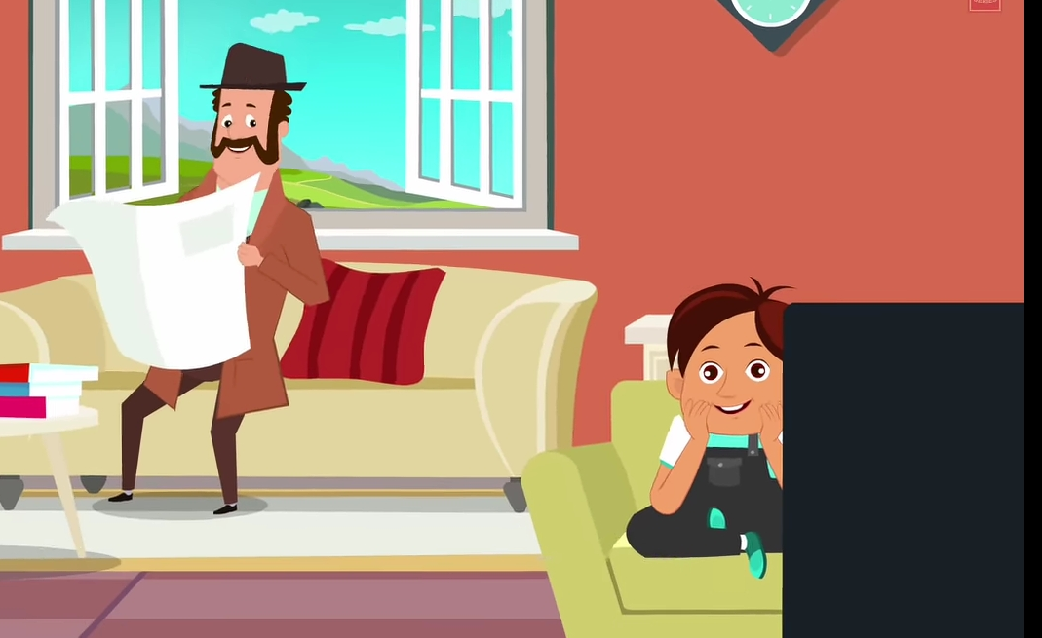
RICH MAN AND HIS SON (INTRODUCTION)
Rich Man
His son

Slide 3
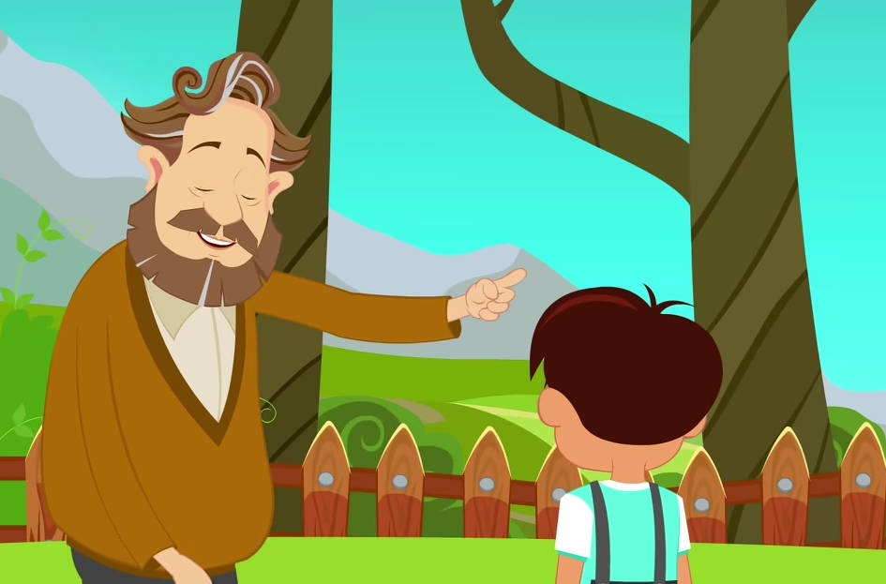
He is a wise man ……..…. tried to teach lessons to the boy.

Slide 4
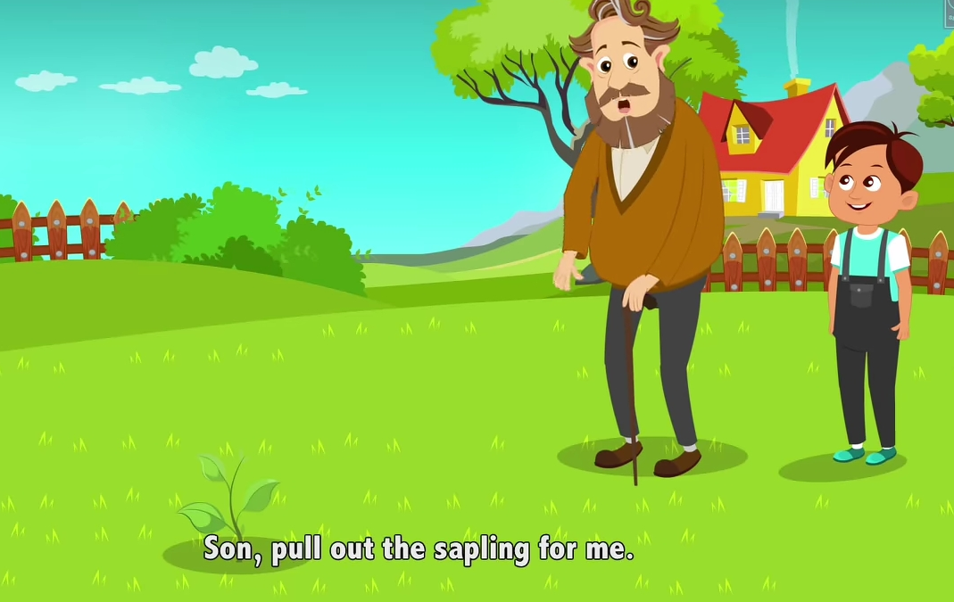
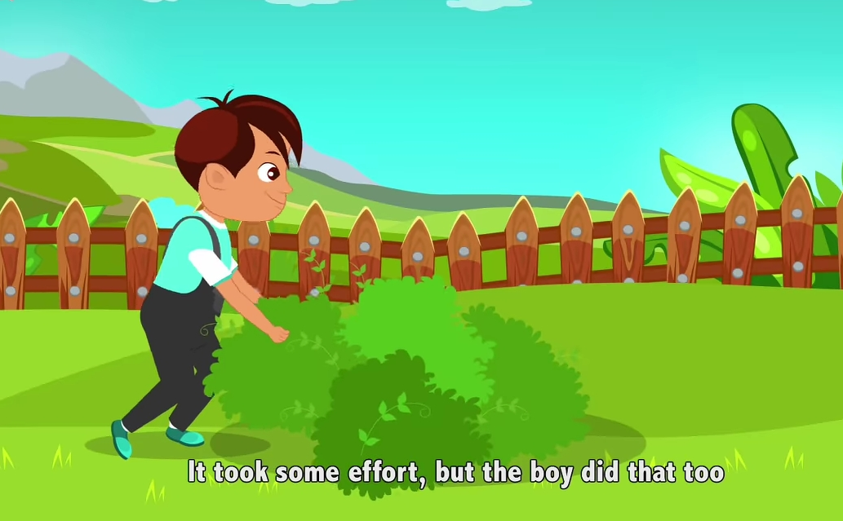
He had an idea. He took the boy to the garden and said son, can you pull out the sapling for me? The boy did it easily.

Slide 5
Then, the man said look at the big and strong tree and please pull out for me. The boy tried a lot but he did not succeed. Here, the man explained bad habits are like strong trees. If you will not give up from the beginning, it will grow stronger. So my son, try to remove your bad habits from the beginning.

Slide 6
In next class - we will learn the story
“ ”
Based on BAD HABITS.
BETTER ALONE

Slide 7
THANKING YOU
ODM EDUCATIONAL GROUP

