Slide 1

WELCOME TO ODM ONLINE CLASS
CLASS-UKG
SUBJECT-MATHEMATICS
T0PIC- SHAPES(ACTIVITY)
(BK PG 75 TO 78)

Slide 2


Slide 3

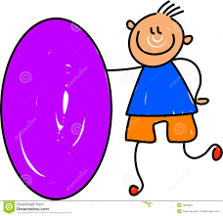
It is round.
It has no corners.
What shape is that?
It is a circle.
It is almost round.
It looks like an egg.
What shape is that?
It is an oval.

Slide 4
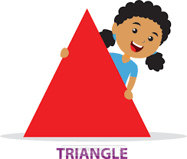

It has three sides.
It has three corners.
What shape is that?
It is a triangle.
It has four sides.
They are all the same.
What shape is that?
It is a square.

Slide 5
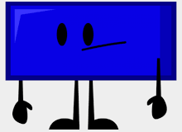

It has four sides.
Two are longer.
What shape is that?
It is a rectangle.
It has a flat shape.
It has 1 straight side.
It has 1 curved side.
It has 2 corners.
What shape is that?
It is a semicircle.

Slide 6
Draw and colour the shapes as per the given instruction:
Circle-
Semicircle-
Triangle-
Rectangle-
Oval-
Square-
Classwork
24.8.21

Slide 7

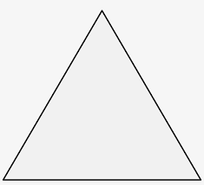


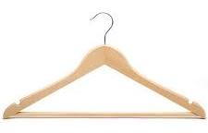

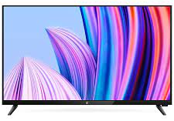

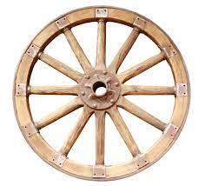
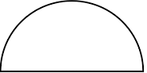
Homework
24.8.21
Match the shapes with the objects that are similar:

Slide 8

THANKING YOU
ODM EDUCATIONAL GROUP

