Slide 1

WELCOME TO ODM ONLINE CLASS
CLASS-UKG
SUBJECT-MATHEMATICS
T0PIC- SHAPE(SEMICIRCLE AND OVAL)
(BK PG 75 TO 78)

Slide 2


A semicircle is half of a circle
It has 2 sides.
One side is curved and other side is straight
It has 2 corners.
What is it?

Slide 3

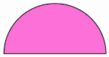
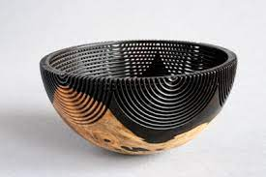


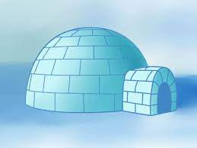

Semicircle
as

Slide 4
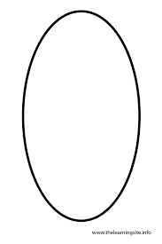

Olli oval is my name. The circle and I are not the same. A circle is as round as it can be. I am shaped like an egg as you can see.
HEY! LOOK AT ME. WHO AM I?

Slide 5
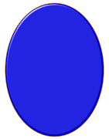

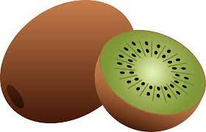

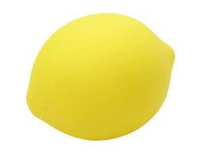
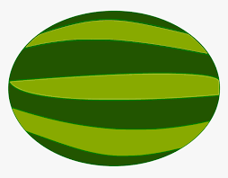
Oval as

Slide 6
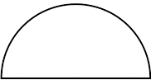
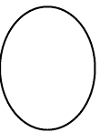

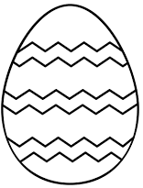
Draw and colour:
CLASSWORK
23.8.21

Slide 7
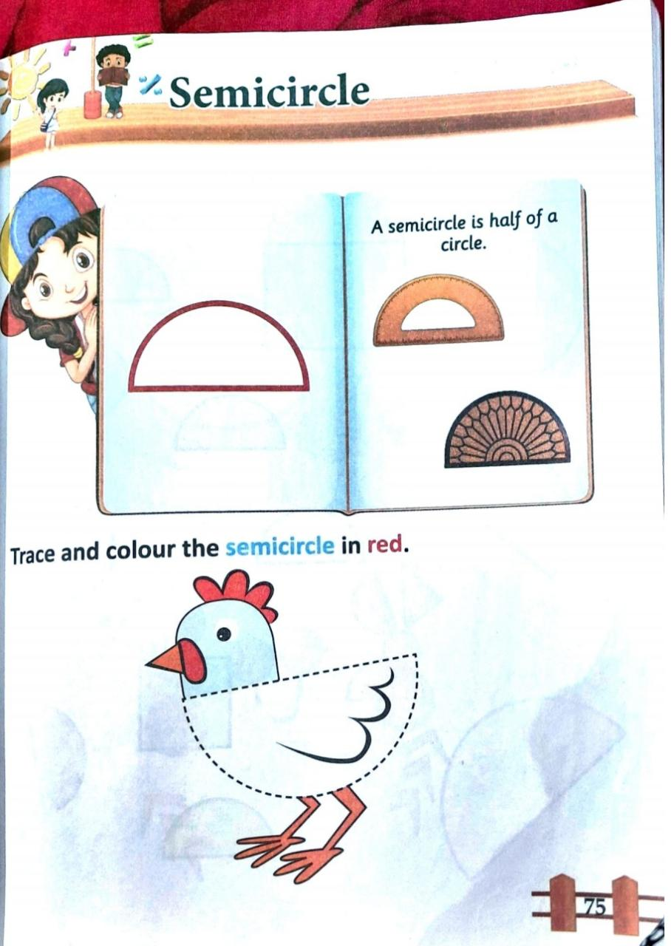
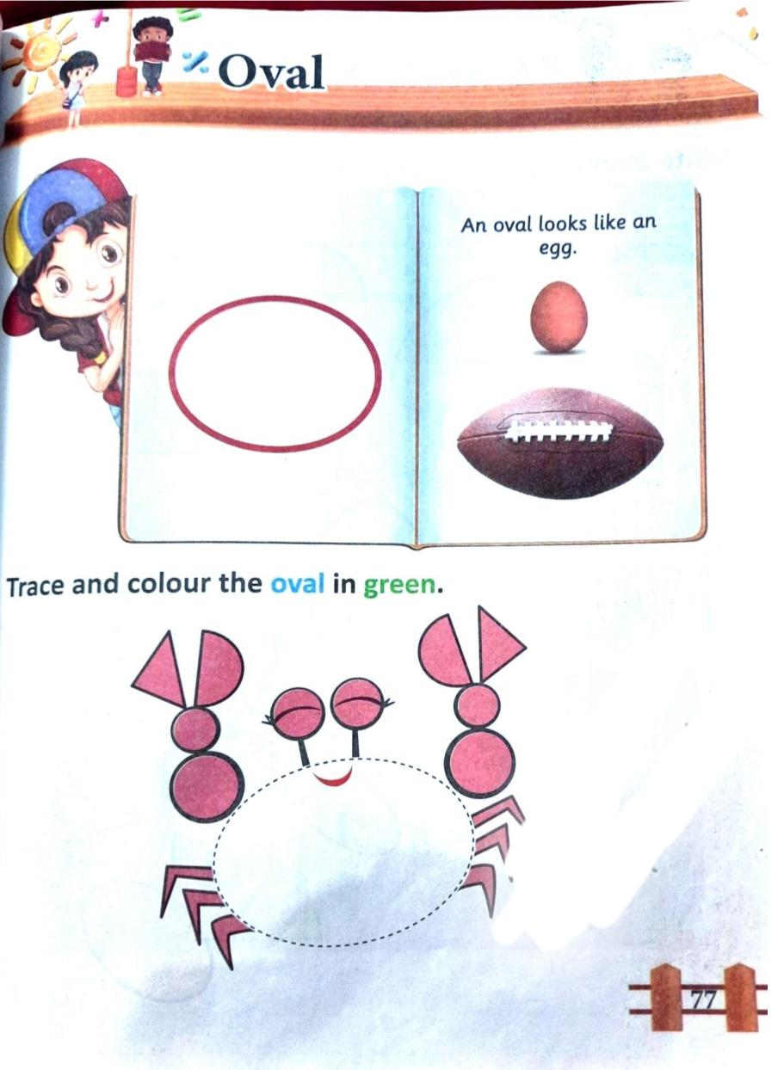
CLASSWORK
23.8.21

Slide 8
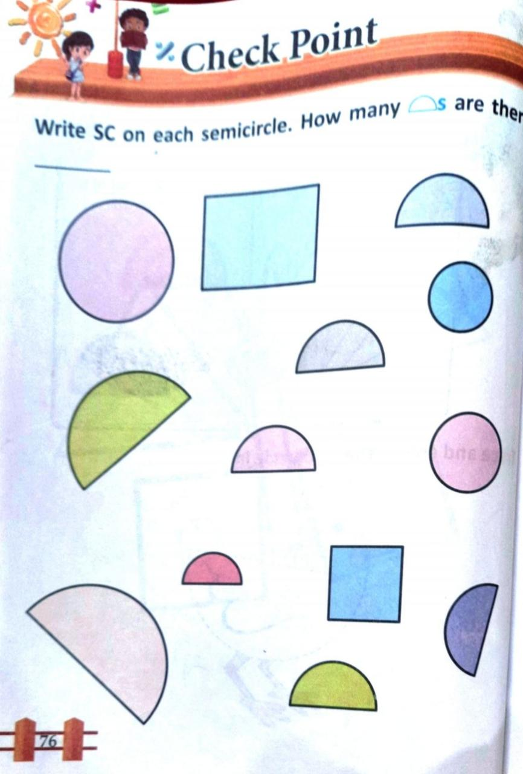
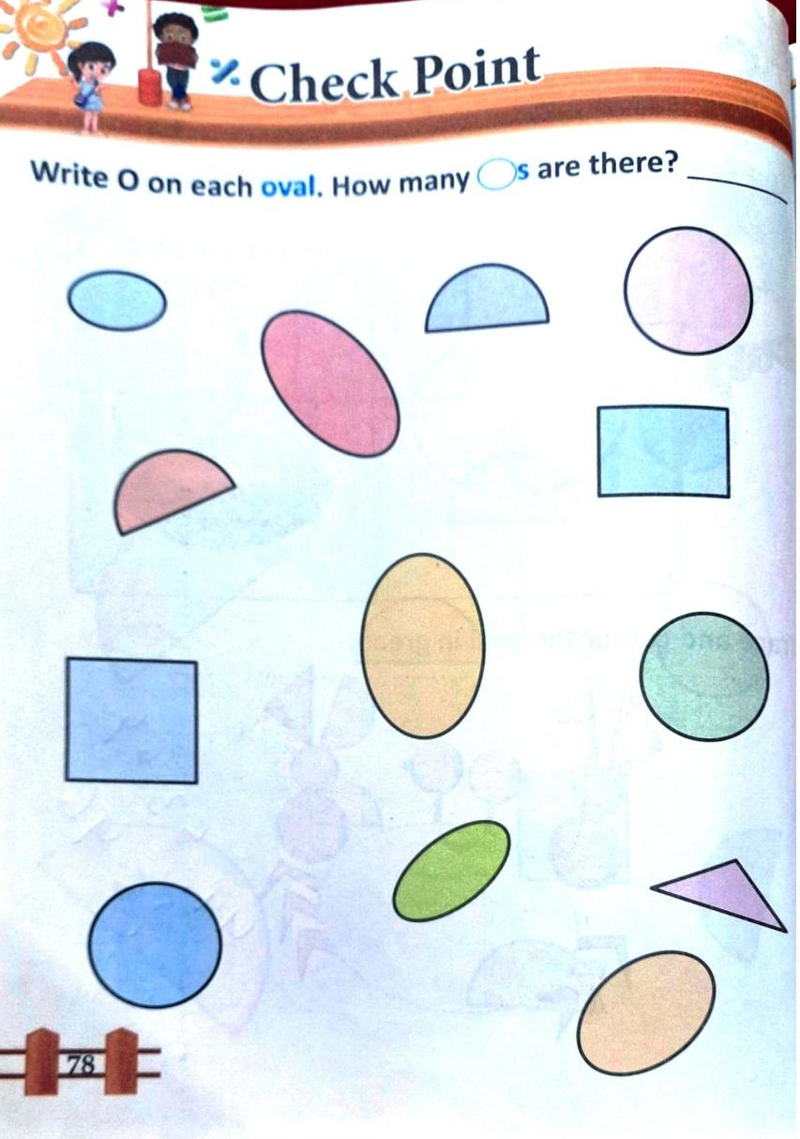
homework
23.8.21

Slide 9

THANKING YOU
ODM EDUCATIONAL GROUP

