Slide 1

WELCOME YOU ALL TO THE ONLINE CLASS
SUBJECT : ENGLISH
CHAPTER : UNIT-1
TOPIC- RHYMING WORDS

Slide 2
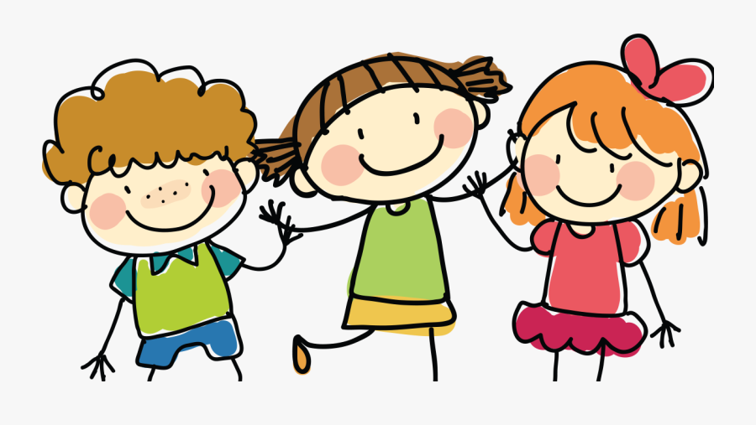
TODAY WE ARE GOING TO LEARN ABOUT
RHYMING WORDS

Slide 3
Rhyming words are two or more words that don’t start with the same sound or same letter, but they end with the same sound (maybe with the same letters).

Slide 4
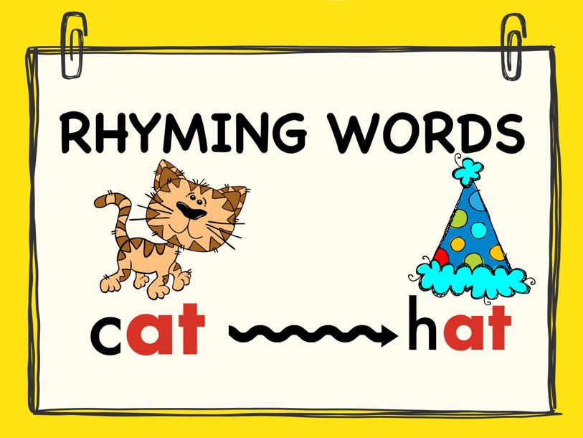
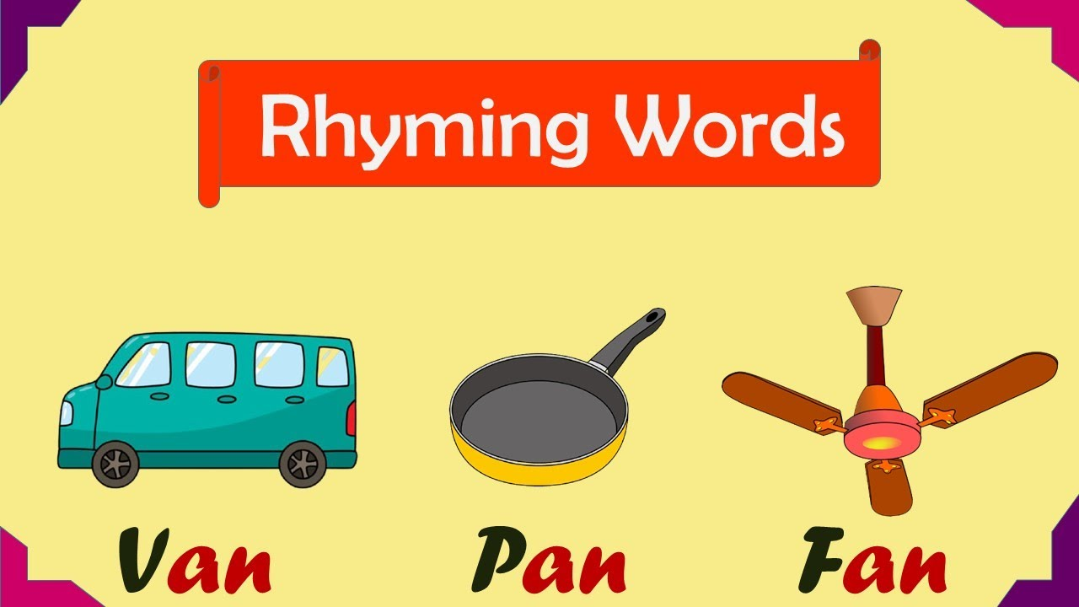

Slide 5
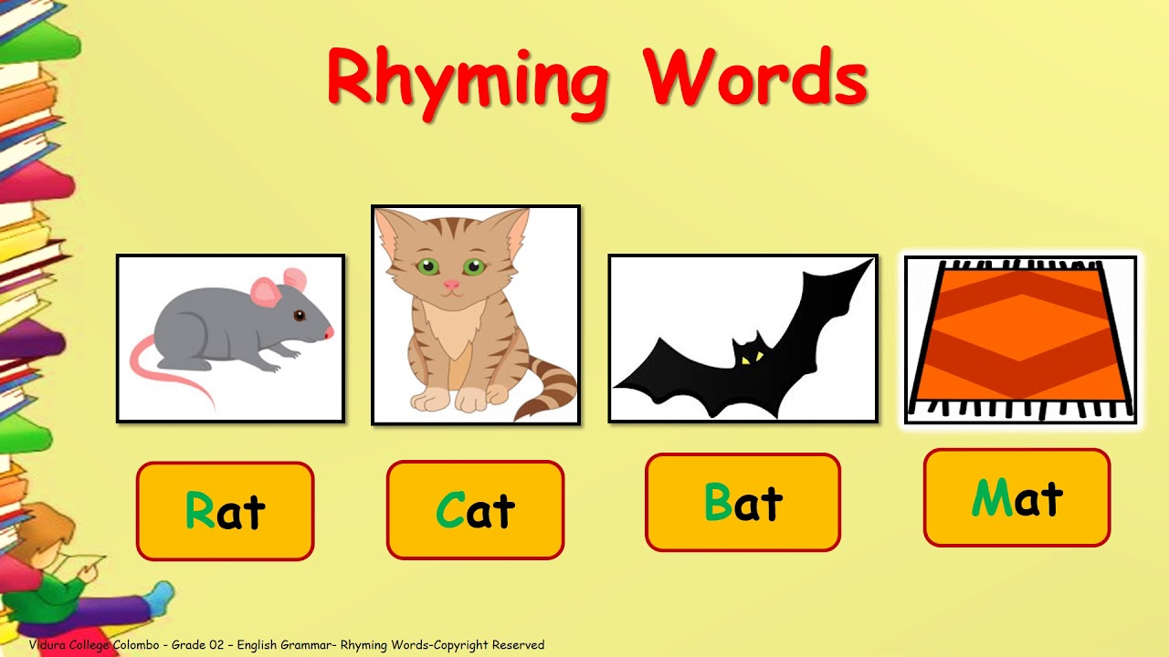
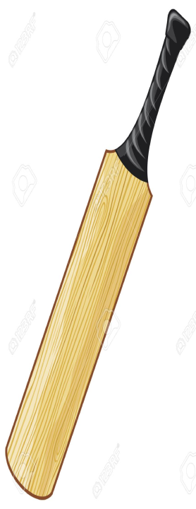

Slide 6

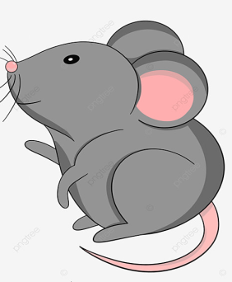

rat
hat

Slide 7

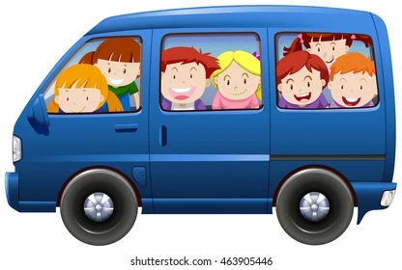
pan
van

Slide 8
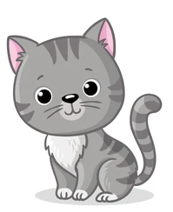
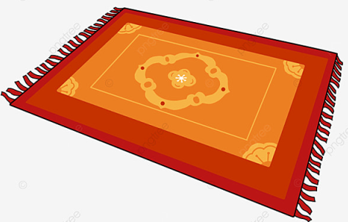
cat
mat

Slide 9
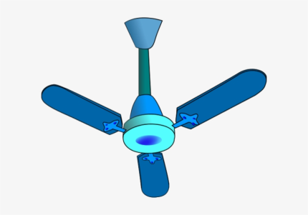
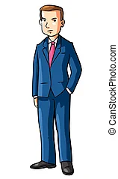
fan
man

Slide 10

hat
bat

Slide 11
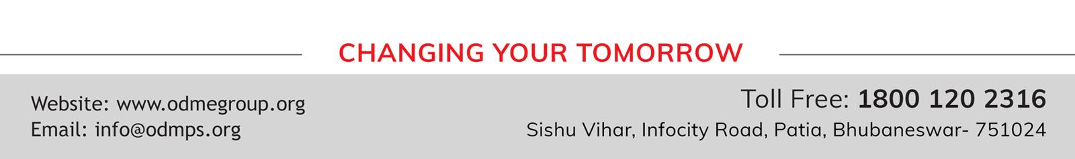
THANKING YOU
ODM EDUCATIONAL GROUP

