Slide 1

WELCOME TO ON LINE CLASS
CLASS-UKG
SUBJECT-RHYME
TOPIC-'I AM A RECTANGLE'
& 'I AM A BEAUTIFUL TRIANGLE'
(bkpg-17)

Slide 2

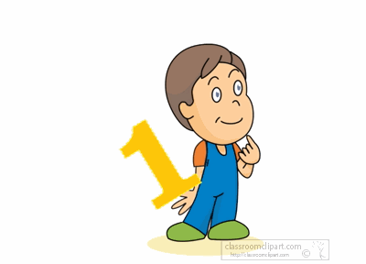
I am Mr. Rectangle,
I have four equal angles,

Slide 3

I have four sides that do not tangle

Slide 4

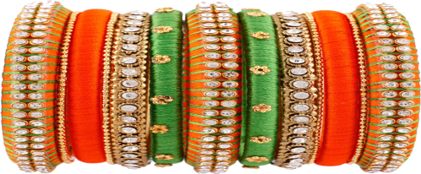
I have no hands to
wear a bangle.

Slide 5
I am Mr. Rectangle,
I have four equal angles,

Slide 6
I have four sides that do not tangle

Slide 7
I have no hands to
wear a bangle.

Slide 8
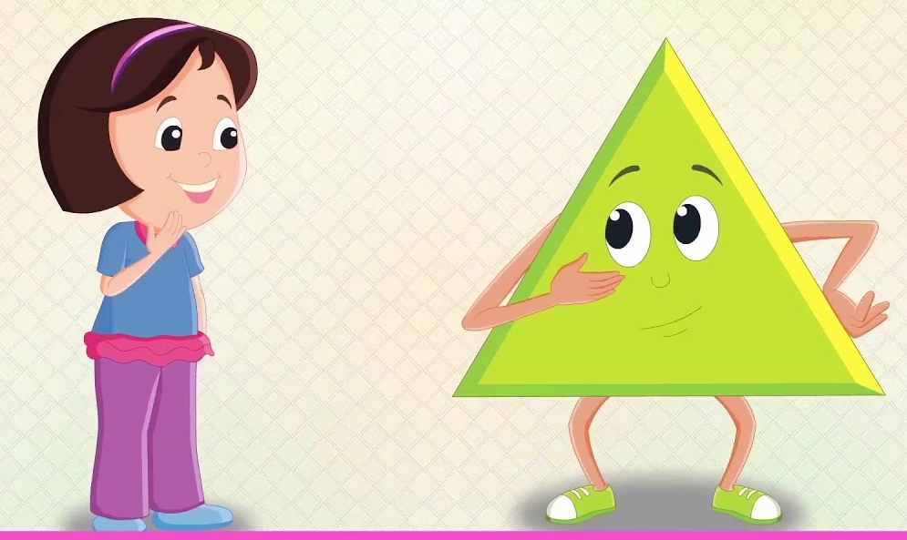
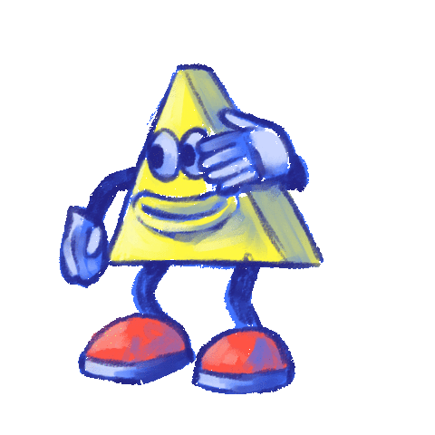
I AM A BEAUTIFUL TRIANGLE
I' HAVE 3 ANGLES

Slide 9

3 SIDES ,SURROUND ME.

Slide 10
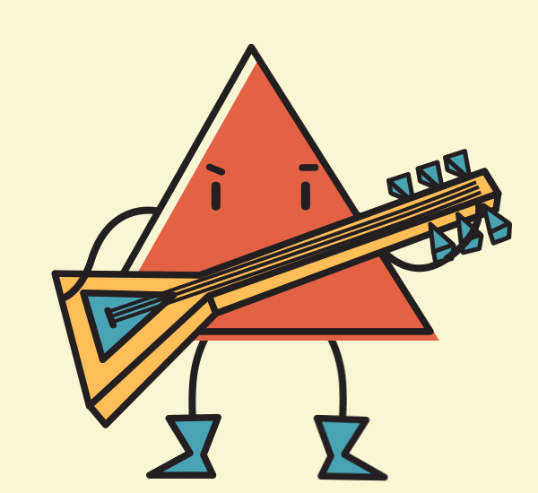
COME LETS PLAY, SHALL WE ?

Slide 11
I AM A BEAUTIFUL TRIANGLE
I' HAVE 3 ANGLES

Slide 12
I' HAVE 3 ANGLES
3 SIDES ,SURROUND ME.

Slide 13
COME LETS PLAY, SHALL WE ?

Slide 14
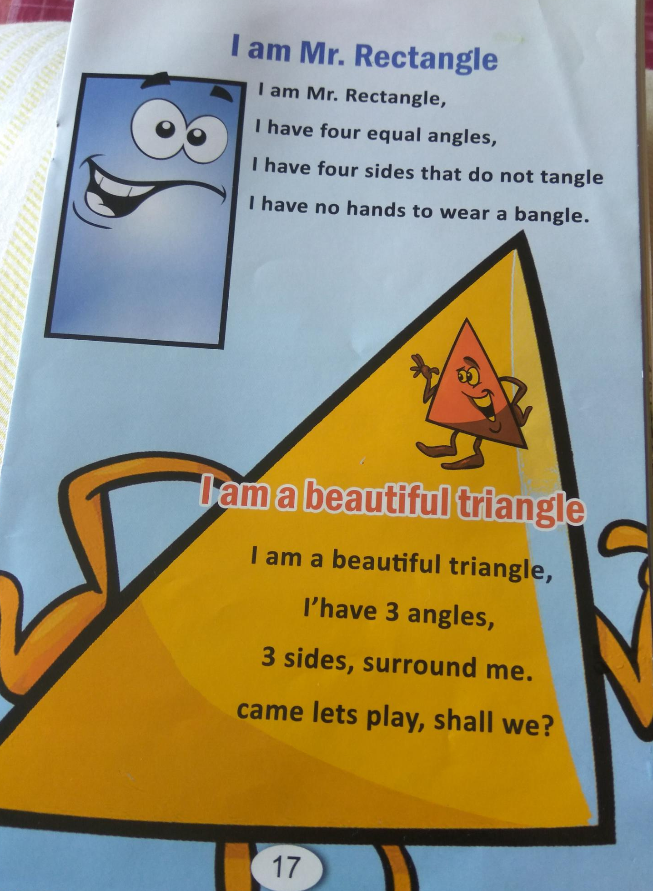

Slide 15

THANKING YOU
ODM EDUCATIONAL GROUP

