Slide 1

WELCOME TO ODM ONLINE CLASS CLASS-UKG
SUBJECT-CONVERSATION
T0PIC-CHAPTER-2
(about myself)
(revision- bkpg-2 ,3)

Slide 2
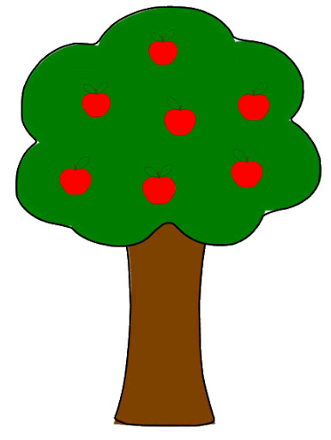
mother
father
grandfather
cousins
grandmother
aunt
brother
uncle
sister
Family

Slide 3
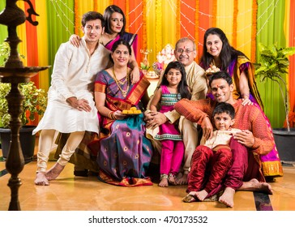
What picture is this ?
This is a picture of a
family.

Slide 4
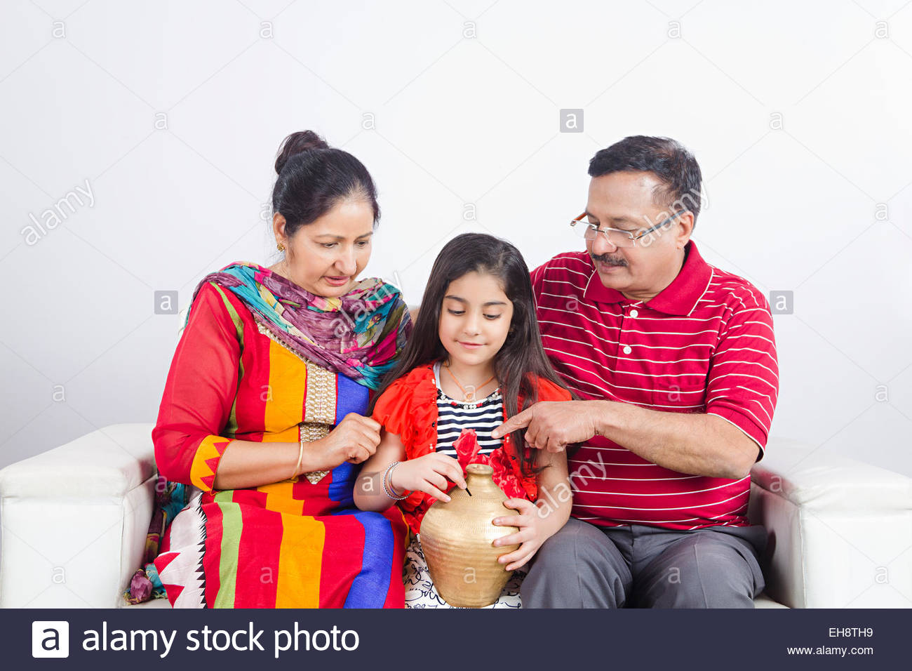
I am Ria.
She is my mother.
He is my father.
They are my ________.
parents

Slide 5

Can you recognise this picture ?
This is my school. The name of my school is ODM Public school.

Slide 6
Answer in full sentence-
What is your father’s name?
What is your grand mother’s name?
How many members are there in your house?
What do your father do?
What do your mother do?
How old are you & in which class do you study?

Slide 7

Answer in full sentence-
What is your favourite game?
What is your mother’s name?
What is your grand father’s name?
Who is taller at your home?
How many fingers are there in your both hands?
Who cooks food at your home?
Where do you live?

Slide 8


Slide 9

THANKING YOU
ODM EDUCATIONAL GROUP

