Slide 1

WELCOME TO THE ONLNE CLASS
SUBJECT—MATHS
TOPIC – NUMBER NAMES 7,8

Slide 2


Seven

Slide 3


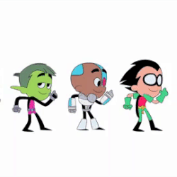

Eight

Slide 4
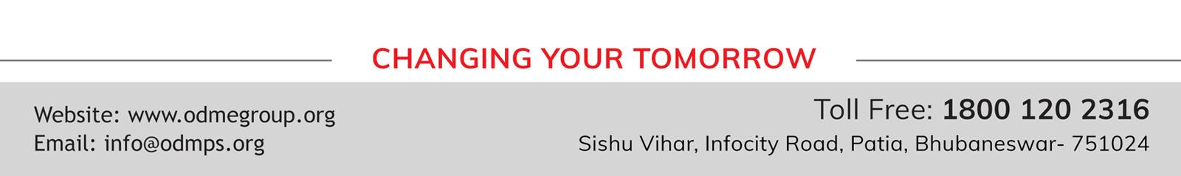
THANKING YOU
ODM EDUCATIONAL GROUP

