Slide 1

WELCOME TO ONLINE CLASS
CLASS-UKG
SUBJECT-MATHS
TOPIC-NUMBERS(51 TO 100)

Slide 2
Let’s Recap…
51
55
58
63
74
83
61
93
89
73
100

Slide 3
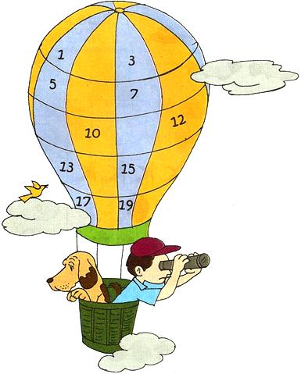



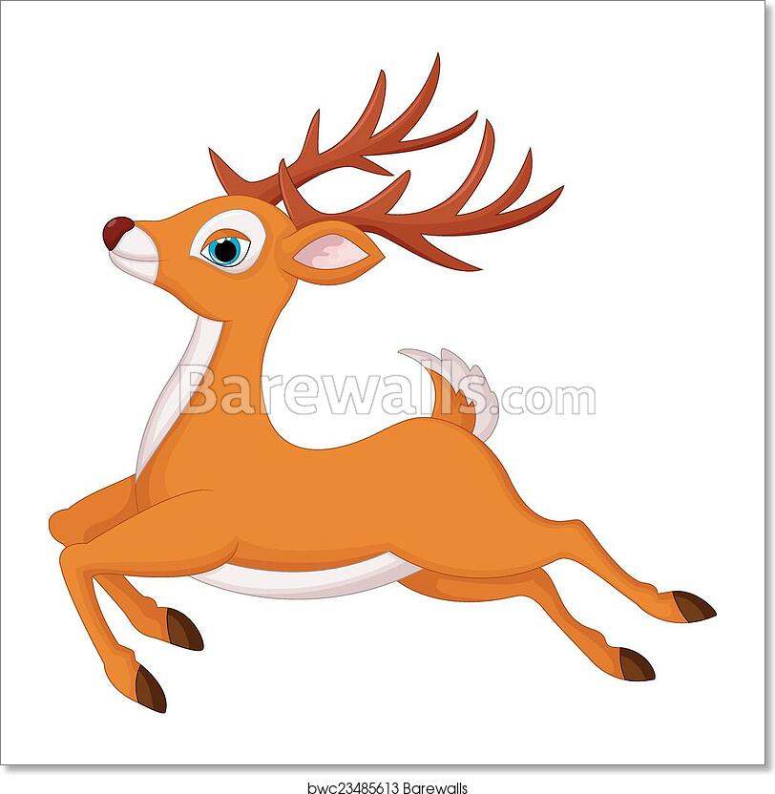
Find the missing numbers:
50
61
62
63
64
51
65
68
65
67
66
67
52
72
69
70
71
53
73
75
76
74
54
77
78
79
80
55
60
59
56
57
58

Slide 4
CLASSWORK - DATE-2.9.21
Write 81 to 100 under HTO manner:
H | T | O |  | H | T | O
 | 8 | 1 |  |  | 9 | 1
 |  |  |  | 1 | 0 | 0

Slide 5

HOMEWORK - DATE-2.9.21
Count forward and write the missing number:
54
57
60
54
57
54
57
57
64
67
64
64
60
64
60
72
75
78
81
84
87

Slide 6
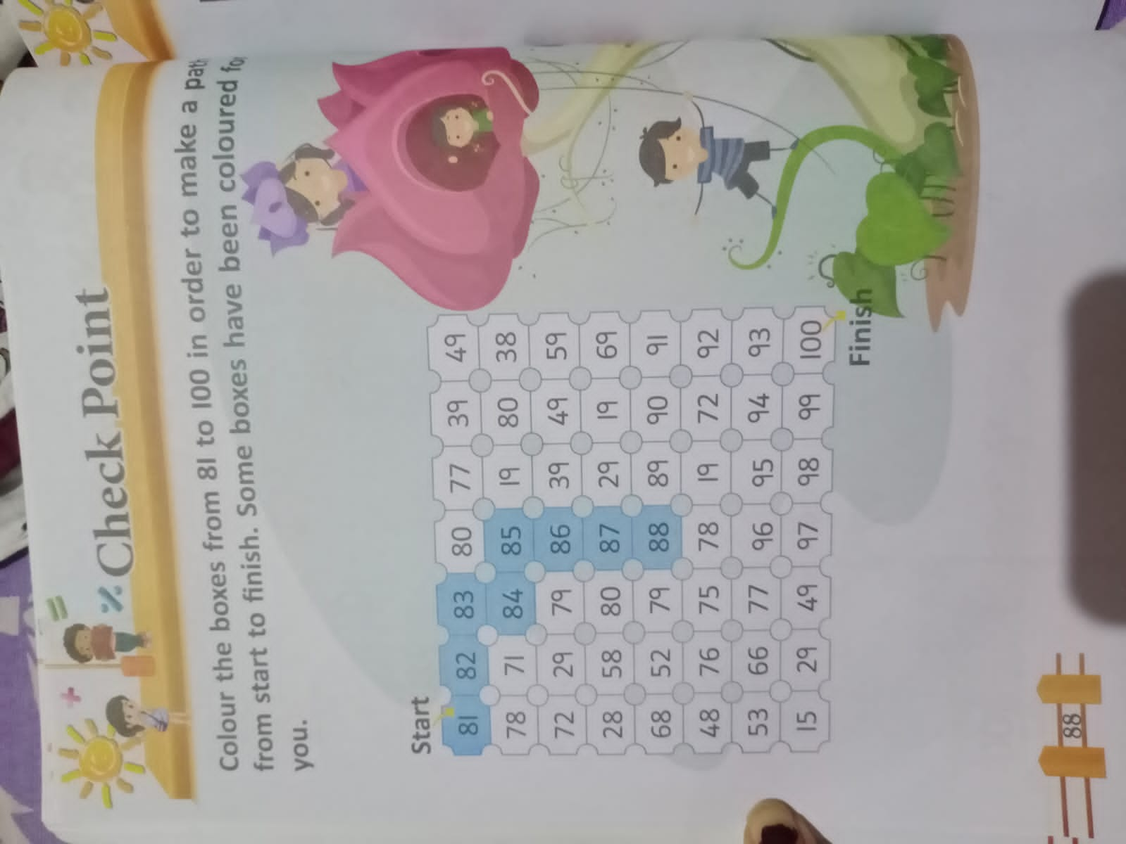
HOMEWORK
2.9.21

Slide 7

THANKING YOU
ODM EDUCATIONAL GROUP

