Slide 1

WELCOME TO ONLINE CLASS
CLASS-UKG
SUBJECT-STORY
TOPIC-THE SELFISH DOG
(PICTURE READING)

Slide 2
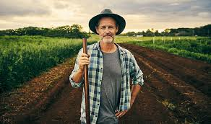
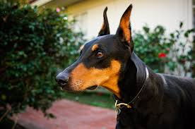
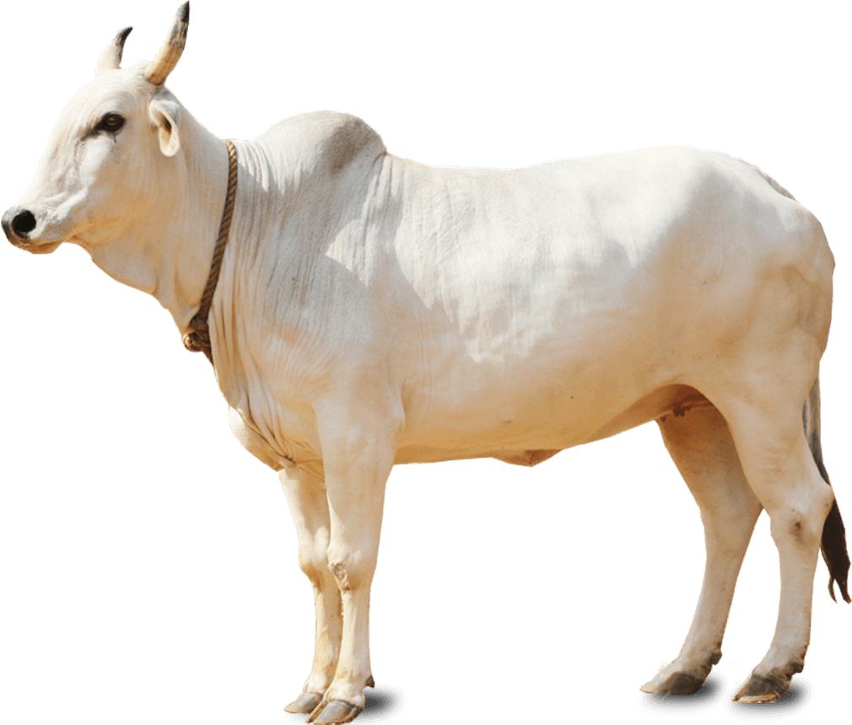
IDENTIFY THE PICTURE AND TELL THE SENTENCE:

Slide 3
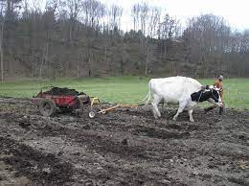
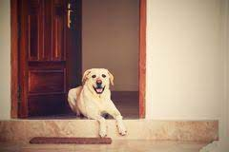


Slide 4
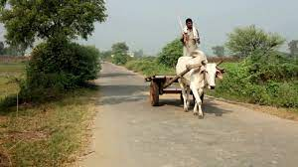
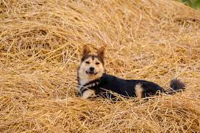

Slide 5
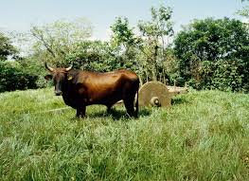
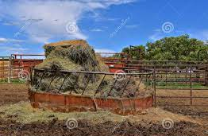

Slide 6
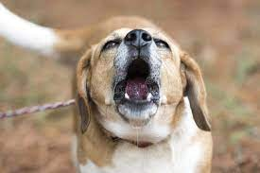

Slide 7
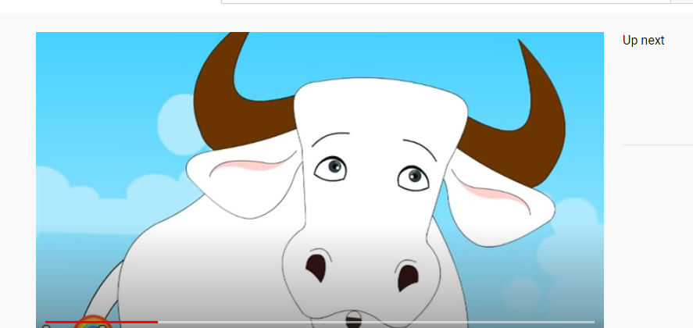
The moral of the story….
Selfish persons
won’t let you have
anything what
they could not.

Slide 8

THANKING YOU
ODM EDUCATIONAL GROUP

