Slide 1


BIOMOLECULES
NATURE OF ENZYME ACTION, FACTORS AFFECTING ENZYME ACTIVITY
SUBJECT : (BIOLOGY)
CHAPTER NUMBER: 9
CHAPTER NAME : BIOMOLECULES

Slide 2
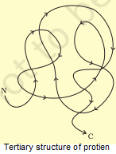
ENZYMES
“Enzymes can be defined as biological polymers that catalyze biochemical reactions.”
An enzyme like any protein has a primary structure, i.e., amino acid sequence of the protein. An enzyme like any protein has the secondary and the tertiary structure.
The backbone of the protein chain folds upon itself, the chain criss-crosses itself and hence, many crevices or pockets are made.
One such pocket is the ‘active site’. An active site of an enzyme is a crevice or pocket into which the substrate fits. Thus enzymes, through their active site, catalyse reactions at a high rate.
Catalysed reactions proceed at rates vastly higher than that of uncatalysed ones.
When enzyme catalysed reactions are observed, the rate would be vastly higher than the same but uncatalysed reaction.
For example CO2 + H2O → H2 CO3 (carbonic acid)
Carbonic anhydrase

Slide 3
How do Enzymes bring about such High Rates of Chemical Conversions?
The idea of an ‘active site ’ of enzyme is important. The chemical or metabolic conversion refers to a reaction. The chemical which is converted into a product is called a ‘substrate’.
Hence enzymes, i.e. proteins with three dimensional structures including an ‘active site’, convert a substrate (S) into a product (P).
Symbolically, this can be depicted as: S → P
It is now understood that the substrate ‘S’ has to bind the enzyme at its ‘active site’ within a given cleft or pocket.
The substrate has to diffuse towards the ‘active site’.

Slide 4
.
Nature of Enzyme Action
Each enzyme (E) has a substrate (S) binding site in its molecule so that a highly reactive enzyme-substrate complex (ES) is produced.
This complex is short-lived and dissociates into its product(s) P and the unchanged enzyme with an intermediate formation of the enzyme-product complex (EP).
The formation of the ES complex is essential for catalysis.

Slide 5
An enzyme is a catalyst which is utilised in metabolic reactions. Almost all enzymes are proteins.
"Lock and Key" Model: The lock and key model was suggested by Emil Fischer in 1894. Emil Fischer postulated that both the enzyme and the substrate possess specific complementary geometric shapes that fit exactly into one another. This model explains the specificity of enzyme. But this model fails to explain the stabilization of the transition state which an enzyme achieves.
Induced Fit Model: This is the most accepted model and is a modification over the lock and key model. The induced fit model was proposed by Daniel Koshland in 1958. According to this model, since enzymes are rather flexible structures; the active site is continually reshaped by interactions with the substrate when the substrate interacts with the enzyme.
In some cases, the substrate molecule also changes shape slightly when it enters the active site. The active site continues to change until the substrate is completely bound. The final shape and charge is determined at this point of enzyme-substrate reaction.
There are many differences between enzyme catalysts and inorganic catalysts. Inorganic catalysts work efficiently at high temperatures and high pressures, enzymes get damaged at high temperatures (above 40°C). But enzymes which are isolated from thermophilic organisms show thermal stability.

Slide 6
Mechanisms of Enzymatic Actions
Enzyme lowers the activation energy by creating an environment in which the transition state is stabilized.
Enzyme lowers the energy of the transition state by creating an environment with the opposite charge distribution to that of the transition state. But an enzyme does this without distorting the substrate.
Enzyme provides an alternative pathway.
Enzyme reduces the reaction entropy charge by bringing substrates together in the correct orientation to react.
Increase in temperatures speeds up reactions. But if the enzyme is heated too much, its shape deteriorates and it regains it shape only when the temperature comes back to normal.
Some enzymes work best at low temperatures, e.g. thermolabile.

Slide 7
The catalytic cycle of an enzyme action can be described in the following steps:
The substrate binds to the active site of the enzyme, fitting into the active site.
The binding of the substrate induces the enzyme to alter its shape, fitting more tightly around the substrate.
The active site of the enzyme breaks the chemical bonds of the substrate and the new enzyme- product complex is formed.
The enzyme releases the products of the reaction and the free enzyme is ready to bind to another molecule of the substrate.

Slide 8
Mechanism of Enzyme Reaction
Any two molecules have to collide for the reaction to occur along with the right orientation and a sufficient amount of energy. The energy between these molecules needs to overcome the barrier in the reaction. This energy is called activation energy.
Enzymes are said to possess an active site. The active site is a part of the molecule that has a definite shape and the functional group for the binding of reactant molecules. The molecule binding with the enzyme is called the substrate group.
The substrate and the enzyme form an intermediate reaction with low activation energy without any catalysts.
reactant(1)+reactant(2)→product
reactant(1)+enzyme→intermediate
intermediate+reactant(2)→product+enzyme

Slide 9
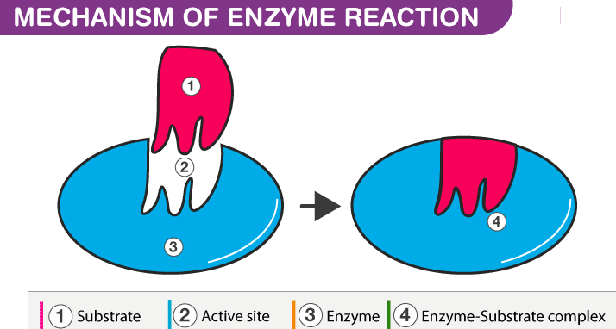
The basic mechanism of enzyme action is to catalyze the chemical reactions, which begins with the binding of the substrate with the active site of the enzyme. This active site is a specific area that combines with the substrate.

Slide 10
Action and Nature of Enzymes
Once substrate (S) binds to this active site, they form a complex (intermediate-ES) which then produces the product (P) and the enzyme (E).
The substrate which gets attached to the enzyme has a specific structure, and that can only fit in a particular enzyme. Hence by providing a surface for the substrate, an enzyme slows down the activation energy of the reaction. The intermediate state where the substrate binds to the enzyme is called the transition state.
By breaking and making the bonds, the substrate binds to the enzyme (remains unchanged), which converts into the product and later splits into product and enzyme.
The free enzymes then bind to other substrates, and the catalytic cycle continues until the reaction completes.
The enzyme action basically happens in two steps:
Step1: Combining of enzyme and the reactant/substrate.
E+S → [ES]
Step 2: Disintegration of the complex molecule to give the product.
[ES]→E+P
Thus, the whole catalyst action of enzymes is summarized as:
E + S → [ES] → [EP] → E + P

Slide 11
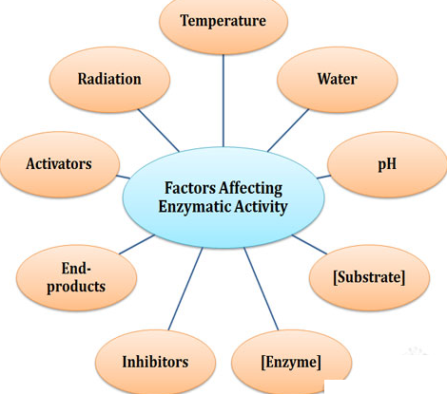
Factors Affecting Enzyme Activity
The activity of an enzyme can be affected by a change in the conditions which can alter the tertiary structure of the protein.
These include temperature, pH, change in substrate concentration or binding of specific chemicals that regulate its activity.

Slide 12
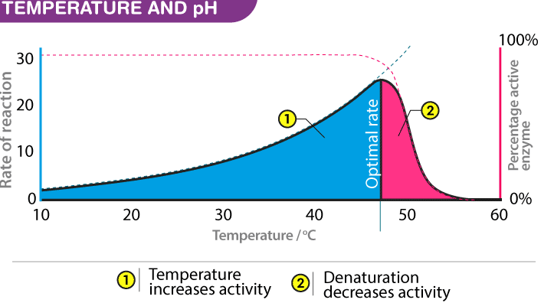
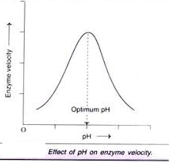
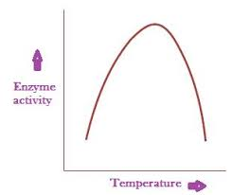
Temperature and pH: Enzymes usually function in a narrow range of temperature and pH. Each enzyme shows its highest activity at optimum temperature and optimum pH.
Beyond that range, the activity declines. Low temperature preserves the enzyme temporarily in inactive state, while high temperature destroys the enzyme.
Enzymes require an optimum temperature and pH for their action. The temperature or pH at which a compound shows its maximum activity is called optimum temperature or optimum pH, respectively. As mentioned earlier, enzymes are protein compounds. A temperature or pH more than optimum may alter the molecular structure of the enzymes. Generally, an optimum pH for enzymes is considered to be ranging between 5 and 7.

Slide 13
Optimum T°
The greatest number of molecular collisions
human enzymes = 35°- 40°C
body temp = 37°C
Heat: increase beyond optimum T°
The increased energy level of molecules disrupts bonds in enzyme & between enzyme & substrate H, ionic = weak bonds.
Denaturation = lose 3D shape (3° structure)
Cold: decrease T°
molecules move slower decrease collisions between enzyme & substrate

Slide 14
Concentration of Substrate: The velocity of enzymatic action at first rises with an increase in substrate concentration. But the velocity of reaction does not rise once it reaches a maximum velocity (V_{max}).
This happens because there are fewer molecules of enzyme and no free enzyme molecule is left to bind with the additional substrate molecules.
Enzymes have a saturation point, i.e., once all the enzymes added are occupied by the substrate molecules, its activity will be ceased.
When the reaction begins, the velocity of enzyme action keeps on increasing on further addition of substrate. However, at a saturation point where substrate molecules are more in number than the free enzyme, the velocity remains the same.
The type of substrate is another factor that affects the enzyme action. The chemicals that bind to the active site of the enzyme can inhibit the activity of the enzyme and such substrate is called an inhibitor.
Competitive inhibitors are chemicals that compete with the specific substrate of the enzyme for the active site. They structurally resemble the specific substrate of the enzyme and bind to the enzyme and inhibit the enzymatic activity. This concept is used for treating bacterial infectious diseases.

Slide 15
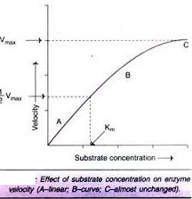

Slide 16
Effect of Inhibitor: .
The activity of an enzyme is also sensitive to the presence of specific chemicals that bind to the enzyme. When the binding of the chemical shuts off enzyme activity, the process is called inhibition and the chemical
is called an inhibitor.
When the inhibitor closely resembles the substrate in its molecular structure and inhibits the activity of the enzyme, it is known as competitive inhibitor.
Due to its close structural similarity with the substrate, the inhibitor competes with the substrate for the substrate binding site of the enzyme.
Consequently, the substrate cannot bind and as a result, the enzyme action declines, e.g., inhibition of succinic dehydrogenase by malonate which closely resembles the substrate succinate in structure. Such competitive inhibitors are often used in the control of bacterial pathogens.

Slide 17
THANKING YOU
ODM EDUCATIONAL GROUP

