Slide 1


BIOMOLECULES
NUCLEIC ACID
SUBJECT : (BIOLOGY)
CHAPTER NUMBER: 9
CHAPTER NAME : BIOMOLECULES

Slide 2
Nucleic Acid
Nucleic Acids are one of the most important biomolecules present in humans.
They store all our genetic information that we pass down to future generations.
And they are able to perform their functions, due to the shape and structure they form.
The other type of macromolecule that one would find in the acid insoluble fraction of any living tissue is the nucleic acid.
These are polynucleotides.
Together with polysaccharides and polypeptides these comprise the true macromolecular fraction of any living tissue or cell.
Nucleic acids are big and complex molecules.

Slide 3
Just like in all biomolecules, nucleic acids are also made up of repeating monomers.
Here these repeating units or monomers have a special name, nucleotides.
These are the building blocks of nucleic acids.
The nucleic acid is one of the most important biopolymers. They are present in all organisms.
Think of them as the mother chip of your body.
This is where your genetic information is encoded and recorded.
The function of nucleic acid is to express this information outside the cell to the future generation.
So it felicitates the transfer of genetic information from one generation to the next and so onwards.

Slide 4
Deoxyribonucleic acid (DNA) and ribonucleic acid (RNA) are two major types of nucleic acids.
DNA and RNA are responsible for the inheritance and transmission of specific characteristics from one generation to the other.
There are prominently two types of nucleic acids known to us.
Deoxyribonucleic Acid (DNA)
Chemically, DNA is composed of a pentose sugar, phosphoric acid and some cyclic bases containing nitrogen. The sugar moiety present in DNA molecules is β-D-2-deoxyribose.
The cyclic bases that have nitrogen in them are adenine (A), guanine (G), cytosine(C) and thymine (T).
These bases and their arrangement in the molecules of DNA play an important role in the storage of information from one generation to the next one.
DNA has a double-strand helical structure in which the strands are complementary to each other.

Slide 5
Ribonucleic Acid (RNA)
The RNA molecule is also composed of phosphoric acid, a pentose sugar and some cyclic bases containing nitrogen. RNA has β-D-ribose in it as the sugar moiety.
The heterocyclic bases present in RNA are adenine (A), guanine (G), cytosine(C) and uracil (U).
In RNA the fourth base is different from that of DNA.
The RNA generally consists of a single strand which sometimes folds back; that results in a double helix structure.
There are three types of RNA molecules, each having a specific function:
messenger RNA (m-RNA)
ribosomal RNA (r-RNA)
transfer RNA (t-RNA)

Slide 6
A nucleic acid has three chemically distinct components- heterocyclic compound ( nitrogenous base), polysaccharides ( ribose/ deoxy-ribose sugar) and phosphate or phosphoric acid.
For nucleic acids, the building block is a nucleotide.
Nucleotide Structure
A nucleotide consists of three units, which are covalently linked.
They are:
A nucleotide has three chemically distinct components.
One is a heterocyclic compound, the second is a monosaccharide and the third a phosphoric acid or phosphate.
Nitrogenous bases – Purine and Pyrimidine
Pentose Sugar – Ribose and Deoxyribose
Phosphate – monophosphate, diphosphate, triphosphate

Slide 7
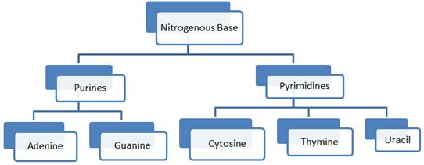
The heterocyclic compounds in nucleic acids are the nitrogenous bases named adenine, guanine, uracil, cytosine, and thymine.
Adenine and Guanine are substituted purines while the rest are substituted pyrimidines.
The skeletal heterocyclic ring is called as purine and pyrimidine respectively.
The sugar found in polynucleotides is either ribose (a monosaccharide pentose) (C₅H₁₀O₅) or 2’ deoxyribose (C₅H₁₀O4) .
A nucleic acid containing deoxyribose is called deoxyribonucleic acid (DNA) while that which contains ribose is called ribonucleic acid (RNA).

Slide 8
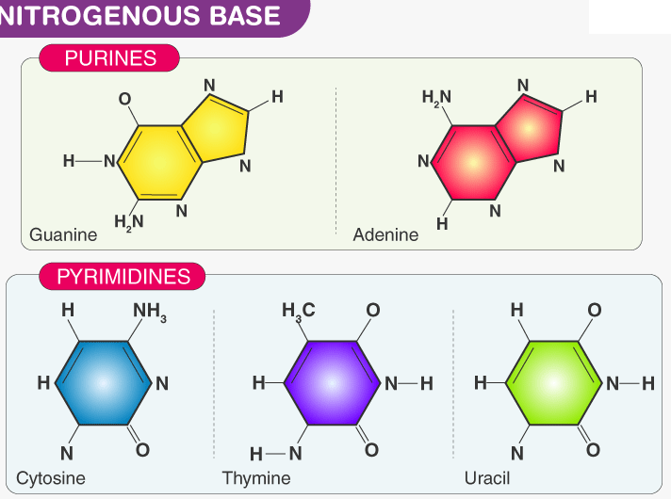
Nitrogenous Base: They contain purine or pyrimidine base. DNA contains adenine (A), guanine (G), thymine (T) and cytosine (C), whereas RNA contains adenine, guanine, uracil (U) and cytosine.

Slide 9
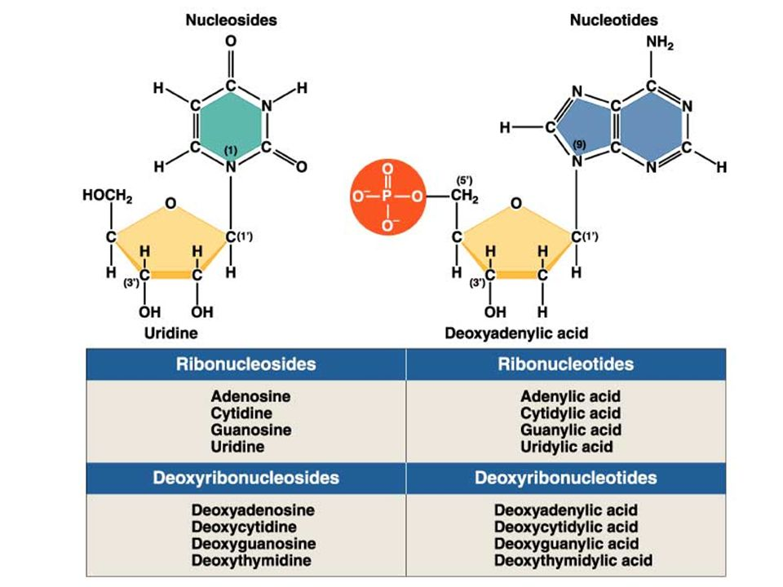
How do nucleotides and nucleosides differ?
Nucleoside = Nitrogenous base + Sugar
Nucleotide = Nucleoside + Phosphate
Nucleotides are also named as nucleoside mono, di or triphosphate, based on the number of phosphate groups attached to it, e.g. Adenosine monophosphate (AMP), Adenosine diphosphate (ADP) or Adenosine triphosphate (ATP).

Slide 10
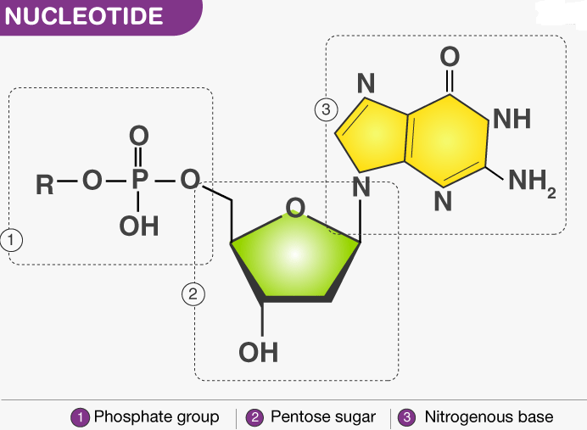

Slide 11
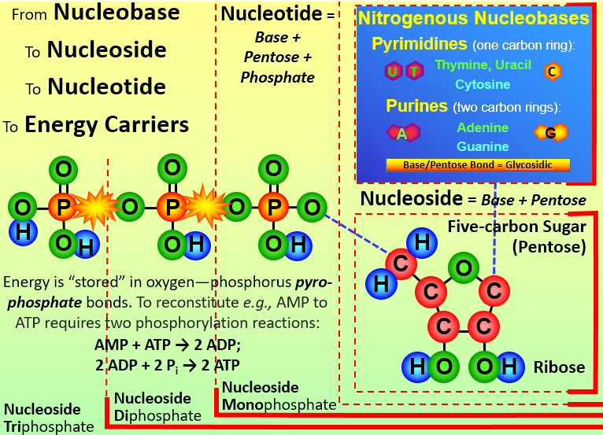
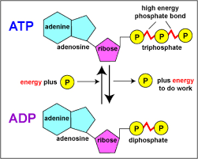

Slide 12
The important features of Watson – Crick Model or double helix model of DNA are as follows:
1. The DNA molecule consists of two polynucleotide chains or strands that spirally twisted around each other and coiled around a common axis to form a right-handed double-helix.
2. The two strands are antiparallel i.e. they ran in opposite directions so that the 3′ end of one chain facing the 5′ end of the other.
3. The sugar-phosphate backbones remain on the outside, while the core of the helix contains the purine and pyrimidine bases.
4. The two strands are held together by hydrogen bonds between the purine and pyrimidine bases of the opposite strands.

Slide 13
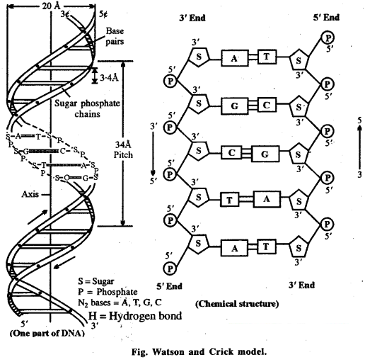
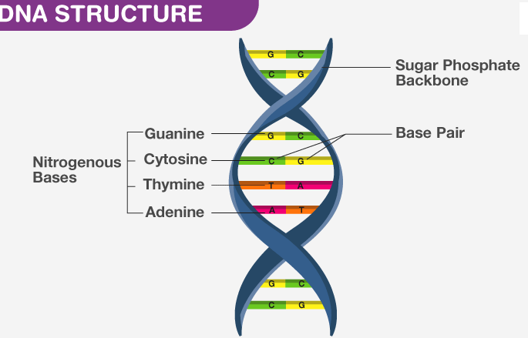

Slide 14
5. Adenine (A) always pairs with thymine (T) by two hydrogen bonds and guanine (G) always pairs with cytosine (C) by three hydrogen bonds.
This complimentarily is known as the base pairing rule. Thus, the two stands are complementary to one another.
6. The base sequence along a polynucleotide chain is variable and a specific sequence of bases carries the genetic information.
7. The base compositions of DNA obey Chargaff s rules (E.E. Chargaff, 1950) according to which A=T and G=C; as a corollary ∑ purines (A+G) = 2 pyrimidines (C+T); also (A+C) = (G+T).
It also states that ratio of (A+T) and (G+C) is constant for a species (range 0.4 to 1.9)
8. The diameter of DNA is 20nm or 20 A. Adjacent bases are separated 0.34 nm or by 3.4 A along the axis.
The length of a complete turn of helix is 3.4 nm or 34 A i.e. there are 10bp per turn. (B- DNA-Watson rick DNA).
9. The DNA helix has a shallow groove called minor groove (-1,2nm) and a deep groove called major groove (- 2.2nm) across.

Slide 15
Polymerization of Nucleotides Forms Nucleic Acids
DNA and RNA each consists of only four different nucleotides.
All nucleotides have a common structure: a phosphate group linked by a phosphoester bond to a pentose (a five-carbon sugar molecule) that in turn is linked to an organic base.
In RNA, the pentose is ribose; in DNA, it is deoxyribose .
In a nucleic acid a phosphate moiety links the 3’-carbon of one sugar of one nucleotide to the 5’-carbon of the sugar of the succeeding nucleotide (forming 5’ → 3’ linkage).
The bond between the phosphate and hydroxyl group of sugar is an ester bond. As there is one such ester bond on either side, it is called phosphodiester bond (O-HPO₂-O).
When the phosphate group attaches to the hydroxyl group of the same sugar, it forms cyclic nucleotide, they are present as a single monomer, e.g. cAMP, cGMP used in intracellular signal transduction processes.

Slide 16
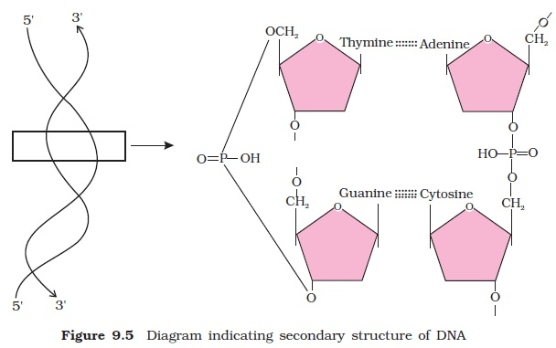
Some other characteristics of DNA:
1. The amount of DNA per nucleus is constant in all the somatic cells of a given species.
2. The total amount of DNA in a haploid genome is a characteristic of each organism and is known as C-value.
3. Only a small fraction of DNA is functional in eukaryotes.

Slide 17
The Functions of Nucleic Acids
Nucleic acid are responsible for the transmission of inherent characters from parent to offspring.
They are responsible for the synthesis of protein in our body.
DNA fingerprinting is a method used by forensic experts to determine paternity. It is also used for the identification of criminals.
It has also played a major role in studies regarding biological evolution and genetics.
Nucleotides are the building block of DNA and RNA. They contain genetic information
Nucleotides act as coenzymes, which are required to catalyse many biochemical reactions by enzymes
Energy is stored in our body as ATP. When there is a need for the energy they get converted to ADP or AMP.
ATP also acts as a coenzyme
NAD, NADP has an essential role to play in many redox reactions, they act as an electron carrier cAMP helps in transporting chemical signals and metabolic regulation.

Slide 18
THANKING YOU
ODM EDUCATIONAL GROUP

