Slide 1


BIOMOLECULES
CARBOHYDRATES (POLYSACCHARIDES)
SUBJECT : (BIOLOGY)
CHAPTER NUMBER: 9
CHAPTER NAME : BIOMOLECULES

Slide 2
Carbohydrates
The term carbohydrate is itself a combination of the “hydrates of carbon”. They are also known as “Saccharides” which is a derivation of the Greek word “Sakcharon” meaning sugar.
The definition of carbohydrates in chemistry is as follows:
“Optically active polyhydroxy aldehydes or polyhydroxy ketones or substances which give these on hydrolysis are termed as carbohydrates”.
Some of the most common carbohydrates that we come across in our daily lives are in form of sugars. These sugars can be in form of Glucose, Sucrose, Fructose, Cellulose, Maltose etc.

Slide 3
General Formula of Carbohydrate
The general formula for carbohydrate is Cn(H₂O)n.
There are various exceptions to this that we will see.
Acetic Acid which is CH₃COOH.
Now although this will fit in the general formula of carbohydrate i.e. Cn(H₂O)n, we know that acetic acid is not a carbohydrate.
Formaldehyde (HCHO) also falls under this category of this general formula but is also not a carbohydrate.
And on the other hand, Rhamnose (C₆H₁₂O₆) which is very much a carbohydrate but does not follow the general formula.

Slide 4
Classification of Carbohydrates
The main classification of carbohydrate is done on the basis of hydrolysis. This classification is as follow:
Monosaccarides: These are the simplest form of carbohydrate that cannot be hydrolyzed any further. They have the general formula of (CH₂O)_{n}. Some common examples are glucose, Ribose etc.
Oligosaccharides: Carbohydrates that on hydrolysis yield two to ten smaller units or monosaccharides are oligosaccharides.
They are a large category and further divides into various subcategories.
Disaccharides: A further classification of oligosaccharides, these give two units of the same or different monosaccharides on hydrolysis. For example, sucrose on hydrolysis gives one molecule of glucose and fructose each.
Whereas maltose on hydrolysis gives two molecules of only glucose,
Trisaccharides: Carbohydrates that on hydrolysis gives three molecules of monosaccharides, whether same or different.
An example is Raffinose.
Tetrasaccharides: And as the name suggests this carbohydrate on hydrolysis give four molecules of monosaccharides. Stachyose is an example.

Slide 5
Polysaccharide
These are complex carbohydrates made up of repeating units of monosaccharides or sugar that are attached together by Glycosidic linkage. Another class of acid insoluble pellet.
Another name for them is Glycans.
These carbohydrates are not sweet in taste and are also known as non-sugars. Some common examples are starch, glycogen etc.
Polysaccharides are classified into two parts, namely: homo and hetero polysaccharide.
Homopolysaccharide: These molecules are made up of only one type of monosaccharides.
A general theme for them is derived from the kind of monosaccharide units they have. Ex: starch, glycogen, cellulose.
A homopolysaccharide made up of only glucose molecules is named Glucans.
One with only galactose molecules known as Galactans, fructan (fructose), xylan (xylose), araban (arabinose)

Slide 6
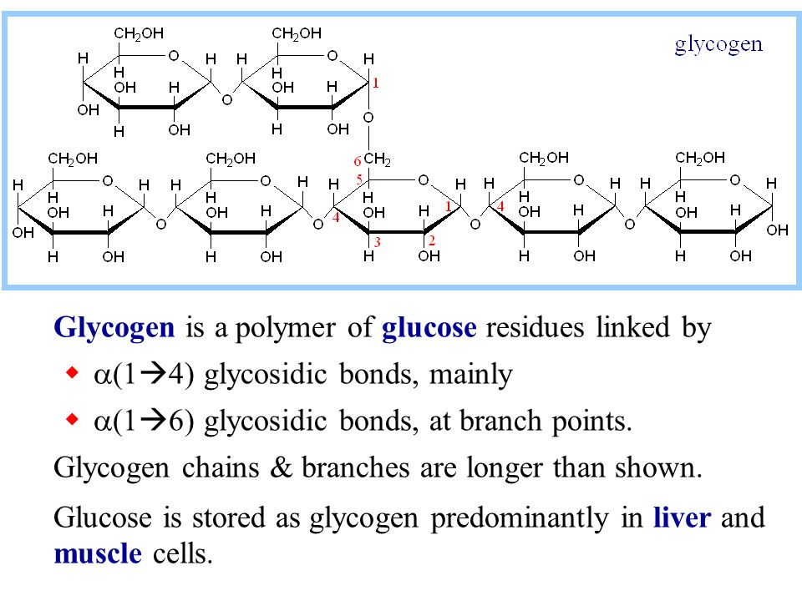
.
In a polysaccharide chain (say glycogen), the right end is called the reducing end and the left end is called the non-reducing end.
It has branches as shown in the form of a cartoon .

Slide 7
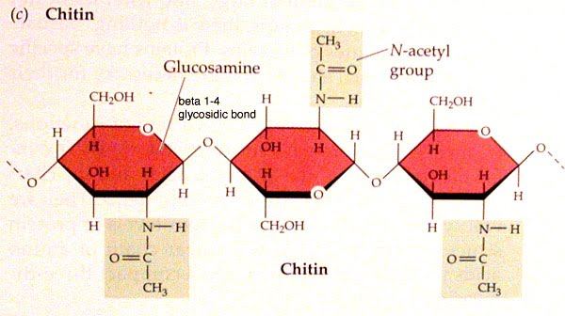
Heteropolysaccharide: These are polysaccharide molecules consisting of more than one type of monosaccharides.
Ex: agar, chitin (homopolymer), peptidoglycan

Slide 8
Polysaccharides are threads (literally a cotton thread) containing different monosaccharides as building blocks.
For example, cellulose is a polymeric polysaccharide consisting of only one type of monosaccharide i.e., glucose. Cellulose is a homopolymer.
Starch is a variant of this but present as a store house of energy in plant tissues. Animals have another variant called glycogen.
Inulin is a polymer of fructose.
Starch forms helical secondary structures. In fact, starch can hold I2 molecules in the helical portion. The starch-I₂ is blue in colour. Cellulose does not contain complex helices and hence cannot hold I₂ .

Slide 9
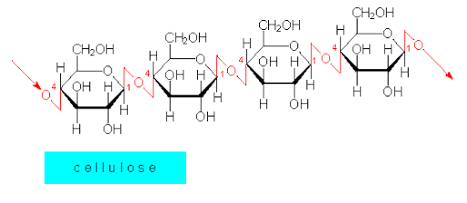
Plant cell walls are made of cellulose.
Paper made from plant pulp and cotton fibre is cellulosic. There are more complex polysaccharides in nature. They have as building blocks, amino-sugars and chemically modified sugars (e.g., glucosamine, N-acetyl galactosamine, etc.).
Exoskeletons of arthropods, for example, have a complex polysaccharide called chitin. These complex polysaccharides are mostly homopolymers.

Slide 10
Importance of Carbohydrates
Carbohydrates are responsible for storing chemical energy in living organism. You must hear all the time when athletes carbo-load before a game. This is so they can provide themselves with extra energy. They are also an important constituent for supporting tissues in plants and even in some animals.
Photosynthesis is the process by which plants utilize solar energy to generate energy for themselves and food for us. Through this process, plants fix CO2 and synthesize carbohydrate.
_{x}(CO2) + _{y}(H2O) + Solar energy ⇒ C_{x} (H2O)_{y} + O₂
So carbohydrates due to photosynthesis are the repository of solar energy in plants, Then when plants or animals metabolize the said carbohydrate this energy releases. The metabolizing equation is just the reverse of the photosynthesis equation
C_{x} (H2O)_{y} + O2 ⇒ _{x}(CO2) + _{y}(H2O) + Energy

Slide 11
THANKING YOU
ODM EDUCATIONAL GROUP

