Slide 1


BIOMOLECULES
PROTEINS AND STRUCTURE OF PROTEINS
SUBJECT : (BIOLOGY)
CHAPTER NUMBER: 9
CHAPTER NAME : BIOMOLECULES

Slide 2
Proteins
Proteins are polypeptide chains made up of amino acids.
Are polymers of aminoacids linked by peptide bond.
• Is a heteropolymer.
There are 20 types of amino acids joined together by peptide bond between amino and carboxylic group.
There are two kinds of amino acids-
The amino acids, which can be synthesised in the body, are known as nonessential amino acids. The number is 13 but one in adult and two in children are slow to be formed. Examples: Alanine, Cysteine, Glutamate
Those which cannot be synthesized in the body and must be obtained through diet are called essential amino acids (7 in number). Examples: Histidine, Valine, Lysine
Semi essential amino acids: Human adults require an additional aminoaci named threonine while children need two more (arginine and histidine).
The size of the proteins varies greatly. It actually depends on the number of polypeptide molecules it contains.
One of the smallest protein molecules is insulin, and the largest being Titin which consist of 34,350 amino acids.

Slide 3
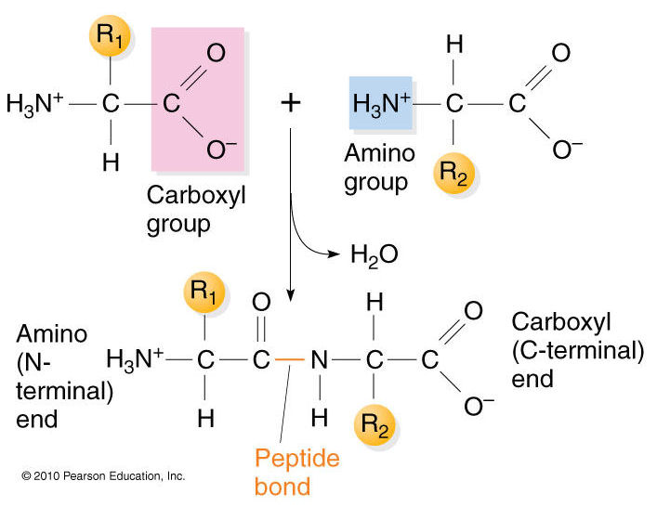
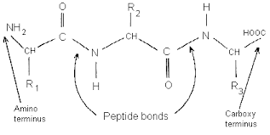
Polypeptide Chains
Amino acids are joined together through dehydration synthesis to form a peptide bond which is formed when the carboxyl (-COOH) group of one amino acid reacts with the amino (-NH2 ) group of the next amino acid with the elimination of a water moiety (the process is called dehydration).
When a number of amino acids are linked together by peptide bonds, a polypeptide chain is formed. One or more polypeptide chains twisted into a 3D shape forms a protein.
The first amino acid is also called as N-terminal amino acid. The last amino acid is called the C-terminal amino acid.

Slide 4
Protein Structure
There are two general classes of protein molecules: globular proteins and fibrous proteins.
Globular proteins are generally compact, soluble, and spherical in shape.
Fibrous proteins are typically elongated and insoluble.
Globular and fibrous proteins may exhibit one or more of four types of protein structure.
The four structure types are primary, secondary, tertiary, and quaternary structure.
A protein's structure determines its function.
For instance, structural proteins like collagen and keratin are fibrous and stringy.
Globular proteins like hemoglobin, on the other hand, are folded and compact.
Hemoglobin, found in red blood cells, is an iron-containing protein that binds oxygen molecules. Its compact structure is ideal for traveling through narrow blood vessels.

Slide 5
Protein Synthesis
Proteins are synthesized in the body through a process called translation.
Translation occurs in the cytoplasm and involves the rendering of genetic codes that are assembled during DNA transcription into proteins.
Cell structures called ribosomes help translate these genetic codes into polypeptide chains. The polypeptide chains undergo several modifications before becoming fully functioning proteins.

Slide 6
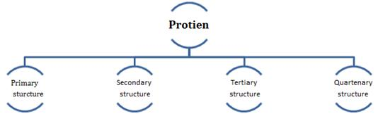
Four Protein Structure Types
The four levels of protein structure are distinguished from one another by the degree of complexity in the polypeptide chain.
A single protein molecule may contain one or more of the protein structure types: primary, secondary, tertiary, and quaternary structure.

Slide 7
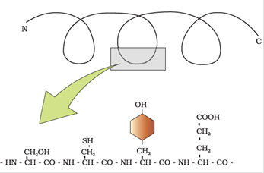
Primary Structure (1⁰ structure) describes the unique order in which amino acids are linked together to form a protein. Proteins are constructed from a set of 20 amino acids. Generally, amino acids have the following structural properties:
A carbon (the alpha carbon) bonded to the four groups below:
A hydrogen atom (H)
A Carboxyl group (-COOH)
An Amino group (-NH2)
A "variable" group or "R" group

Slide 8
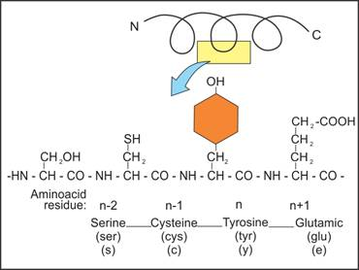
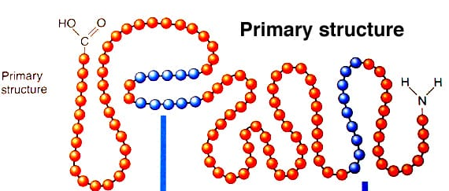
All amino acids have the alpha carbon bonded to a hydrogen atom, carboxyl group, and an amino group. The "R" group varies among aminoacids and determines the differences between these protein monomers.
The sequence of amino acids i.e., the positional information in a protein – which is the first amino acid, which is second, and so on – is called the primary structure. The first amino acid is also called as N-terminal amino acid. The last amino acid is called the C-terminal amino acid.

Slide 9
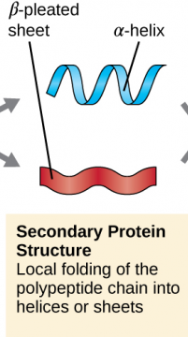
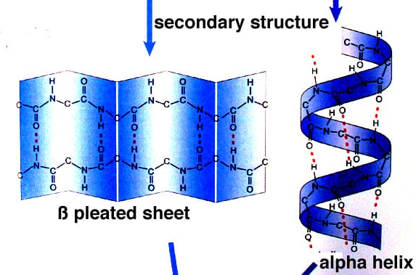
.
Secondary structure protein (2⁰ structure) threads forms helix.
Polypeptide chain undergoes folding or coiling which is stabilized by hydrogen bonding.
Right handed helices are observed. Other regions of the protein thread are folded into other forms in what is called the secondary structure. e.g., fibrous protein in hair, nails.
There are three types of secondary structure- α helix, β pleated and collagen.
In α helix, the polypeptide chain is coiled spirally in right handed manner.
In β pleated secondary proteins two or more polypeptide chains are interconnected by hydrogen bonds.
In collagen there are three strands or polypeptides coiled around one another by hydrogen bonds.

Slide 10
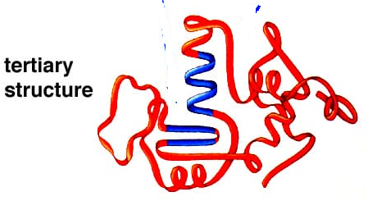
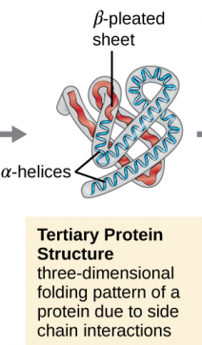
Tertiary structure (3⁰ structure) : Long protein chain is folded upon itself like a hollow woolen ball. Gives a 3-dimensional view of protein, e.g., myosin.
Tertiary structure is absolutely necessary for the many biological activities of proteins.
There are several types of bonds and forces that hold a protein in its tertiary structure.

Slide 11
Hydrophobic interactions greatly contribute to the folding and shaping of a protein. The "R" group of the amino acid is either hydrophobic or hydrophilic.
The amino acids with hydrophilic "R" groups will seek contact with their aqueous environment, while amino acids with hydrophobic "R" groups will seek to avoid water and position themselves towards the center of the protein.
​
Hydrogen bonding in the polypeptide chain and between amino acid "R" groups helps to stabilize protein structure by holding the protein in the shape established by the hydrophobic interactions.
Due to protein folding, ionic bonding can occur between the positively and negatively charged "R" groups that come in close contact with one another.
Folding can also result in covalent bonding between the "R" groups of cysteine amino acids.
This type of bonding forms what is called a disulfide bridge.
Interactions called vanderwals force also assist in the stabilization of protein structure.
These interactions pertain to the attractive and repulsive forces that occur between molecules that become polarized. These forces contribute to the bonding that occurs between molecules.

Slide 12
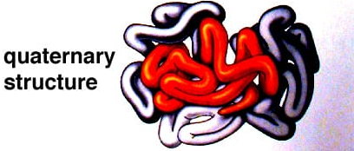
Quaternary Structure (4⁰ structure) refers to the structure of a protein macromolecule formed by interactions between multiple polypeptide chains.
The manner in which these individual folded polypeptides or subunits are arranged with respect to each other (e.g. linear string of spheres, spheres arranged one upon each other in the form of a cube or plate etc.) is the architecture of a protein otherwise called the quaternary structure of a protein.
Proteins with quaternary structure may consist of more than one of the same type of protein subunit. They may also be composed of different subunits.
Hemoglobin is an example of a protein with quaternary structure. Hemoglobin, found in the blood, is an iron-containing protein that binds oxygen molecules. It contains four subunits: two alpha subunits and two beta subunits.

Slide 13
FUNCTIONS OF PROTEINS
The main functions of protein in living cell are:
Transport of nutrient across the membrane.
Fight infectious organisms.
Produce enzyme and proteins.
Collagen is the most abundant protein in animal world.
RuBiSCO (Ribulose-1,5-bisphosphate carboxylase/oxygenase) is the most abundant protein in biosphere.

Slide 14
THANKING YOU
ODM EDUCATIONAL GROUP

