Slide 1


RESPIRATION IN PLANTS
TCA, ETS, OXIDATIVE PHOSPHORYLATION
SUBJECT : BIOLOGY
CHAPTER NUMBER: 14
CHAPTER NAME : RESPIRATION IN PLANTS

Slide 2
Tricarboxylic Acid Cycle
It is the second stage of cellular respiration. It plays an integral role in catabolism of breaking down of organic fuel molecule i.e. glucose, sugar, fatty acid and amino acids.
The cycle starts with the condensation of acetyl group with oxaloacetic acid and water to release citric acid.
The overall reaction of Krebs cycle is –
2 acetyl CoA + 6NAD⁺ + 2FAD + 2ADP + 2P_{i} → 4 CO₂ + 6 NADH + 6H⁺ + 2 FADH₂ + 2ATP
This reaction is catalyzed by citrate synthase enzyme and a molecule of CoA is released.
This citrate is then isomerized to isocitrate followed by decarboxylation that results in the formation of α-ketoglutaric acid and succinyl-CoA.
Then succinyl-CoA is oxidized to OAA allowing the cycle to continue.
During this conversion of succinyl-CoA to succinic acid one molecule of GTP is synthesized.

Slide 3
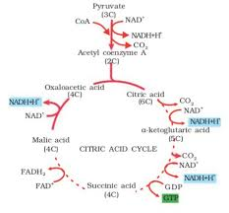

Slide 4
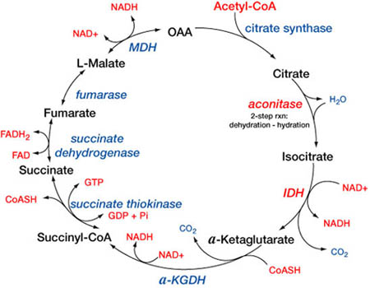
TCA CYCLE

Slide 5
In a coupled reaction GTP is converted to GDP along with the synthesis of ATP from ADP.
Added to this, at three places in the entire cycle, NAD⁺ is reduced to NADH + H⁺ and at one point FAD⁺ is reduced to FADH₂.
Furthermore, the continued oxidation of acetic ued oxidacid in this cycle requires continued replenishment of oxaloacetic acid, i.e. the first member of the cycle.
The summary equation of entire process is given below -

Slide 6
Electron Transport System (ETS) and Oxidative Phosphorylation
NADH and FADH₂ carry electrons to the Electron Transport System.
After the completion of Krebs cycle, oxygen enters in pathway as the electron acceptor at the end of electron transport system.
“The metabolic pathway, through which the electron passes from one carrier to another, is called electron transport system and is present in the inner mitochondrial membrane.”
The electrons produced from NADH in the matrix of mitochondria during krebs/ citric acid cycle are oxidized by an NADH dehydrogenase (Complex I).
The electrons are then transported to ubiquinone present in the inner membrane. This ubiquinone also receives reducing equivalents by FADH₂ (Complex II).

Slide 7
This FADH₂ is generated during the oxidation of succinate in Krebs cycle.
This reduced ubiquinone is oxidized with the transfer of electrons to cytochrome c with cytochrome bc₁ complex (Complex III).
The small protein cytochrome c attached to outer surface of inner membrane acts as mobile carrier that transfers the electrons from Complex III to Complex IV.
This Complex IV is cytochrome coxidase complex which contains cytochrome a and a₃, along with two copper centers.
When the transference of electron takes place from one carrier to another via complex I to IV, they are coupled to Complex V or ATP synthase for the production of ATP from ADP.
The number of molecules of ATP synthesis depends on the nature of electron donor. Oxidation of 1 molecule NADH results in 3 molecules of ATP.

Slide 8
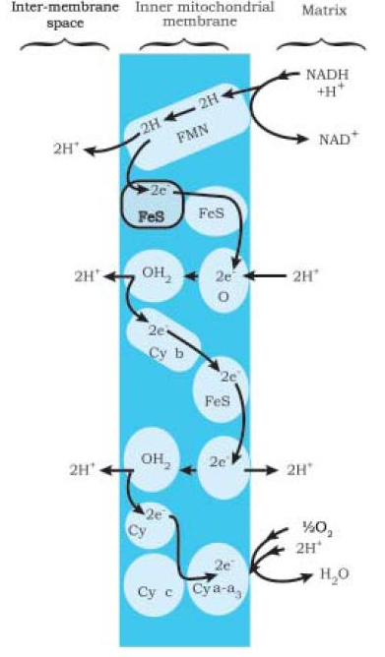

Slide 9
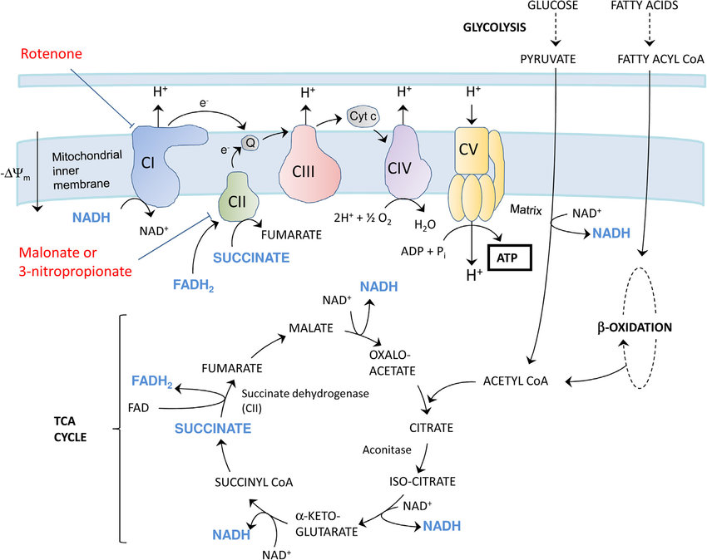

Slide 10
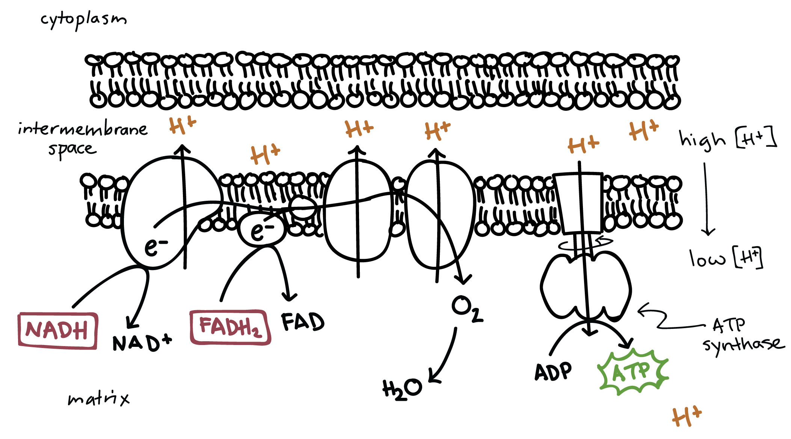
Oxidative phosphorylation

Slide 11
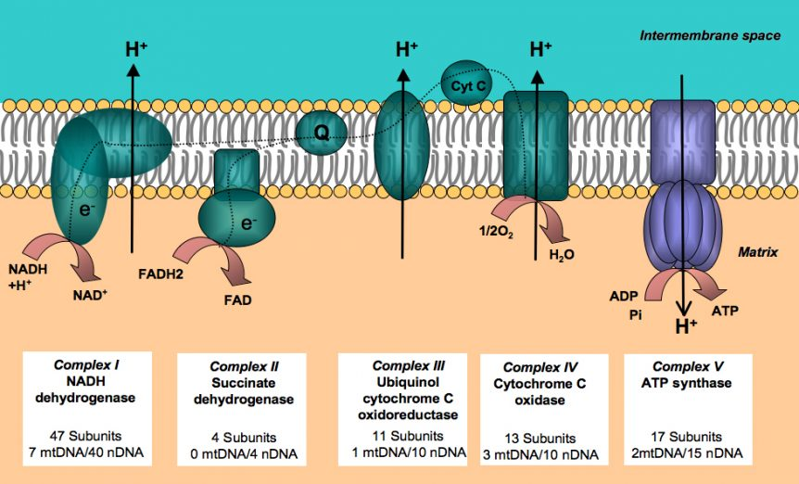
ETS

Slide 12
It is important to note that presence of oxygen is important for aerobic respiration, but its role is limited in the terminal stage of the process.
Presence of oxygen is important because it drives the entire process by eliminating hydrogen from the process or it can be said that oxygen is the final hydrogen acceptor
ATP synthase (complex V). This complex consists of two major components, F₁ and F₀.
The F₁ headpiece is a peripheral membrane protein complex and contains the site for synthesis of ATP from ADP and inorganic phosphate.
F0 is an integral membrane protein complex that forms the channel through which protons cross the inner membrane.
The passage of protons through the channel is coupled to the catalytic site of the F1 component for the production of ATP.
For each ATP produced, 2H⁺ passes through F0 from the intermembrane space to the matrix down the electrochemical proton gradient.

Slide 13
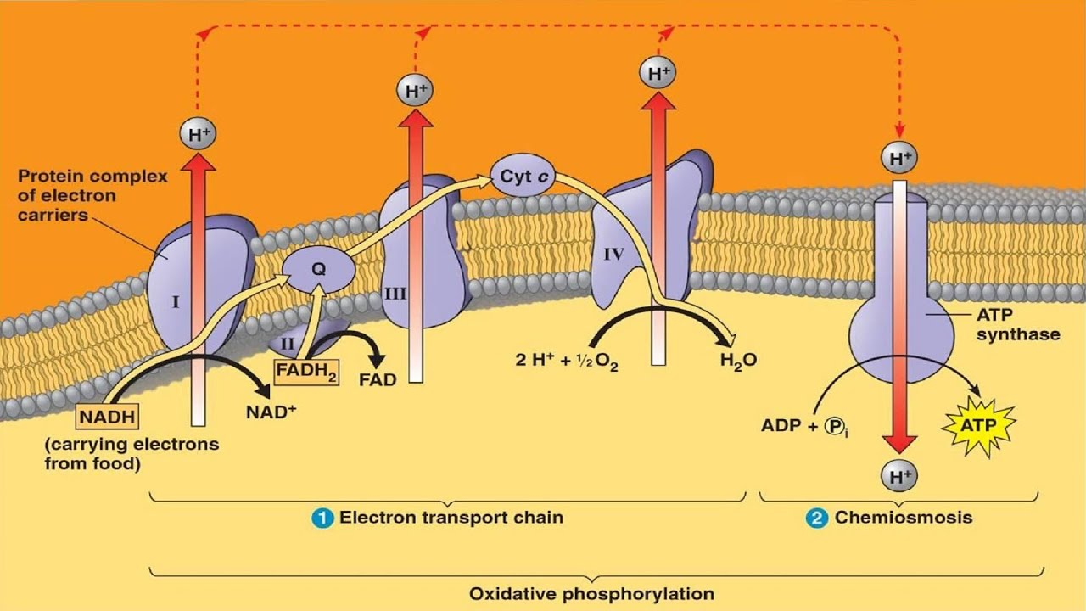

Slide 14
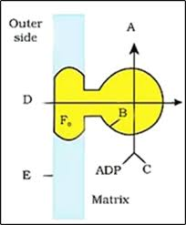
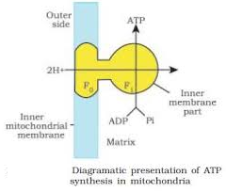
The passage of protons through the channel is coupled to the catalytic site of the F1 component for the production of ATP.
For each ATP produced, 2H+ passes through F0 from the intermembrane space to the matrix down the electrochemical proton gradient.

Slide 15
ATP yield
However, most current sources estimate that the maximum ATP yield for a molecule of glucose is around 30-32 ATP.
This range is lower than previous estimates because it accounts for the necessary transport of ADP into, and ATP out of, the mitochondrion.
Two net ATP are made in glycolysis, and another two ATP (or energetically equivalent GTP) are made in the citric acid cycle.
Beyond those four, the remaining ATP all come from oxidative phosphorylation.
Based on a lot of experimental work, it appears that four H⁺ ions must flow back into the matrix through ATP synthase to power the synthesis of one ATP molecule.
When electrons from NADH move through the transport chain, about 10 H⁺ ions are pumped from the matrix to the intermembrane space, so each NADH yields about 2.5 ATP.
Electrons from FADH₂, end subscript, which enter the chain at a later stage, drive pumping of only 6 H⁺, leading to production of about 1.5 ATP.

Slide 16
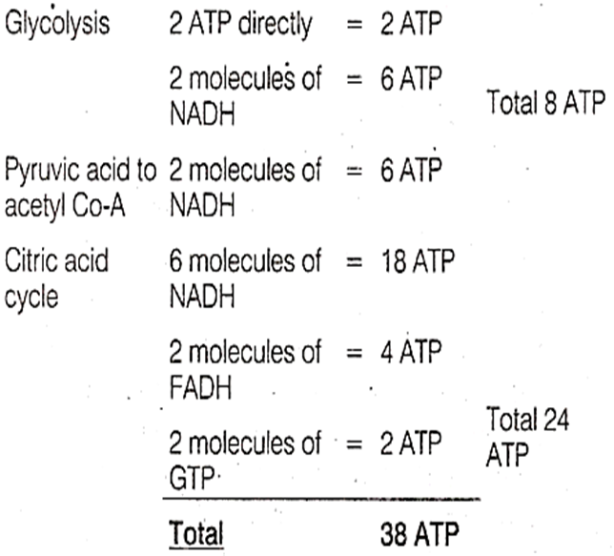
With this information, we can do a little inventory for the breakdown of one molecule of glucose:

Slide 17
Glycolysis | Krebs Cycle
It is the first step in respiration in which glucose is broken down into two molecules of pyruvate | Krebs Cycle is the second step of respiration in which it degrades pyruvate into inorganic substances (water and carbon dioxide)
Occurs inside the cytoplasm | Occurs inside the mitochondria
No carbon dioxide evolved | Carbon dioxide evolved
One molecule of glucose liberates 4 ATP molecules through substrate level phosphorylation | Two acetyl residues liberate two ATP and GTP molecules through substrate level phosphorylation
Oxygen not required for glycolysis | Oxygen is required for Krebs Cycle
Occurs as a linear sequence | Occurs as a cyclic sequence
Consumes 2 molecules of ATP for initial phosphorylation of substance molecules | Doesn’t consume ATP
Two molecules of ATP and two molecules of NADH gained for every molecule of glucose broken down | Six molecules of NADH and two molecules of FADH2 for every acetyl-CoA oxidised

Slide 18
THANKING YOU
ODM EDUCATIONAL GROUP

