Slide 1


PHOTOSYNTHESIS IN HIGHER PLANTS
CYCLIC AND NON CYCLIC PHOTOPHOSPHORYLATION
SUBJECT : BIOLOGY
CHAPTER NUMBER: 13
CHAPTER NAME : PHOTOSYNTHESIS IN HIGHER PLANTS

Slide 2
KEYWORDS
CYCLIC PHOTOPHOSPHORYLATION
NON CYCLIC PHOTOPHOS[HORYLATION

Slide 3
Photophosphorylation
The formation of ATP in the presence of sunlight is called photophosphorylation.
It is of two types:
Non-cyclic photophosphorylation
Cyclic photophosphorylation

Slide 4
THE Z-SCHEME
This movement of electrons is downhill, in terms of an oxidation-reduction or redox potential scale.
The electrons are not used up as they pass through the electron transport chain, but are passed on to the pigments of photosystem PS I.
Simultaneously, electrons in the reaction centre of PS I are also excited when they receive red light of wavelength 700 nm and are transferred to another accepter molecule that has a greater redox potential.
These electrons then are moved downhill again, this time to a molecule of energy-rich NADP+ .
The addition of these electrons reduces NADP⁺ to NADPH + H⁺
This whole scheme of transfer of electrons, starting from the PS II, uphill to the acceptor, down the electron transport chain to PS I, excitation of electrons, transfer to another acceptor, and finally down hill to NADP reducing it to NADPH + H⁺ is called the Z scheme, due to its characteristic shape.
This shape is formed when all the carriers are placed in a sequence on a redox potential scale.

Slide 5
Cyanobacteria and Plants use two PS which simultaneously work to produce energy and reduce power.
Primarily, a photon of light ejects a high energy light from PS II.
This electron travels from excited reaction center of PS II down the chain and enters in PS I.
“This electron transport system generates a proton motive force that is used to produce ATP.
Since the excited electron does not return to PS II, this mechanism for making ATP is called Non – Cyclic Photophosphorylation.”
When PS I absorb a photon of light, it releases high energy electron that is used to drive the formation of reducing power in the form of NADPH.
This ejected electron is replaced by an electron of PS II.
In this process the excited electron does not return to PS II and therefore, this entire mechanism for making ATP is referred as Non – Cyclic Photophosphorylation:

Slide 6
PS-II absorbs light at a wavelength of 680 nm and causes excitation in the electrons.
These excited electrons are accepted by an electron acceptor and transferred to the electron transport system.
The electrons from the electron transport system are transferred to the PS-I.
At the same time, the electrons at PS-I receive a wavelength of 700 nm and get excited.
An electron from the electron acceptor is added to NADP+, which is then reduced to NADPH+ H+.
The electrons lost by PS-II do not return to it and hence named non-cyclic photophosphorylation.
In this, both the photosystems were involved.

Slide 7
NON-CYCLIC PHOTO-PHOSPHORYLATION
Living organisms have the capability of extracting energy from oxidisable substances and store this in the form of bond energy.
Special substances like ATP, carry this energy in their chemical bonds.
The process through which ATP is synthesised by cells (in mitochondria and chloroplasts) is named phosphorylation.
Photophosphorylation is the synthesis of ATP from ADP and inorganic phosphate in the presence of light.
When the two photosystems work in a series, first PS II and then the PS I, a process called
non-cyclic photo-phosphorylation occurs.
The two photosystems are connected through an Electron transport chain, as seen earlier in the
Z scheme.
Both ATP and NADPH + H ⁺ are synthesised by this kind of electron flow.

Slide 8
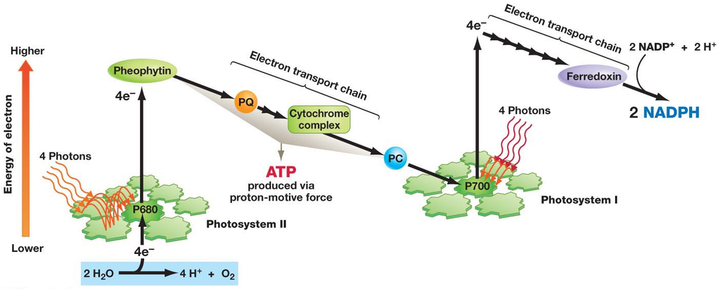
NON-CYCLIC PHOTO-PHOSPHORYLATION
NON-CYCLIC PHOTO-PHOSPHORYLATION

Slide 9
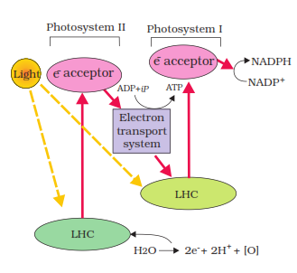
Z-SCHEME OF LIGHT REACTION

Slide 10
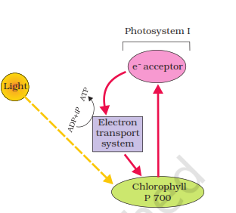
CYCLIC PHOTO-PHOSPORYLATION

Slide 11
CYCLIC PHOTO-PHOSPHORYLATION
When only PS I is functional, the electron is circulated within the photosystem and the phosphorylation occurs due to cyclic flow of electrons.
A possible location where this could be happening is in the stroma lamellae.
While the membrane or lamellae of the grana have both PS I and PS II the stroma lamellae membranes lack PS II as well as NADP reductase enzyme.
The excited electron does not pass on to NADP but is cycled back to the PS I complex through the electron transport chain .
The cyclic flow hence, results only in the synthesis of ATP, but not of NADPH + H ⁺
Cyclic photophosphorylation also occurs when only light of wavelengths beyond 680 nm are available for excitation.

Slide 12
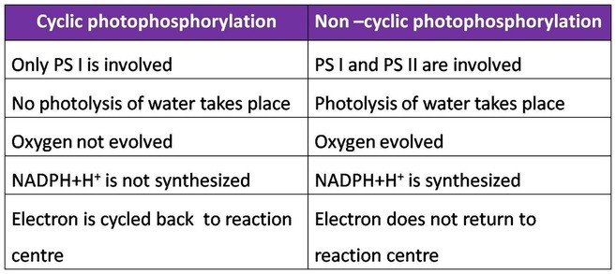
DIFFERENCE BETWEEN CYCLIC
AND
NON CYCLIC PHOTO-PHOSPHORYLATION

Slide 13
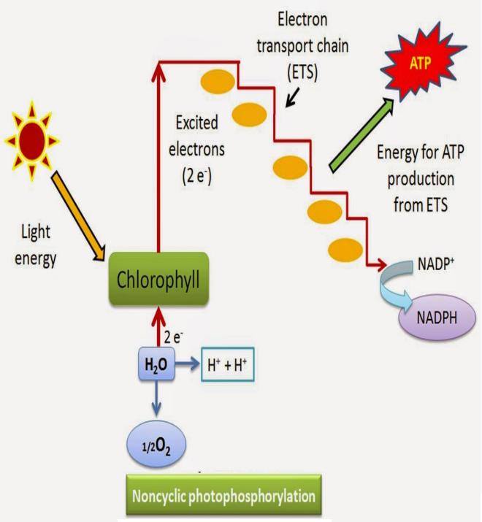
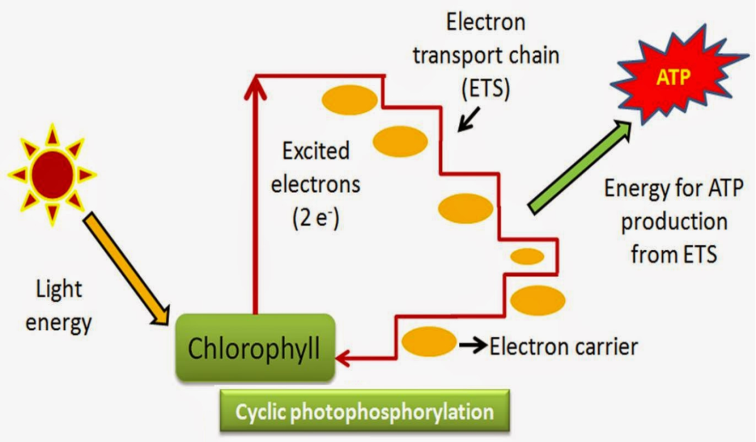

Slide 14
THANKING YOU
ODM EDUCATIONAL GROUP

