Slide 1


BIOMOLECULES
LIPIDS, PRIMARY AND SECONDARY METABOLITES, BIOMACROMOLECULES
SUBJECT : (BIOLOGY)
CHAPTER NUMBER: 9
CHAPTER NAME : BIOMOLECULES

Slide 2
LIPIDS
Lipids are generally water insoluble. They could be simple fatty acids.
A fatty acid has a carboxyl group attached to an R group.
The R group could be a methyl (–CH3 ), or ethyl (–C2H5 ) or higher number of –CH2 groups (1 carbon to 19 carbons).
For example, palmitic acid has 16 carbons including carboxyl carbon.
Arachidonic acid has 20 carbon atoms including the carboxyl carbon.

Slide 3
Another simple lipid is glycerol which is trihydroxy propane.
Many lipids have both glycerol and fatty acids.
Here the fatty acids are found esterified with glycerol.
They can be then monoglycerides, diglycerides and triglycerides.
These are also called fats and oils based on melting point.
Oils have lower melting point (e.g., gingely oil) and hence remain as oil in winters.
Some lipids have phosphorous and a phosphorylated organic compound in them.
These are phospholipids.
They are found in cell membrane.
Lecithin is one example.
Some tissues especially the neural tissues have lipids with more complex structures.

Slide 4
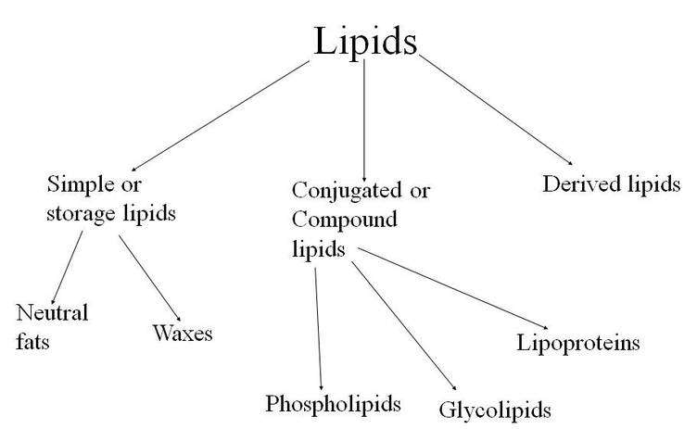
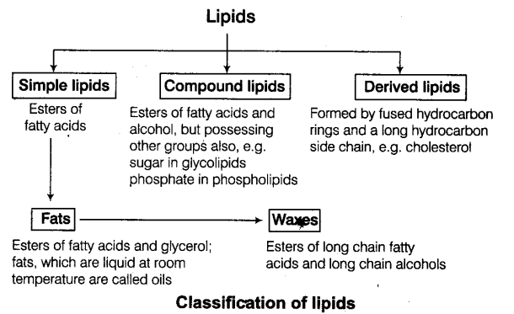

Slide 5
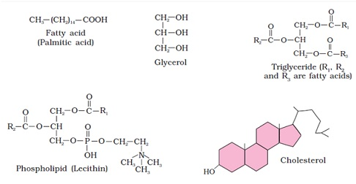
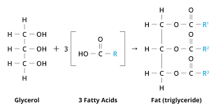

Slide 6
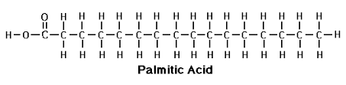
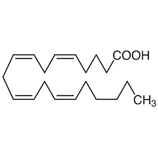
Saturated fatty acids (general formula CnH₂nO₂) lack double bonds between the individual carbon atoms, while in unsaturated fatty acids (general formula CnH₂n-2xO₂) there is at least one double bond in the fatty acid chain.
Saturated fats tend to be solid at room temperature and from animal sources, while unsaturated fats are usually liquid and from plant sources.
Palmitic acid is a saturated fatty acid. Its chemical formula is CH3​(CH2​)14​COOH.
Meat, cheese and diary products are the main source of the palmitic acid.
Arachidonic acid is a long-chain fatty acid that is a C20, polyunsaturated fatty acid having four (Z)-double bonds at positions 5, 8, 11 and 14.

Slide 7
PRIMARY AND SECONDARY METABOLITES
The most exciting aspect of chemistry deals with isolating thousands of compounds, small and big, from living organisms, determining their structure and if possible synthesising them.
If one were to make a list of biomolecules, such a list would have thousands of organic compounds including amino acids, sugars, etc.
In animal tissues, one notices the presence of all such categories of compounds.
These are called primary metabolites.
However, when one analyses plant, fungal and microbial cells, one would see thousands of compounds other than these called primary metabolites, e.g. alkaloids, flavonoids, rubber, essential oils, antibiotics, coloured pigments, scents, gums, spices.
These are called secondary metabolites.

Slide 8
While primary metabolites have identifiable functions and play known roles in normal physiologial processes, at the moment, to understand the role or functions of all the ‘secondary metabolites’ in host organisms.
However, many of them are useful to ‘human welfare’ (e.g., rubber, drugs, spices, scents and pigments).
Some secondary metabolites have ecological importance. In the later chapters and years you will learn more about this.

Slide 9
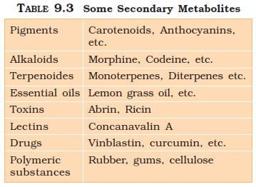

Slide 10
BIOMACROMOLECULES
There is one feature common to all those compounds found in the acid soluble pool.
They have molecular weights ranging from 18 to around 800 daltons (Da) approximately.
The acid insoluble fraction, has only four types of organic compounds i.e., proteins, nucleic acids, polysaccharides and lipids.
These classes of compounds with the exception of lipids, have molecular weights in the range of ten thousand daltons and above. For this very reason, biomolecules, i.e., chemical compounds found in living organisms are of two types.
One, those which have molecular weights less than one thousand dalton and are usually referred to as micromolecules or simply biomolecules while those which are found in the acid insoluble fraction are called macromolecules or biomacromolecules.
The molecules in the insoluble fraction with the exception of lipids are polymeric substances. Then why do lipids, whose molecular weights do not exceed 800 Da, come under acid insoluble fraction, i.e., macromolecular fraction?

Slide 11
Lipids are indeed small molecular weight compounds and are present not only as such but also arranged into structures like cell membrane and other membranes.
The reason why lipids do not appear in acid soluble portion:
i-Non polar nature in free state.
ii-When we grind a tissue, we are disrupting the cell structure.
Cell membrane and other membranes are broken into pieces, and form vesicles which are not water soluble. Therefore, these membrane fragments in the form of vesicles get separated along with the acid insoluble pool and hence in the macromolecular fraction.
Lipids are not strictly macromolecules.

Slide 12
The acid soluble pool represents roughly the cytoplasmic composition.
The macromolecules from cytoplasm and organelles become the acid insoluble fraction.
Together they represent the entire chemical composition of living tissues or organisms.
In summary if we represent the chemical composition of living tissue from abundance point of view and arrange them class-wise, we observe that water is the most abundant chemical in living organisms (Table 9.4).

Slide 13
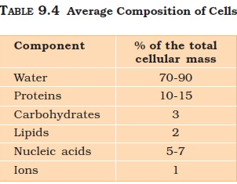

Slide 14
THANKING YOU
ODM EDUCATIONAL GROUP

