Slide 1


RESPIRATION IN PLANTS
TYPES OF RESPIRATION AND FERMENTATION
SUBJECT : BIOLOGY
CHAPTER NUMBER: 14
CHAPTER NAME : RESPIRATION IN PLANTS

Slide 2
Types of Respiration
Respiration is of two types:
Aerobic Respiration: In this type of respiration, the food substances are completely oxidized into H₂O and CO₂ with the release of energy.
It requires atmospheric oxygen and all higher organisms respire aerobically. Following figure shows the steps included in Aerobic Respiration.
Anaerobic Respiration: In this type of respiration, partial oxidation of food takes place and energy is released in the absence of oxygen.
This type of respiration occurs in prokaryotic organisms like bacteria and yeast. Ethyl alcohol and carbon dioxide are formed in this process.

Slide 3
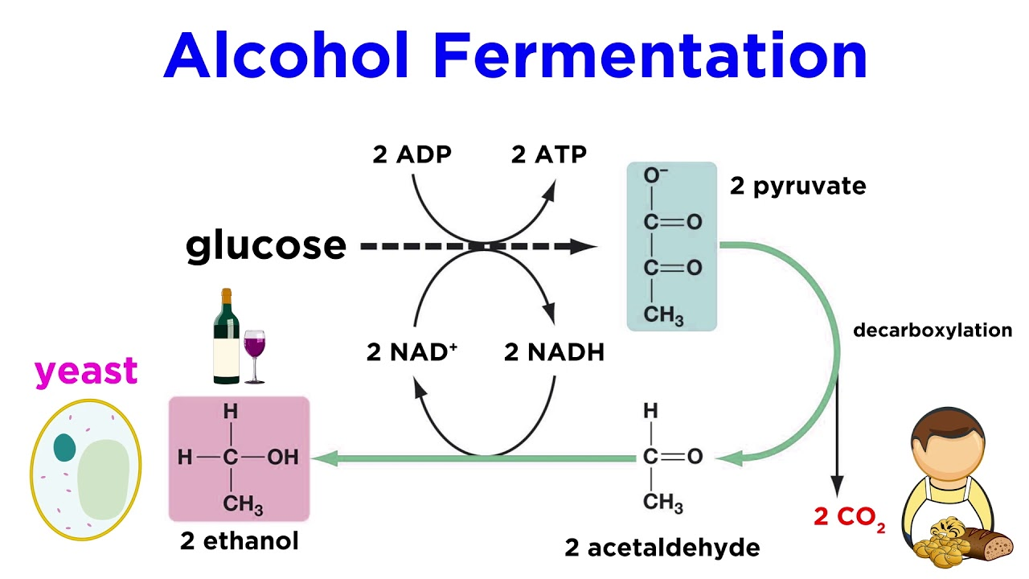

Slide 4
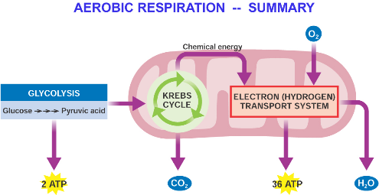

Slide 5
FERMENTATION
In this process, incomplete oxidation of glucose is obtained under anaerobic conditions by a set of reactions resulting in the conversion of carbon dioxide to ethanol, reactions catalyzed by enzymes – alcohol dehydrogenase, pyruvic acid decarboxylase.
In fermentation, say by yeast, the incomplete oxidation of glucose is achieved under anaerobic conditions by sets of reactions where pyruvic acid is converted to CO2 and ethanol.
The enzymes, pyruvic acid decarboxylase and alcohol dehydrogenase catalyse these reactions.
Other organisms like some bacteria produce lactic acid from pyruvic acid.
In animal cells also, like muscles during exercise, when oxygen is inadequate for cellular respiration pyruvic acid is reduced to lactic acid by lactate dehydrogenase.

Slide 6
FERMENTATION
The reducing agent is NADH+ H+ which is reoxidised to NAD+ in both the processes.
What is the net ATPs that is synthesised (calculate how many ATP are synthesised and deduct the number of ATP utilised during glycolysis) when one molecule of glucose is fermented to alcohol or lactic acid.
Yeasts poison themselves to death when the concentration of alcohol reaches about 13 per cent.
In both alcohol and lactic acid fermentation, very less energy is released.
Both these process are hazardous because alcohol or acid is produced during the process.
Fermentation process is used in our daily life such as in the formation of curd, vinegar, bread and alcoholic drinks.

Slide 7
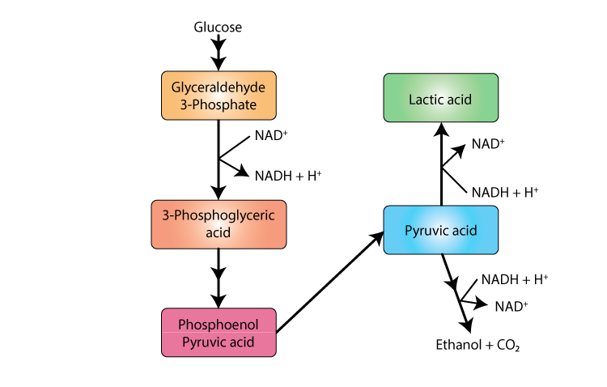
The various steps involved in fermentation

Slide 8
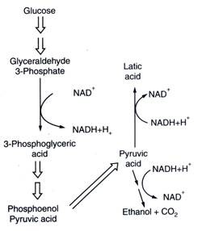
The various steps involved in fermentation are as follows:

Slide 9
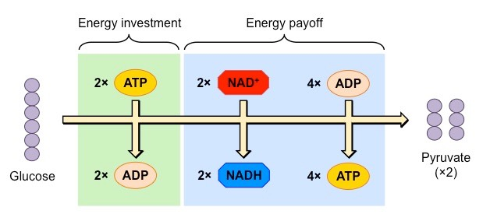
GLYCOLYTIC PATHWAY

Slide 10
Aerobic Respiration
For aerobic respiration to take place within the mitochondria, the final product of glycolysis, pyruvate is transported from the cytoplasm into the mitochondria.
The crucial events in aerobic respiration are:
• The complete oxidation of pyruvate by the stepwise removal of all the hydrogen atoms, leaving three molecules of CO₂ .
• The passing on of the electrons removed as part of the hydrogen atoms to molecular O₂ with simultaneous synthesis of ATP.
This entire process is catalyzed by pyruvic dehydrogenase and this reaction requires involvement of several coenzymes such as Coenzyme A and NAD⁺.

Slide 11
The first process takes place in the matrix of the mitochondria while the second process is located on the inner membrane of the mitochondria.
Pyruvate, which is formed by the glycolytic catabolism of carbohydrates in the cytosol, after it enters mitochondrial matrix undergoes oxidative decarboxylation by a complex set of reactions catalysed by pyruvic dehydrogenase.
The reactions catalysed by pyruvic dehydrogenase require the participation of several coenzymes, including NAD+ and Coenzyme A.
During this process, two molecules of NADH are produced from the metabolism of two molecules of pyruvic acid (produced from one glucose molecule during glycolysis).
The acetyl CoA then enters a cyclic pathway, tricarboxylic acid cycle, more commonly called as Krebs’ cycle after the scientist Hans Krebs who first elucidated it.

Slide 12
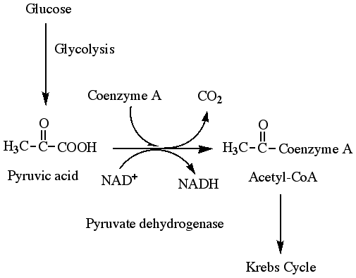
AEROBIC RESPIRATION

Slide 13
THANKING YOU
ODM EDUCATIONAL GROUP

