Slide 1


RESPIRATION IN PLANTS
INTRODUCTION, GLYCOLYSIS
SUBJECT : BIOLOGY
CHAPTER NUMBER: 14
CHAPTER NAME : RESPIRATION IN PLANTS

Slide 2
KEYWORDS
Breathing
Respiration
Glycolysis

Slide 3
INTRODUCTION
All the energy required for ‘life’ processes is obtained by oxidation of some macromolecules that we call ‘food’.
Only green plants and cyanobacteria can prepare their own food; by the process of photosynthesis they trap light energy and convert it into chemical energy that is stored in the bonds of carbohydrates like glucose, sucrose and starch.
In green plants too, not all cells, tissues and organs photosynthesise; only cells containing chloroplasts, that are most often located in the superficial layers, carry out photosynthesis.
Hence, even in green plants all other organs, tissues and cells that are non-green, need food for oxidation. Hence, food has to be translocated to all non-green parts.

Slide 4
Animals are heterotrophic, i.e., they obtain food from plants directly (herbivores) or indirectly (carnivores).
Saprophytes like fungi are dependent on dead and decaying matter.
Ultimately all the food that is respired for life processes comes from photosynthesis.
The cellular respiration or the mechanism of breakdown of food materials within the cell to release energy, and the trapping of this energy for synthesis of ATP.
Photosynthesis, of course, takes place within the chloroplasts (in the eukaryotes), whereas the breakdown of complex molecules to yield energy takes place in the cytoplasm and in the mitochondria (also only in eukaryotes).
The breaking of the C-C bonds of complex compounds through oxidation within the cells, leading to release of considerable amount of energy is called respiration.

Slide 5
The compounds that are oxidised during this process are known as respiratory substrates.
Usually carbohydrates are oxidised to release energy, but proteins, fats and even organic acids can be used as respiratory substances in some plants, under certain conditions.
During oxidation within a cell, all the energy contained in respiratory substrates is not released free into the cell, or in a single step.
It is released in a series of slow step-wise reactions controlled by enzymes, and it is trapped as chemical energy in the form of ATP.
Hence, it is important to understand that the energy released by oxidation in respiration is not (or rather cannot be) used directly but is used to synthesise ATP, which is broken down whenever (and wherever) energy needs to be utilised.
Hence, ATP acts as the energy currency of the cell.
This energy trapped in ATP is utilised in various energy-requiring processes of the organisms, and the carbon skeleton produced during respiration is used as precursors for biosynthesis of other molecules in the cell.

Slide 6
Respiration | Photosynthesis
Respiration takes place in all living cells, including green (Chlorophylls) and non – green. | Photosynthesis takes place only in case of Chlorophylls cells.
It occurs both in night and day and includes Glycolysis – in cytoplasm, Krebs cycle/ Citric acid cycle – in mitochondrial matrix and Electron transport chain and oxidative phosphorylation in inner mitochondrial membrane. | Photosynthesis occurs only in light and includes Light reaction – in grana of chloroplast, Calvin cycle or dark reaction – in stroma of chloroplast and Photolysis or water splitting complex in thylakoid lumen
O₂ is utilized and CO₂ and H₂O is formed | CO₂ and water is used and O₂ is released
It is a catabolic process which includes destruction of food. | It is an anabolic process which includes the manufactured food.
Oxygen is absorbed and carbohydrate is oxidized. | Oxygen is liberated and carbohydrate is synthesized.
It is an exothermic process and energy is released during respiration. | It is an endothermic process and energy is stored during the process.
Dry weight of plant decreases and potential energy is transformed into kinetic energy. | In this case, dry weight of plant increases and light energy is converted into potential energy.

Slide 7
DO PLANTS BREATHE?
Plants need oxygen for respiration but at the same time they also give out carbon dioxide. Thus, plants have proper system to ensure the availability of oxygen.
Unlike animals, plants do not possess any specialized organs for exchange of gases but they have lenticels and stomata (present in stems and leaves respectively) that carry out the function of gaseous exchange.
Plants do not have any specialized organ to respire and exchange gases because each part of the plant takes care of the need of gases themselves.
The parts of the plant do not display any great demand for exchange of gases. Added to this, stems, leaves and roots respire at very lower rate as compared to animals.

Slide 8
The complete combustion of glucose produces H₂O and CO₂ as end products and release energy in the form of heat.
In case, this energy is required by the cell, it will utilize accordingly. Following reaction explains the entire process:
C₆H₁₂O₆ + 6O₂ → 6CO₂ + 6H₂O + Energy
During the process of respiration, O₂ is utilized and carbon dioxide, energy and water are released as products.
There is also a situation when then the oxygen is not available. For instance, the first cell on this planet must have carried out reaction in the absence of oxygen and even in the current living world we are aware of several living organisms adapted to anaerobic conditions.
Some of these organisms are facultative and some are obligate. In any of these cases, all living organisms retain enzymatic machinery to partially oxidize glucose in the absence of oxygen.
This process is also called as Glycolysis which includes breaking down of glucose to Pyruvic Acid.

Slide 9
Respiration in Plants
Plants perform photosynthesis to create sugars (such as glucose), this, along with oxygen is used to produce energy which is used in the plant’s growth.
This process of respiration is essentially the process of photosynthesis but in reverse.
Respiration In Roots
The process of respiration in roots is carried out in the following manner:
Air occurs in several interspaces of soil. The hairs of the roots are in direct contact with them.
Oxygen of the soil gets diffused via root hairs and reaches all internal cells of the root for respiration.
Carbon dioxide produced during the diffusion is released in the opposite direction.
In the condition of water logging, air gets deficient in soil and in this case, metabolic activity of the roots declines.

Slide 10
But during the process of photosynthesis, large exchange of gases takes place and each part of the plant is well adapted to fulfill its need of gases.
Availability of oxygen is not a problem during photosynthesis because the cells release oxygen within cells.
It is important to note that each living cell in a plant is located quite close to the surface of the plant and in case of stems, the living cells are arranged in the form of thin layers beneath and inside the bark and have openings which are referred as lenticels.
Thereby, the respiration and translocation takes place at every part of the plant.

Slide 11
Respiration In Stems
The stems of herbaceous plants possess stomata and the air gets diffused via it and reaches the cells for respiration.
The carbon dioxide produced during the process gets diffused in the air via stomata.
When the stems are woody, this gaseous exchange is carried out by lenticels.
Respiration In Leaves
Leaves of the plants have tiny pores which are referred as stomata.
The exchange of gases takes place by the process of diffusion via stomata.
The stomata are present in large number on lower surface of leaves of plant.
Each stoma is surrounded and controlled by Guard Cells (two kidney shaped cells).
Then the stoma, open gaseous exchange takes place between Atmosphere and Interior of Leaves.

Slide 12
Glycolysis
Glycolysis is the primary step of cellular respiration.
In the absence of oxygen, the cells take small amounts of ATP through the process of fermentation.
This metabolic pathway was discovered by three German biochemists- Gustav Embden, Otto Meyerhof, and Jakub Karol Parnas in the early 19th century and is known as EMP pathway (Embden–Meyerhof–Parnas).
This process takes place in the cytoplasm of the cell and is found in all the living entities wherein glucose undergoes partial oxidation forming two molecules of pyruvic acid.
“Glycolysis is the metabolic process that breaks down glucose into pyruvic acid.”
Glycolysis is the process in which glucose is broken down to produce energy. It produces two molecules of pyruvate, ATP, NADH and water.
The process takes place in the cytosol of the cell cytoplasm, in the presence or absence of oxygen.

Slide 13
Stage 1
A phosphate group is added to glucose in the cell cytoplasm by the action of enzyme hexokinase.
In this, a phosphate group is transferred from ATP to glucose forming glucose,6-phosphate.
Stage 2
Glucose-6-phosphate is isomerized into fructose,6-phosphate by the enzyme phosphoglucomutase.
Stage 3
The other ATP molecule transfers a phosphate group to fructose 6-phosphate and converts it into fructose 1,6-bisphosphate by the action of enzyme phosphofructokinase.
Stage 4
The enzyme aldolase breaks down fructose 1,6-bisphosphate into glyceraldehyde 3-phosphate and dihydroxyacetone phosphate, which are isomers of each other.
Step 5
Triose-phosphate isomerase converts dihydroxyacetone phosphate into glyceraldehyde 3-phosphate which is the substrate in the successive step of glycolysis.

Slide 14
Step 6
This step undergoes two reactions:The enzyme glyceraldehyde 3-phosphate dehydrogenase transfers 1 hydrogen molecule from glyceraldehyde phosphate to nicotinamide adenine dinucleotide to form NADH + H⁺.
Glyceraldehyde 3-phosphate dehydrogenase adds a phosphate to the oxidized glyceraldehyde phosphate to form 1,3-bisphosphoglycerate.
Step 7
Phosphate is transferred from 1,3-bisphosphoglycerate to ADP to form ATP with the help of phosphoglycerokinase.
Thus two molecules of phosphoglycerate and ATP are obtained at the end of this reaction.

Slide 15
Step 8
The phosphate of both the phosphoglycerate molecules is relocated from the third to the second carbon to yield two molecules of 2-phosphoglycerate by the enzyme phosphoglyceromutase.
Step 9
The enzyme enolase removes a water molecule from 2-phosphoglycerate to form phosphoenolpyruvate.
Step 10
A phosphate from phosphoenolpyruvate is transferred to ADP to form pyruvate and ATP by the action of pyruvate kinase. Two molecules of pyruvate and ATP are obtained as the end products.

Slide 16
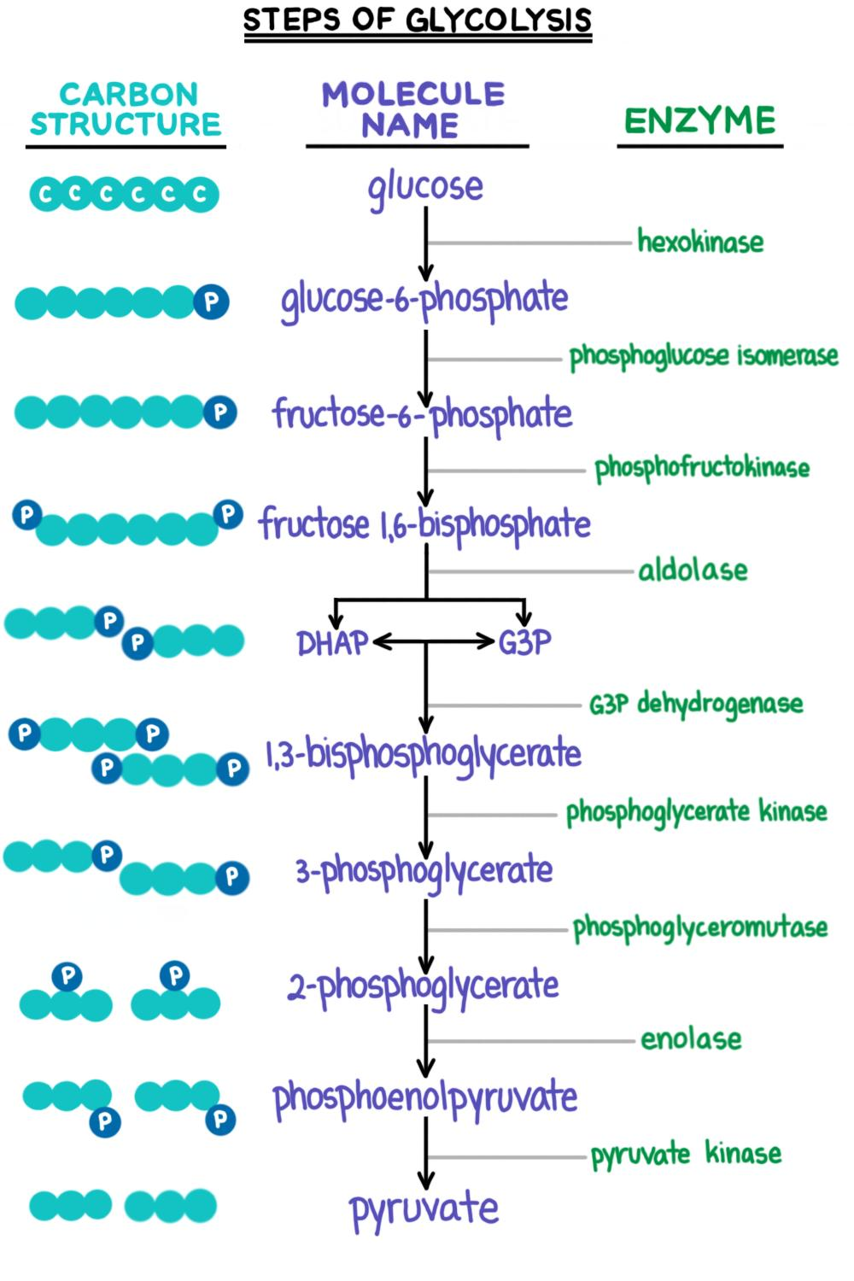
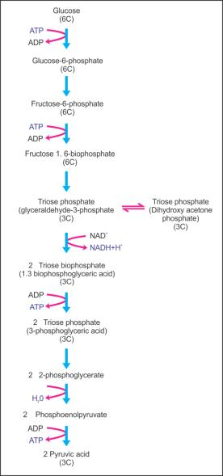

Slide 17
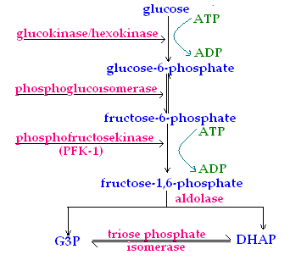

Slide 18
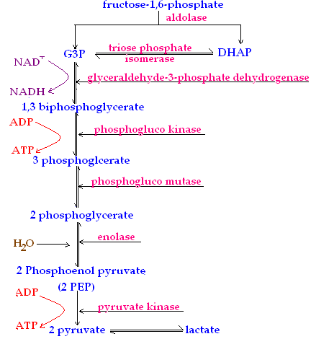

Slide 19
THANKING YOU
ODM EDUCATIONAL GROUP

