Slide 1


BIOMOLECULES
HOW TO ANALYSE CHEMICAL COMPOSITION?
SUBJECT : (BIOLOGY)
CHAPTER NUMBER: 9
CHAPTER NAME : BIOMOLECULES

Slide 2
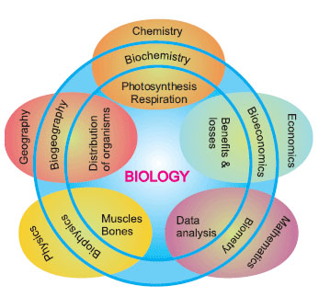
INTRODUCTION
Branches of Biology

Slide 3
INTRODUCTION
The Cellular Pool
There is a wide diversity in living organisms in our biosphere.
Now a question that arises in our minds is: Are all living organisms made of the same chemicals, i.e., elements and compounds?
If we perform such an analysis on a plant tissue, animal tissue or a microbial paste, we obtain a list of elements like carbon, hydrogen, oxygen and several others and their respective content per unit mass of a living tissue.
If the same analysis is performed on a piece of earth’s crust as an example of non-living matter, we obtain a similar list.

Slide 4
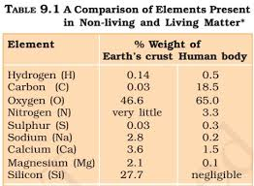
INTRODUCTION
What are the differences between the two lists? In absolute terms, no such differences could be made out.
All the elements present in a sample of earth’s crust are also present in a sample of living tissue.
However, a closer examination reveals that the relative abundance of carbon and hydrogen with respect to other elements is higher in any living organism than in earth’s crust (table 9.1).

Slide 5
INTRODUCTION
A biomolecule or biological molecule is a loosely used term for molecules and ions present in organisms that are essential to one or more typically biological processes, such as cell division, morphogenesis, or development.
Biomolecules include large macromolecules such as proteins, carbohydrates, lipids, and nucleic acids, as well as small molecules such as primary metabolites, secondary metabolites and natural products.
A more general name for this class of material is biological materials.
Biomolecules are usually endogenous, produced within the organism but organisms usually need exogenous biomolecules, in the form of nutrients, to survive.

Slide 6
INTRODUCTION
Biology and its sub-fields of biochemistry and molecular biology study biomolecules and their reactions.
Biomolecules are organic compounds and just four elements—oxygen, carbon, hydrogen, and nitrogen—make up 96% of the human body's mass. But many other elements, such as the various bio-metals, are present in small amounts.
The uniformity of both specific types of molecules (the biomolecules) and of certain metabolic pathways are invariant features among the wide diversity of life forms; thus these biomolecules and metabolic pathways are referred to as "biochemical universals" or "theory of material unity of the living beings".

Slide 7
HOW TO ANALYSE CHEMICAL COMPOSITION?
We can continue asking in the same way, what type of organic compounds are found in living organisms? How does one go about finding the answer?
To get an answer, one has to perform a chemical analysis. We can take any living tissue
(a vegetable or a piece of liver, etc.) and grind it in trichloroacetic acid (Cl₃CCOOH) using a mortar and a pestle. We obtain a thick slurry.
If we were to strain this through a cheesecloth or cotton we would obtain two fractions. One is called the filtrate or more technically, the acid-soluble pool, and the second, the retentate or the acid-insoluble fraction.
Scientists have found thousands of organic compounds in the acid-soluble pool.

Slide 8
HOW TO ANALYSE CHEMICAL COMPOSITION?
ISOLATION, PURIFICATION AND ANALYSIS
It will suffice to say here that one extracts the compounds, then subjects the extract to various separation techniques till one has separated a compound from all other compounds. In other words, one isolates and purifies a compound.
Analytical techniques, when applied to the compound give us an idea of the molecular formula and the probable structure of the compound.
All the carbon compounds that we get from living tissues can be called ‘biomolecules’. However, living organisms have also got inorganic elements and compounds in them.
How do we know this? A slightly different but destructive experiment has to be done. One weighs a small amount of a living tissue (say a leaf or liver and this is called wet weight) and dry weight.

Slide 9
HOW TO ANALYSE CHEMICAL COMPOSITION?
All the water, evaporates. The remaining material gives dry weight. Now if the tissue is fully burnt, all the carbon compounds are oxidised to gaseous form (CO₂, water vapour) and are removed.
What is remaining is called ‘ash’. This ash contains inorganic elements (like calcium, magnesium etc). Inorganic compounds like sulphate, phosphate, etc., are also seen in the acid-soluble fraction.
Therefore elemental analysis gives elemental composition of living tissues in the form of hydrogen, oxygen, chlorine, carbon etc. while analysis for compounds gives an idea of the kind of organic and inorganic constituents (table 9.2) present in living tissues.
From a chemistry point of view, one can identify functional groups like aldehydes, ketones, aromatic compounds, etc.
But from a biological point of view, we shall classify them into amino acids, nucleotide bases, fatty acids etc.

Slide 10
A LIST OF REPRESENTATIVE INORGANIC CONSTITUENTS OF LIVING TISSUES
TABLE: 9.2
Component | Formula
Sodium | Na⁺
Potassium | K⁺
Calcium | Ca⁺⁺
Magnesium | Mg⁺⁺
Water | H₂O
Compounds | NaCl, CaCO_{3,} PO₄³⁻ , SO₄²⁻

Slide 11
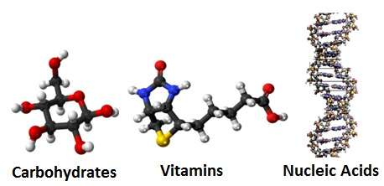
The nutrients in the food have some substances like carbohydrates, proteins, fats which are essential for building and maintaining our body.
Not only that, even the genetic element of our body is also because of a kind of molecules called Nucleic acids.
Biomolecules are molecules produced by living organisms.
A living organism grows, sustains and reproduces itself.
The most amazing thing about a living system is that it is composed of non-living atoms and molecules.
Carbohydrates, Vitamins, Nucleic acids are some examples of Biomolecules.

Slide 12
THANKING YOU
ODM EDUCATIONAL GROUP

