Slide 1

WELCOME TO ONLINE CLASS
CLASS-UKG
SUBJECT-MATHS
TOPIC-NUMBERS(51 TO 100)

Slide 2
LET’S RECAP
1, 2,………………………......, 9, 10
11, 12,……………………....., 19, 20
21, 22,……………………....., 29, 30
31, 32,……………………....., 39, 40
41, 42,……………………....., 49, 50

Slide 3
Counting 51 to 70
70
1
6
1
6
2
7
2
7
50
60
7
5
4
3
2
6
9
8
1
2
4
5
1
3
7
9
8
6
3
8
3
8
4
9
4
9
5
5

Slide 4
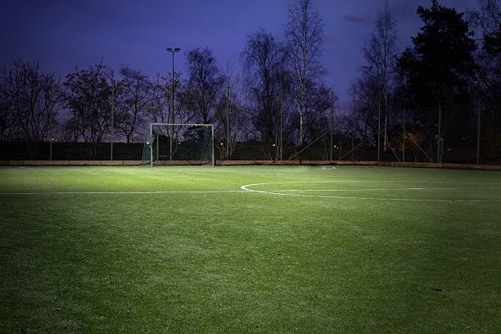


70
71
72
78
74
75
76
77
80
79
73
81
89
85
86
83
91
90
87
92
88
82
84
93
95
96
94
100
98
99
97

Slide 5

YEAH!!
SO MANY BALLS.

Slide 6
Tell the missing numbers:
50 | 51 | __ | __ | 54 | __ | 56 | 57 | __ | 59
__ | 61 | 62 | __ | __ | 65 | __ | 67 | __ | 69
70 | __ | __ | 73 | __ | 75 | __ | 77 | __ | 79
80 | 81 | __ | 83 | __ | __ | 86 | __ | 88 | __
90 | __ | __ | 93 | __ | 95 | __ | 97 | __ | 99
52
53
55
58
60
63
64
66
68
71
72
74
76
78
82
84
85
87
89
91
92
94
96
98
100

Slide 7
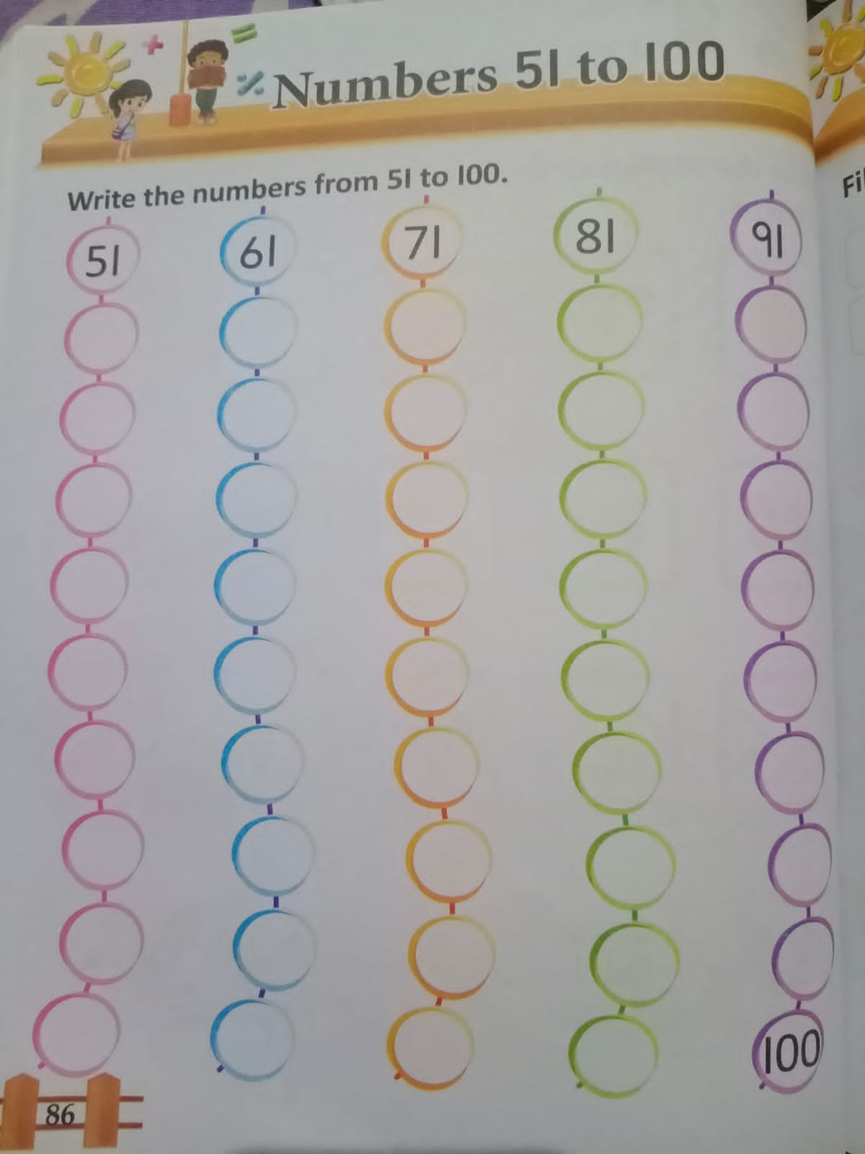
CLASS WORK
31.8.21

Slide 8
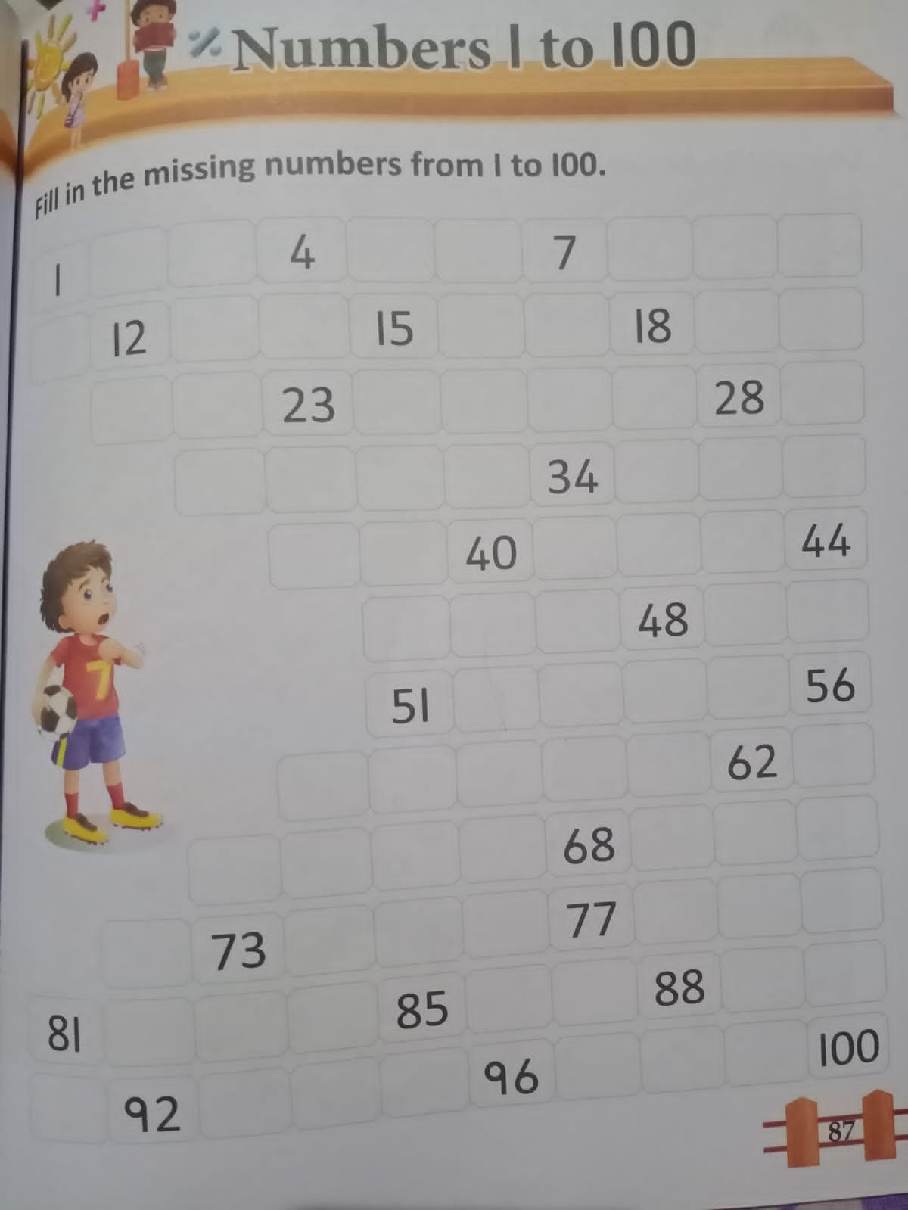
HOME WORK
31.8.21

Slide 9

THANKING YOU
ODM EDUCATIONAL GROUP

