Slide 1

WELCOME TO ON LINE CLASS
CLASS-UKG
SUBJECT-MATHEMATICS
TOPIC-SHAPE-Bkpg-79 to 81
(once again)

Slide 2
DIFFERENT SHAPES
TRIANGLE
RECTANGLE
SEMICIRCLE
SQUARE
CIRCLE
OVAL

Slide 3
ACTIVITY
Identify the shape of the pictures and say-
R for rectangle
S for square
T for triangle
C for circle
SC for semicircle

Slide 4
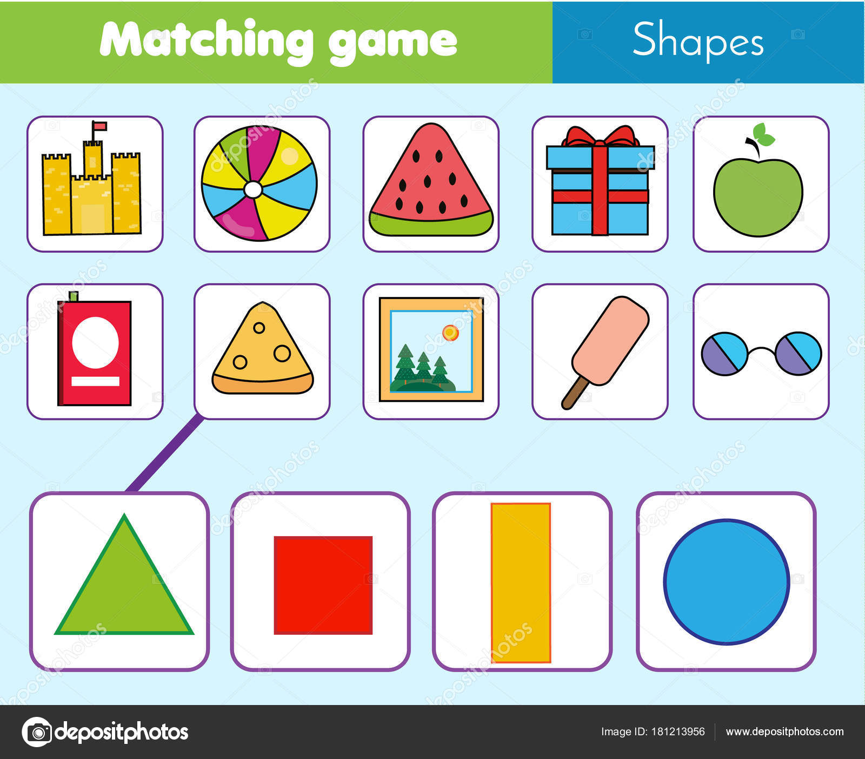

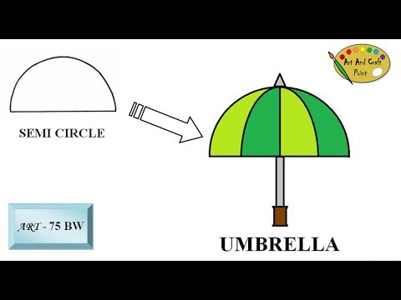
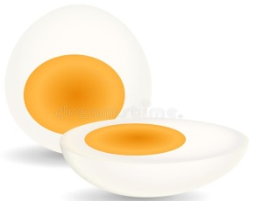
C
R
C
T
S
SC
R
S
R
O
S
R
C
T
O
SC

Slide 5
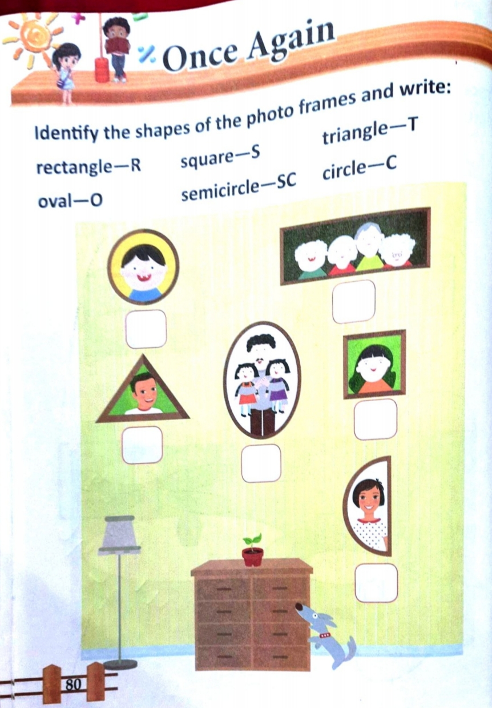
CW
25.8.21

Slide 6
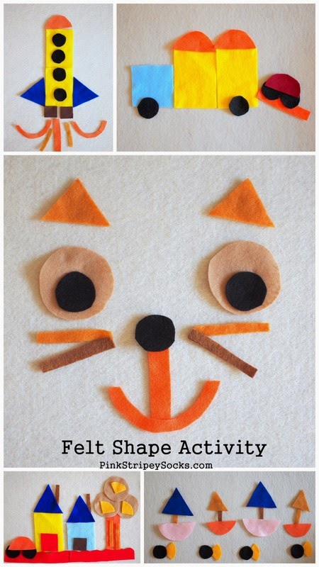
Draw different shapes and tick the shapes used for the picture.
CW
25.8.21
SQUARE
RECTANGLE
CIRCLE
TRANGLE
SEMICIRCLE
OVAL

Slide 7
Draw & colour / paste cut pieces of different shapes and do the given pictures in notebook.
HW
25.8.21

Slide 8
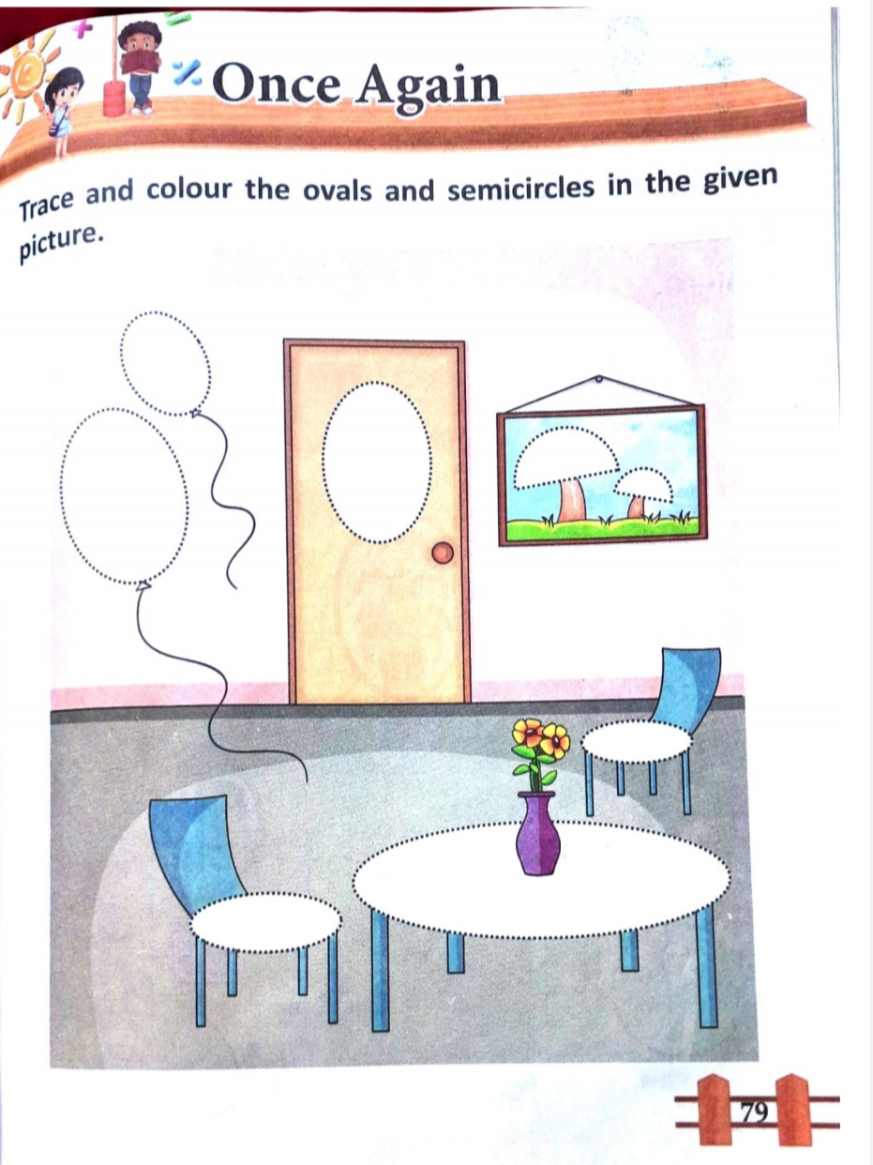
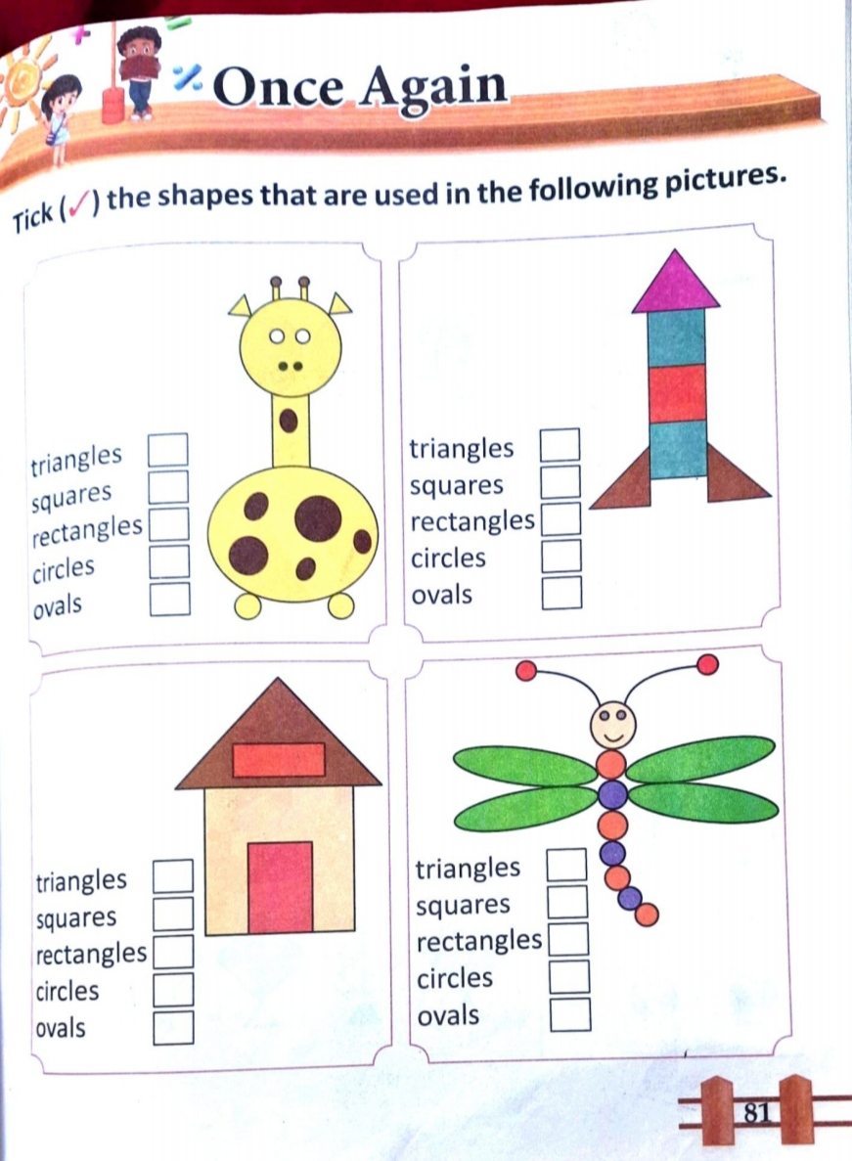
HW
25.8.21

Slide 9

THANKING YOU
ODM EDUCATIONAL GROUP

