Slide 1


CLASS : UKG
SUBJECT : MATHS
CHAPTER : “ADDITION”
TOPIC : STORY SUMS

Slide 2

LET’S DO
STORY SUMS
How many flowers are there altogether ?
+
+
4
2
2
=
4
Altogether there are ___flowers.

Slide 3
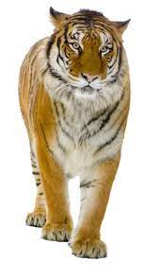
How many tigers are there altogether ?
+
4
+
3
=
7
7
Altogether there are ___tigers.

Slide 4
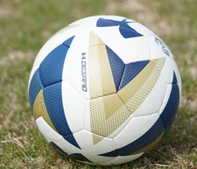
How many balls are there altogether ?
+
3
+
3
6
=
6
Altogether there are ___balls.

Slide 5
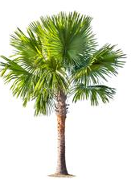
How many trees are there altogether ?
+
4
4
8
+
=
8
Altogether there are ___trees.

Slide 6
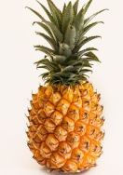

How many pineapples are there altogether ?
+
7
+
6
=
13
Altogether there are ___pineapples.
13

Slide 7
ACTIVITY FOR NOTE BOOK
Q1. Rohan buys 2 Kitkat and 3 dairy milk. How many chocolates he buys altogether ?
2
+
3
=
5
5
Altogether he buys ___ chocolates.

Slide 8
Q2. There are 5 red fish and 5 yellow fish. How many fish were there altogether ?
5
+
5
=
10
10
_______ fish were there altogether .

Slide 9
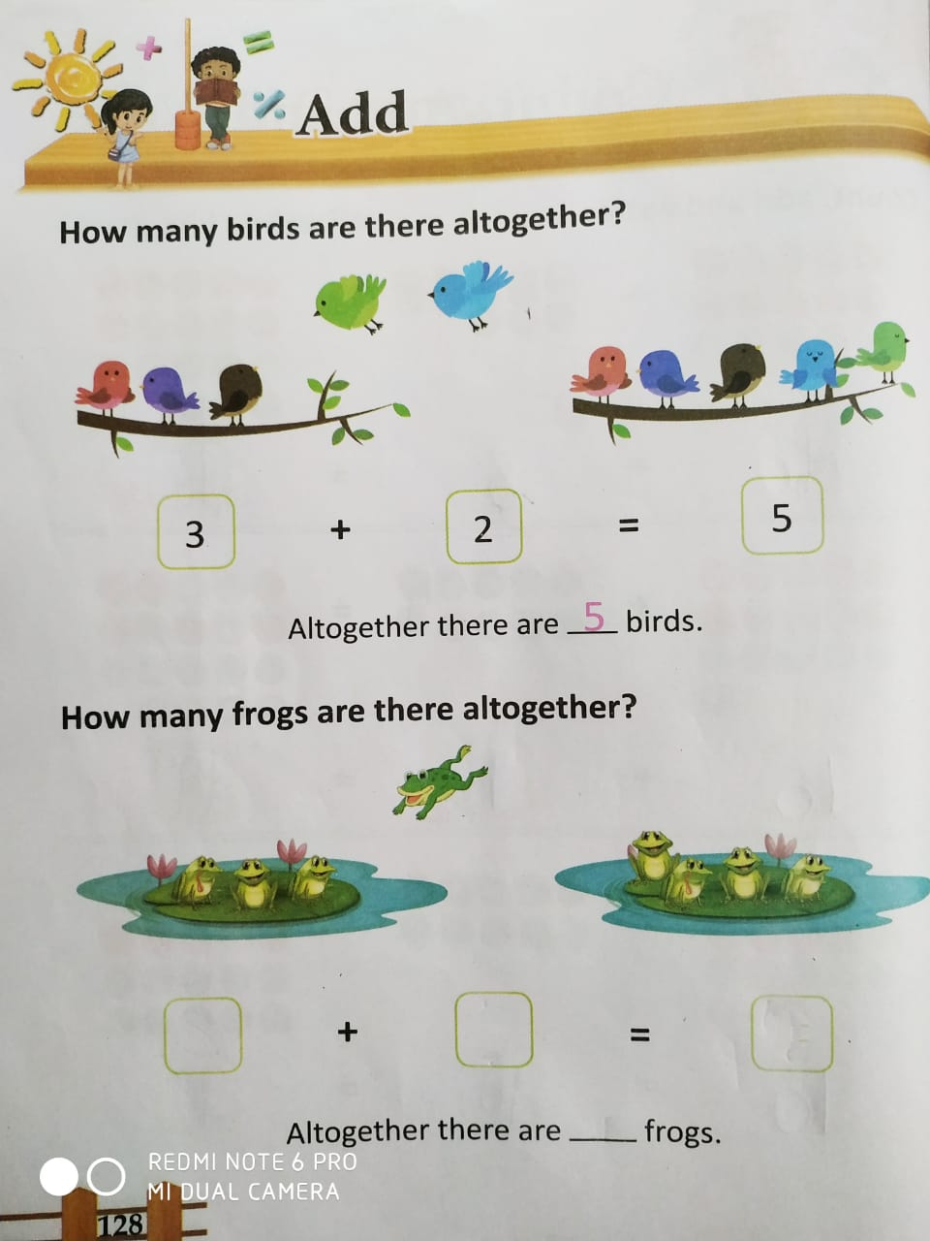
CW
23-11-2021

Slide 10
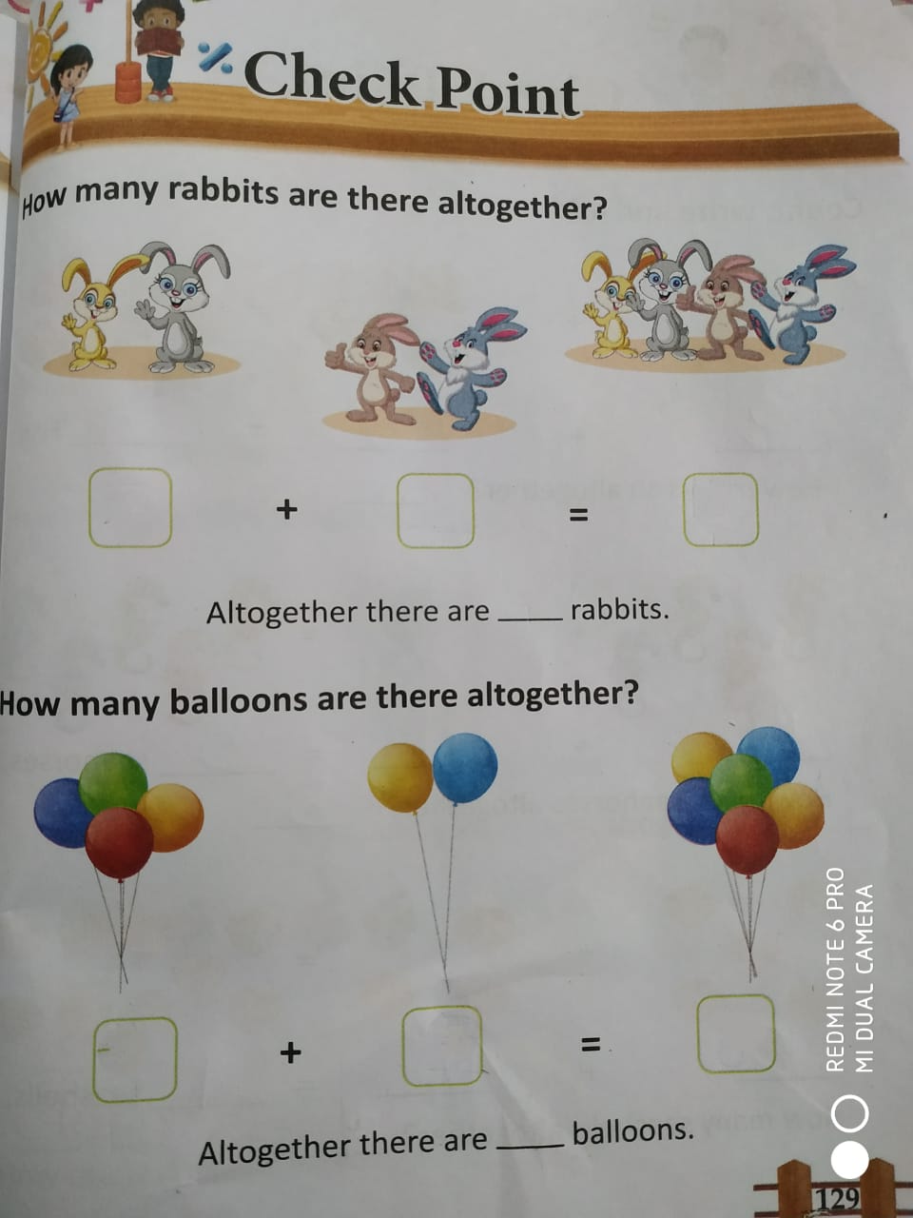
CW
23-11-2021

Slide 11
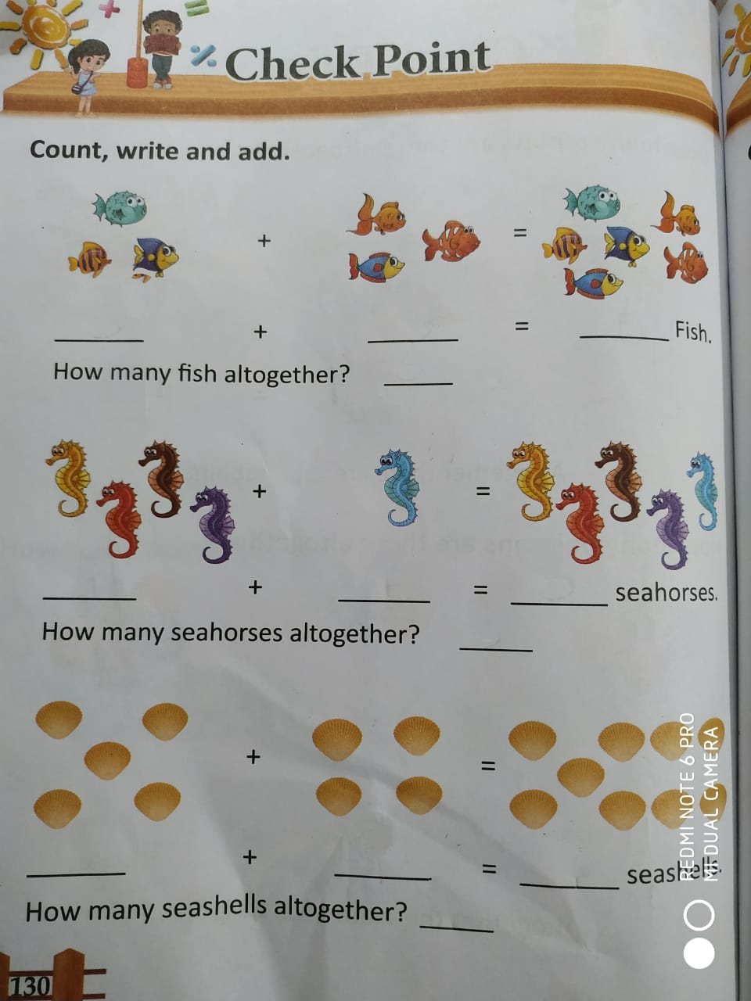
HW
23-11-2021

Slide 12
THANKING YOU
ODM EDUCATIONAL GROUP

