Slide 1

WELCOME TO THE ON LINE CLASS
CLASS-UKG
SUBJECT-MATHS
TOPIC- MAKING PAIRS &
COUNTING BY 2S

Slide 2
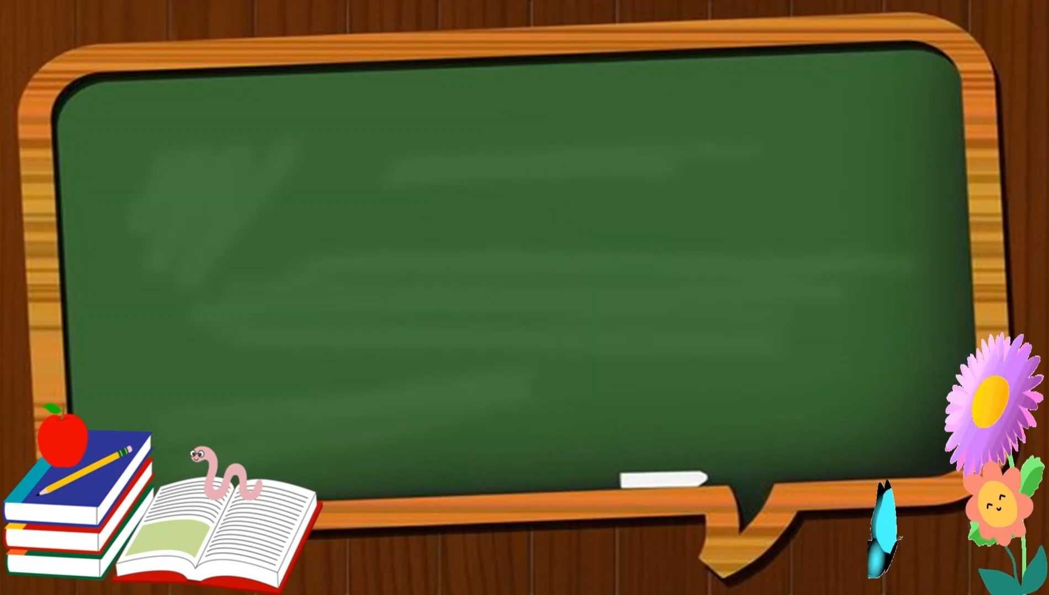

TODAY’S TOPIC
MAKING PAIRS AND COUNT BY 2S

Slide 3

Pair means a group of 2 objects.
Make pairs and circle.
6 PAIRS
HOW MANY PAIRS ?

Slide 4
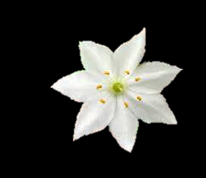

Circle the flowers in pairs.

Slide 5
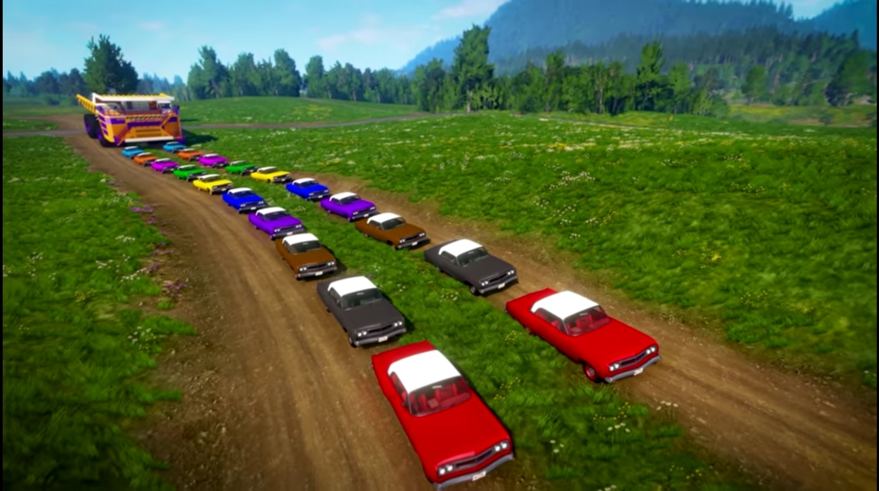
MAKE PAIRS

Slide 6
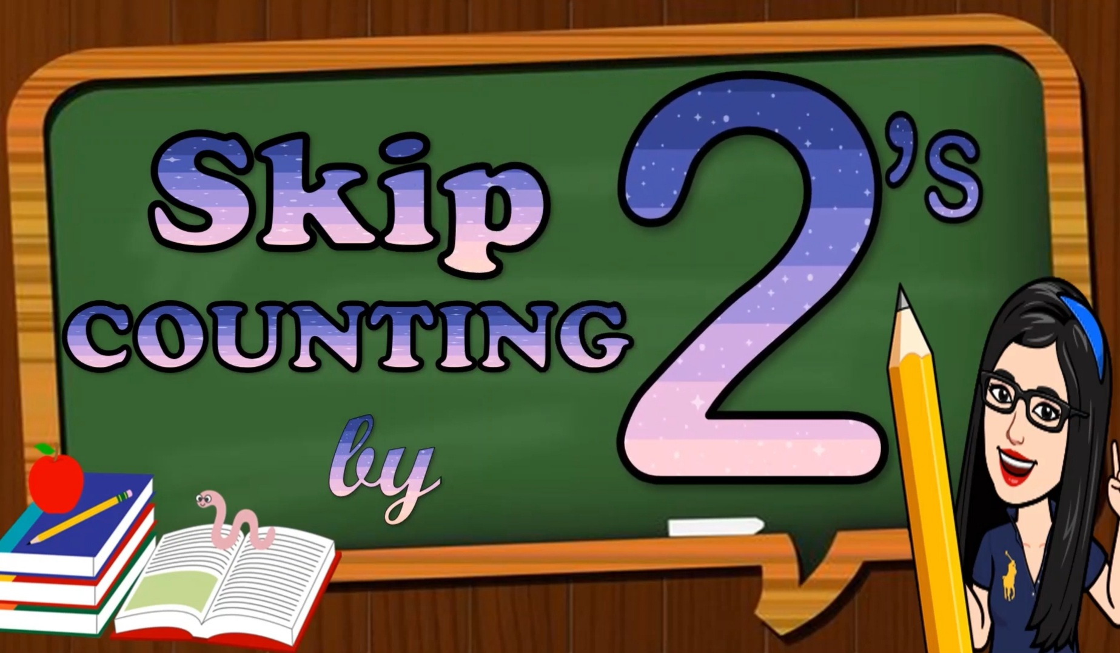

Slide 7
COUNT BY 2S is called skip counting by 2 steps.
Skip counting by 2s means jumping on every
second object.

Slide 8
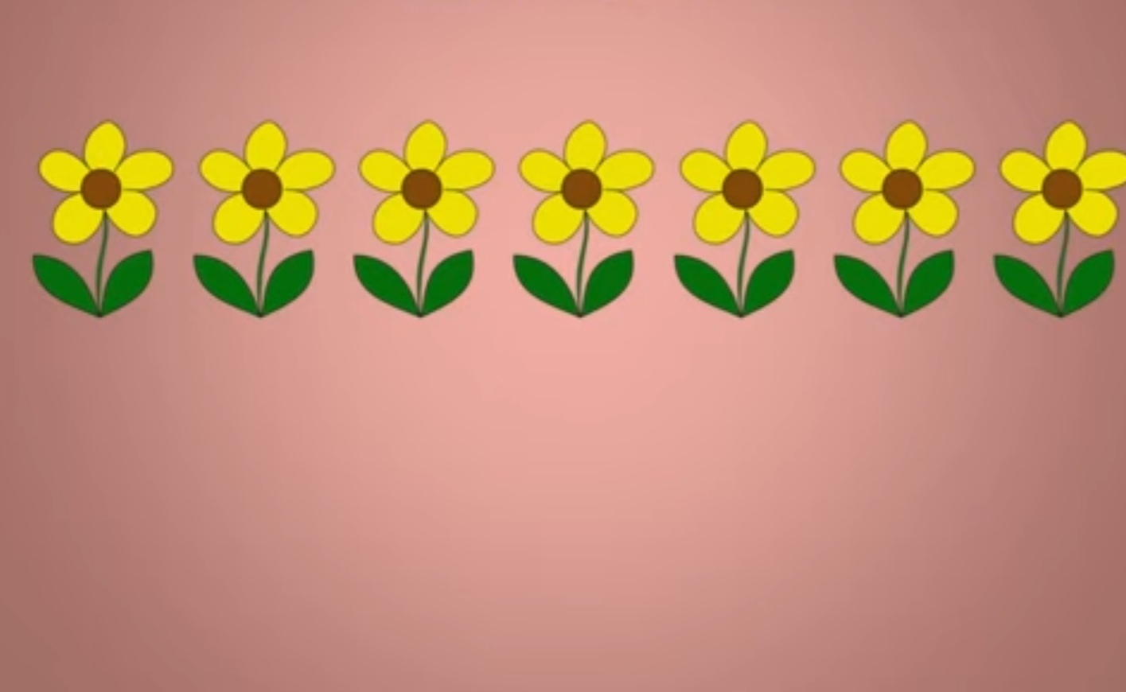

The bee will jump on every second flower by leaving/ skipping the between flower.
This is called counting in 2s or skip counting by 2s.

Slide 9
1
2
3
4
5
6
7
The bee will jump on every second flower starting from 1 by leaving the between flower.
The bee jumped on the numbers are 3, 5 & 7 by leaving the numbers 2, 4 & 6

Slide 10


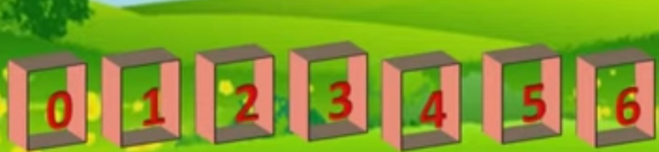
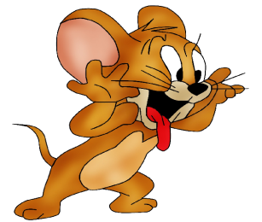
COUNTING BY 2S
The numbers jumped by Tom are 2, 4 & 6.

Slide 11
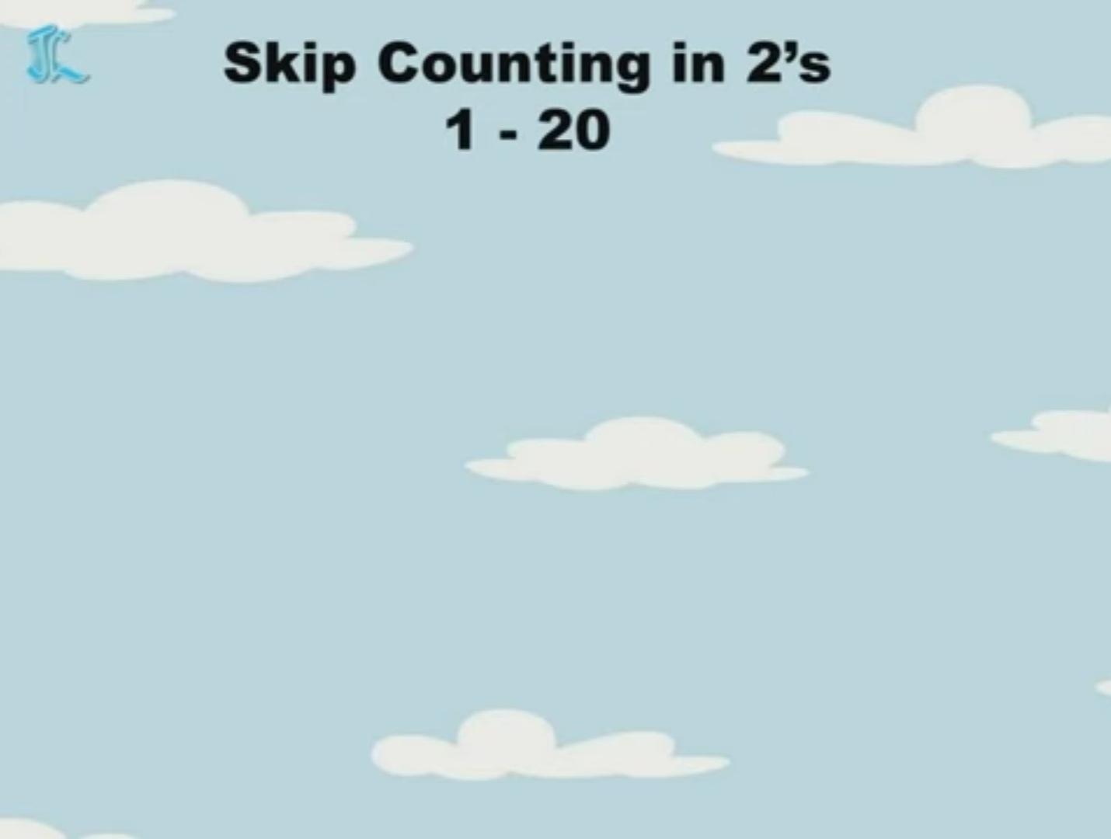
COUNTING BY 2S ( 1-15)
1
2
3
4
5
6
7
8
9
10
11
12
13
14
15
1 3 5 7 9 11 13 15

Slide 12
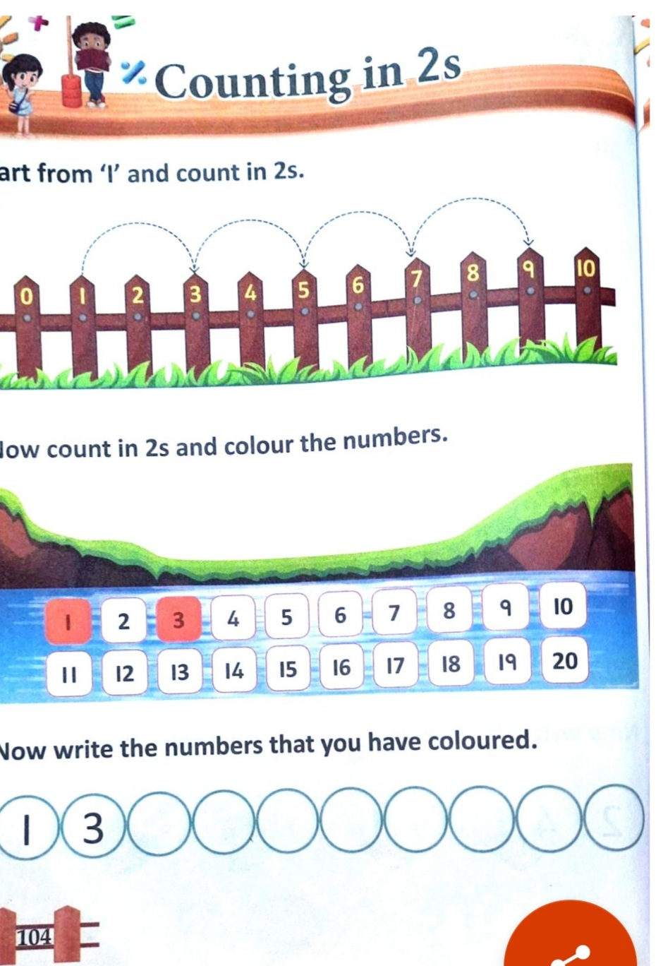
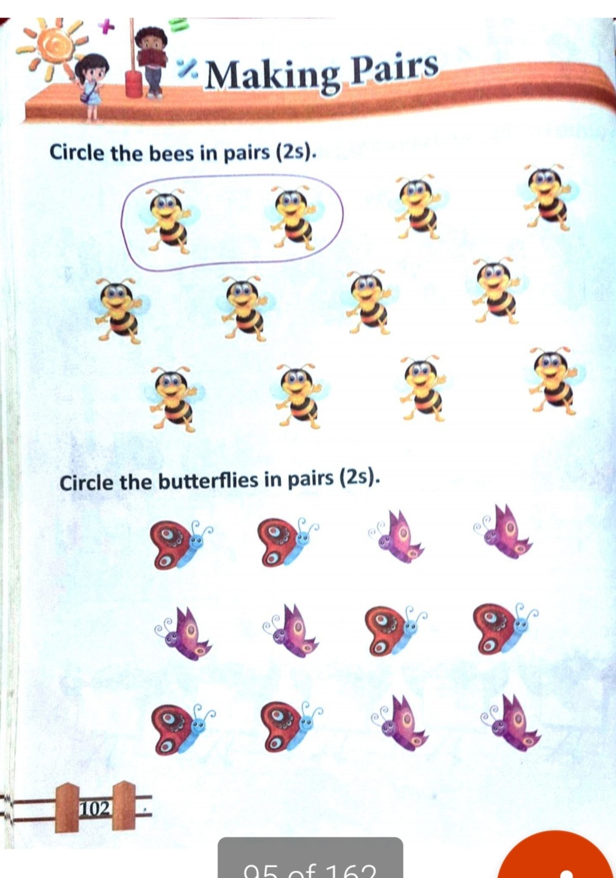
CW
8/11/21

Slide 13
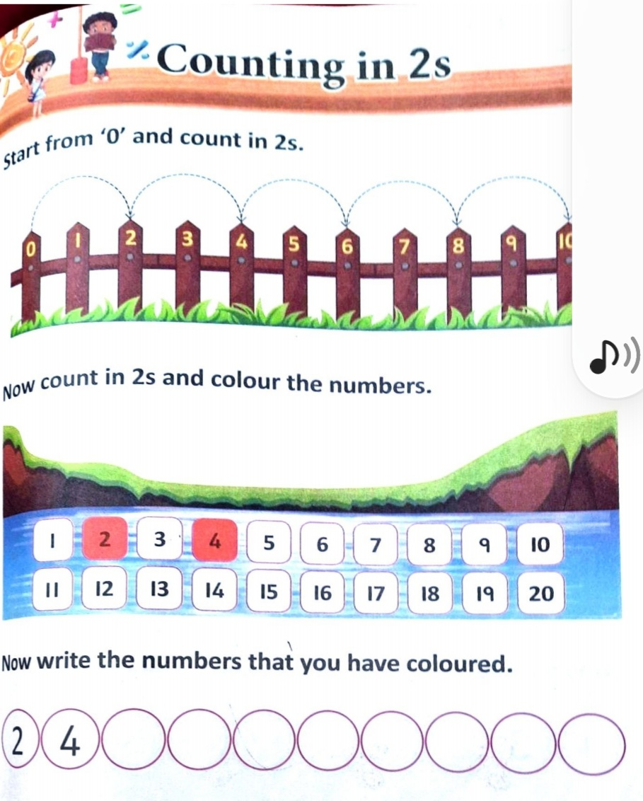
HW
8/11/21

Slide 14

THANKING YOU
ODM EDUCATIONAL GROUP

