Slide 1


CLASS : UKG
SUBJECT : MATHS
CHAPTER : 20
TOPIC : SUBTRACTION
SUB TOPIC : BK PG 135-136

Slide 2

TODAY’S TOPIC
SUBTRACTION

Slide 3

WHAT IS SUBTRACTION ?
Subtraction means TAKE AWAY a number of things from a group.
We use the symbol MINUS ( - ) for Subtraction.
KNOW ABOUT THE SYMBOLS -
SYMBOL OF SUBTRACTION
SYMBOL OF
EQUAL TO

Slide 4

SUBTRACTION
EXAMPLE - 1
✓
✓
5
There are 5 cups.
3
3 cups taken out.
2
Cups are left.

Slide 5
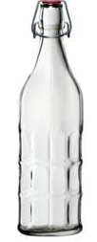
EXAMPLE -2
3
Bottles are on the table.
2
Bottles are taken out.
1
Bottle is left on the table.

Slide 6
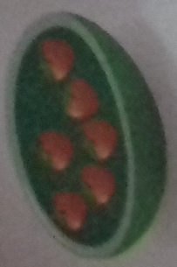

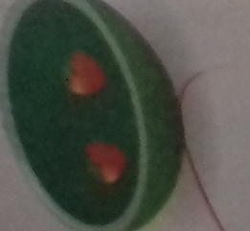
Write how many strawberries left in each set.
6
Strawberries are in the bowl.
4
Strawberries are taken out.
2
Strawberries are left in the bowl.

Slide 7
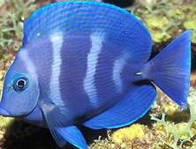
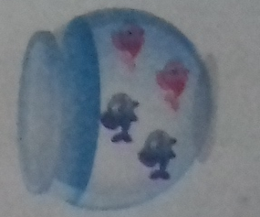
4
fish are in the fish bowl.
2
fish are transferred to other bowl.
2
fish are left in the bowl.

Slide 8
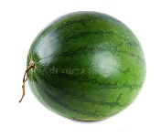
How many watermelons are left ?
8
3
=
5
5
There are ____ watermelons left .

Slide 9
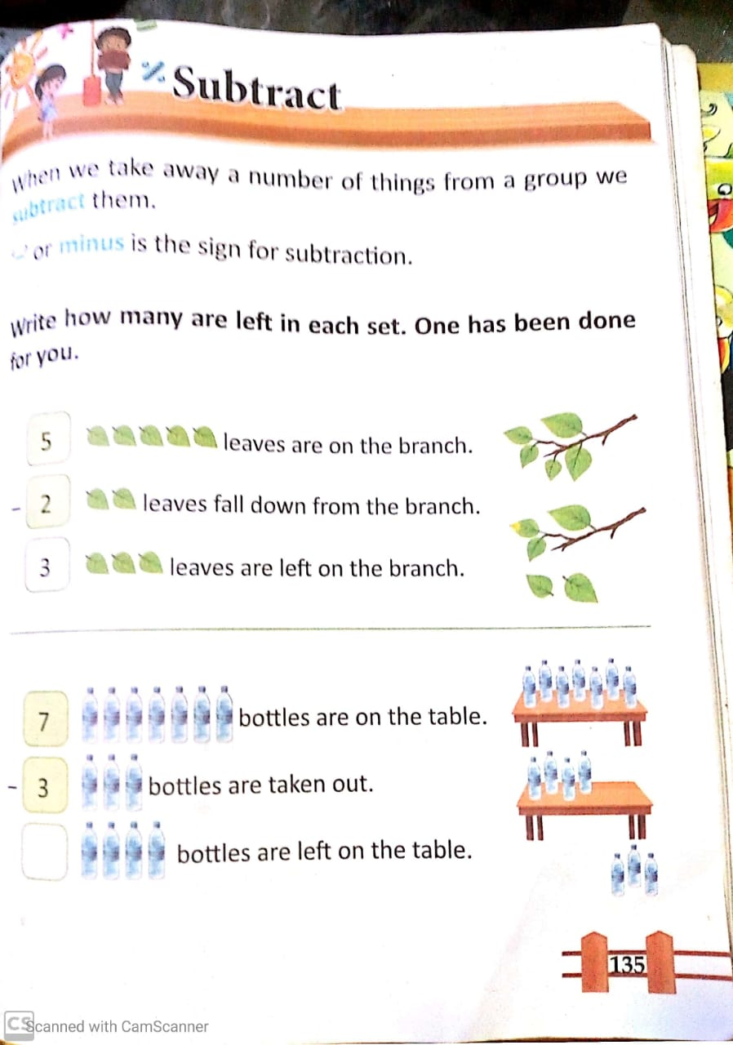
c.w
29/11/2021

Slide 10
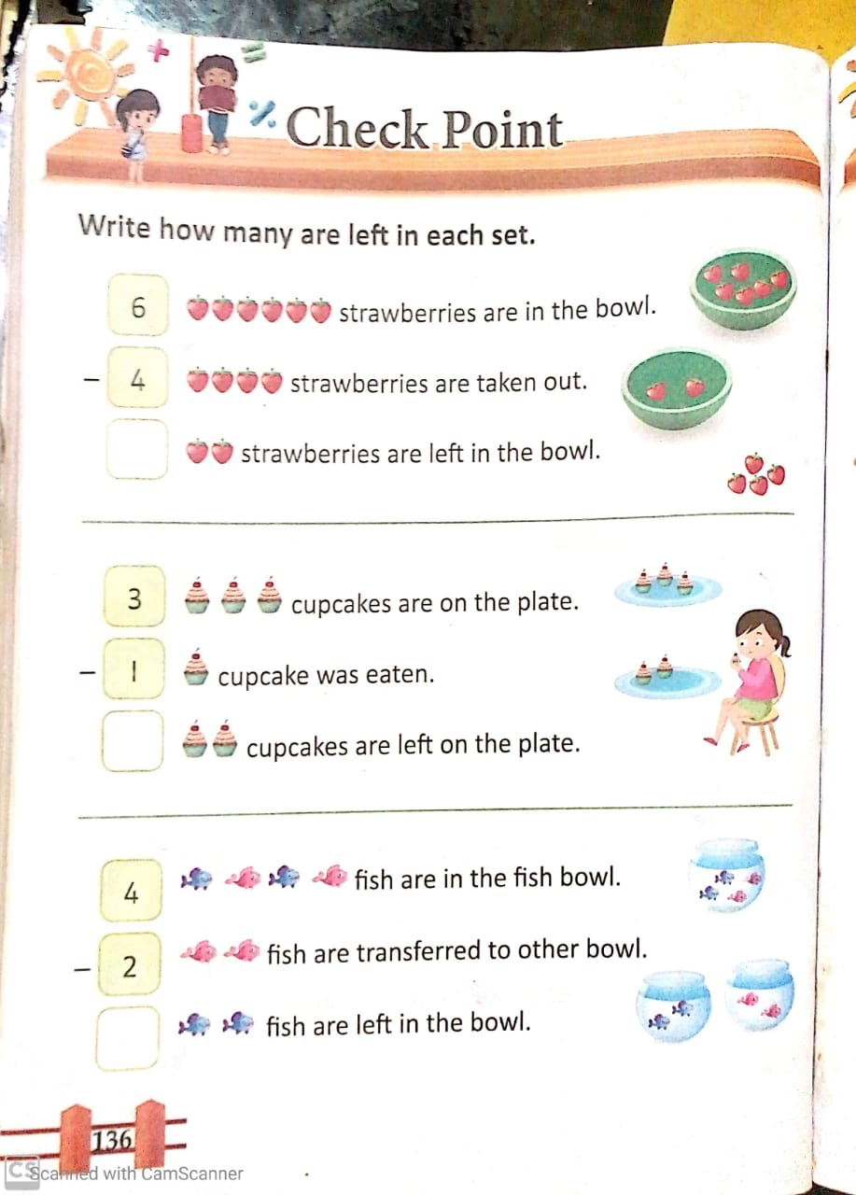
H.W
29/11/2021

Slide 11
THANKING YOU
ODM EDUCATIONAL GROUP

