Slide 1


CLASS : UKG
SUBJECT : MATHS
CHAPTER : 19
CHAPTER NAME: ADDITION
TOPIC : DRAW & ADD, VERTICAL ADDITION

Slide 2


TODAY’S TOPIC
ADDITION
ADDITION MEANS ANYTHING “JOIN TOGETHER OR PUTTING TOGETHER.”
SYMBOL OF ADDITION IS “+”.

Slide 3
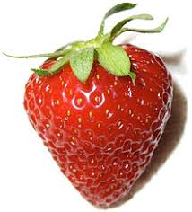
COUNT AND ADD
3 + 2 = ___
5

Slide 4
DRAW, ADD AND SAY
6
+
2
=
8
7
+
2
=
9

Slide 5


COUNT AND ADD
3
3
+
2
+
5
5
8

Slide 6
DRAW, ADD AND WRITE
C.W
17.11.21
5
+
4
=
6
+
2
=

Slide 7

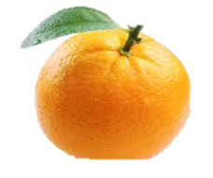
COUNT AND ADD
H.W
17.11.21
3
4
4
+
5
+

Slide 8


COUNT AND ADD
H.W
17.11.21
5
5
+
2
+
5

Slide 9
THANKING YOU
ODM EDUCATIONAL GROUP

