Slide 1

WELCOME TO ON LINE CLASS
CLASS-UKG
SUBJECT-MATHS
TOPIC-EQUAL TO,GREATER THAN
& LESS THAN

Slide 2


Equal to
=
2
2
IS EQUAL TO

Slide 3
Greater Than
>
6
IS GREATER THAN
4

Slide 4
Less Than
<
4
7
IS LESS THAN

Slide 5






Count the objects from the given sets-
1
4
2
4
2
1
3
3
1
2
3
1
4
2
3
4
When 2 groups are same number of objects, the coco closes his mouth.

Slide 6










Slide 7




Slide 8
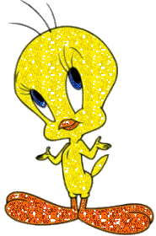
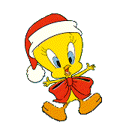
NOW COUNT AND OBSERVE....

Slide 9


We use '>' sign for greater than (more number) and '<' for less than(less number).
6 > 5
5 < 6

Slide 10
7 is greater than 5
7 > 5
5 is greater than 2
5 > 2
6 is greater than 4
6 > 4
4 is greater than 3
4 > 3
and
5 is less than 7
5 < 7
2 is less than 5
2 < 5
4 is less than 6
4 < 6
3 is less than 4
3 < 4
and
and
and

Slide 11

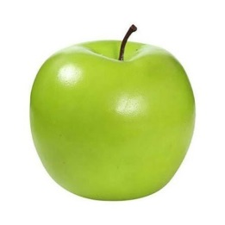


CW
12.8.21
COUNT , WRITE AND PUT THE SIGN (<, > OR = )

Slide 12

THANKING YOU
ODM EDUCATIONAL GROUP

