Slide 1

WELCOME TO ONLINE CLASS
CLASS-UKG
SUBJECT-MATHS
TOPIC-BIGGEST NUMBER
BIG TO SMALL
(BKPG-97-99)

Slide 2


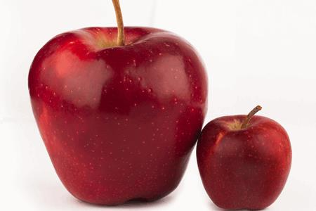


Slide 3
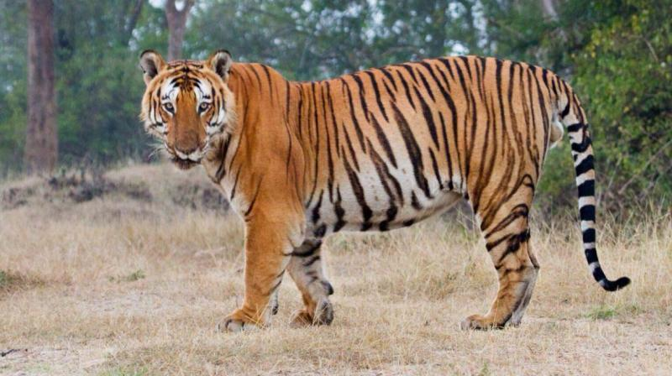
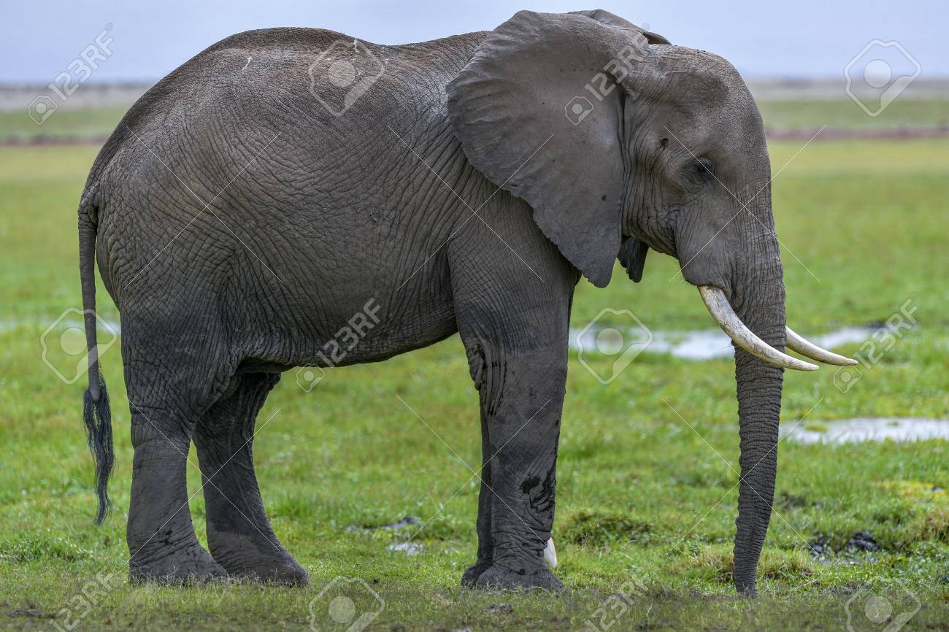
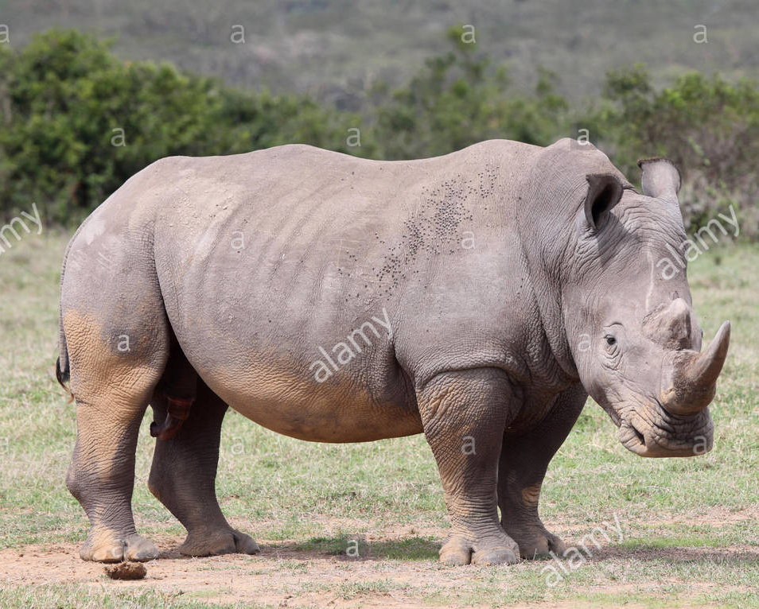
big
bigger
biggest

Slide 4
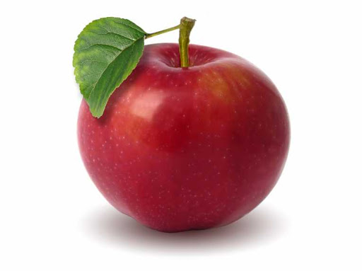

Arrange the apples big to small-
A
C
B
A
B
C

Slide 5
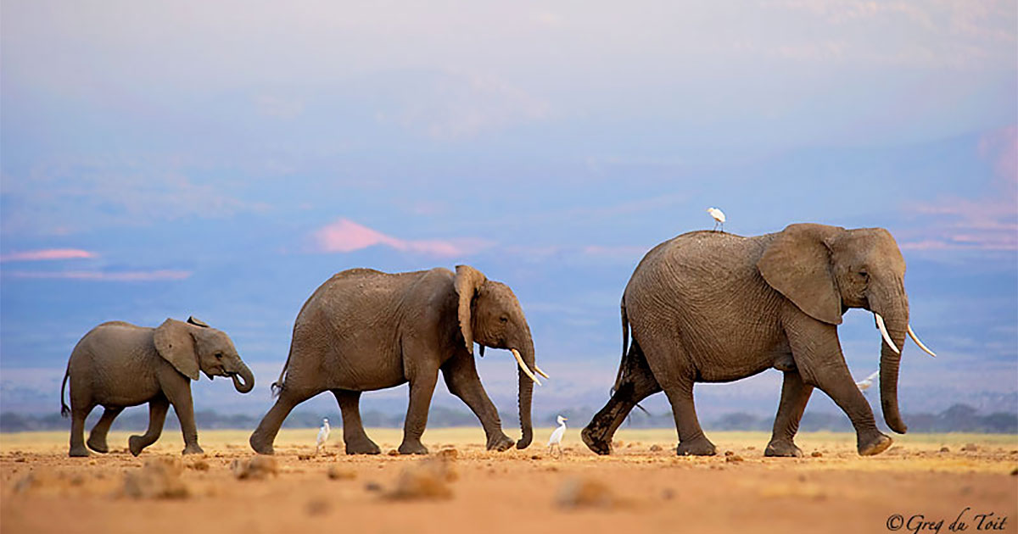

58
48
26
Read the numbers and say the biggest number-
58

Slide 6
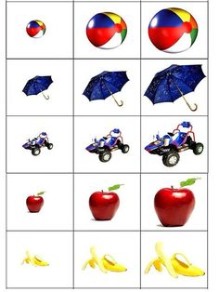
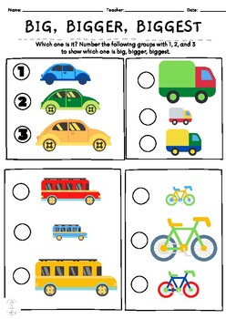
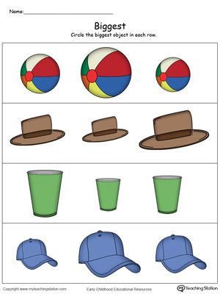
Identify & say the biggest one from
the given sets -
Activity
15.9.21
c
A B C
A B C
1
B
c
A B C

Slide 7
Say the biggest number-
45 67 86
86
76 35 60
76
55 84 97
97

Slide 8
Arrange the numbers from big to small-
58 61 60 59
61
60
59
58
94 92 93 95
95
94
93
92

Slide 9


Slide 10
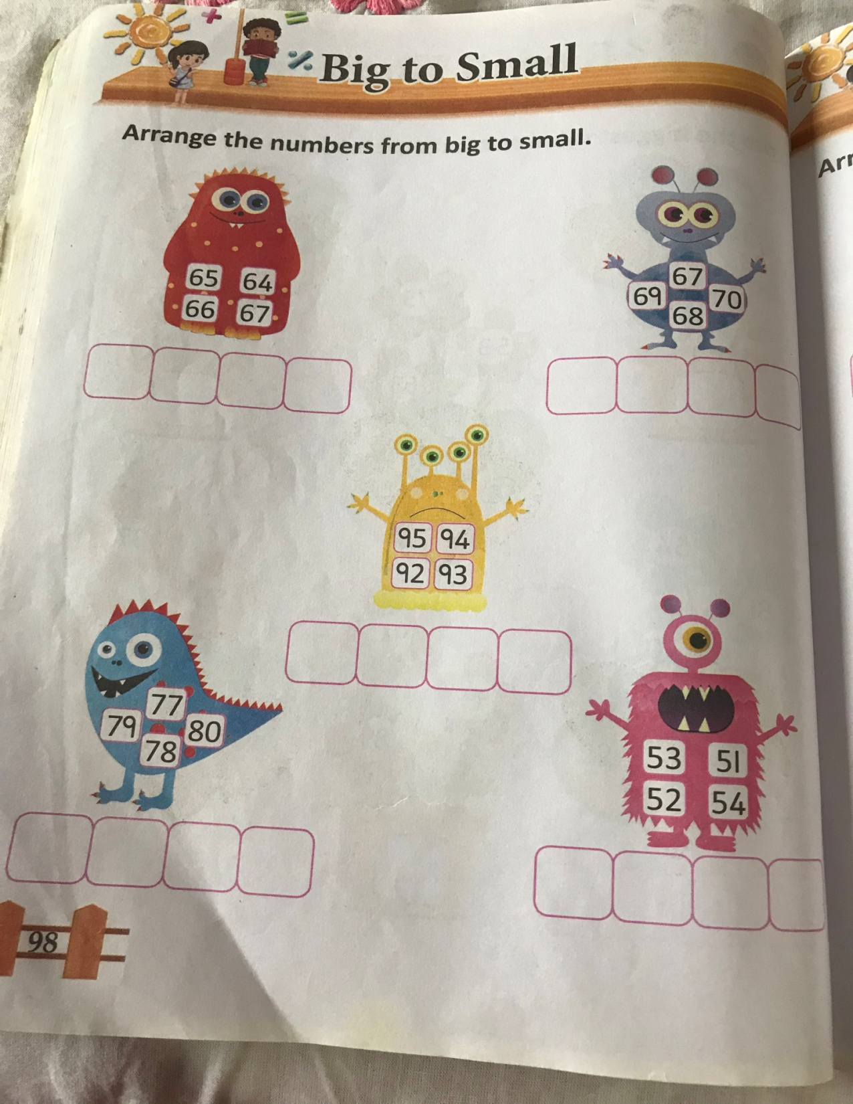
C.W
15.9.21

Slide 11
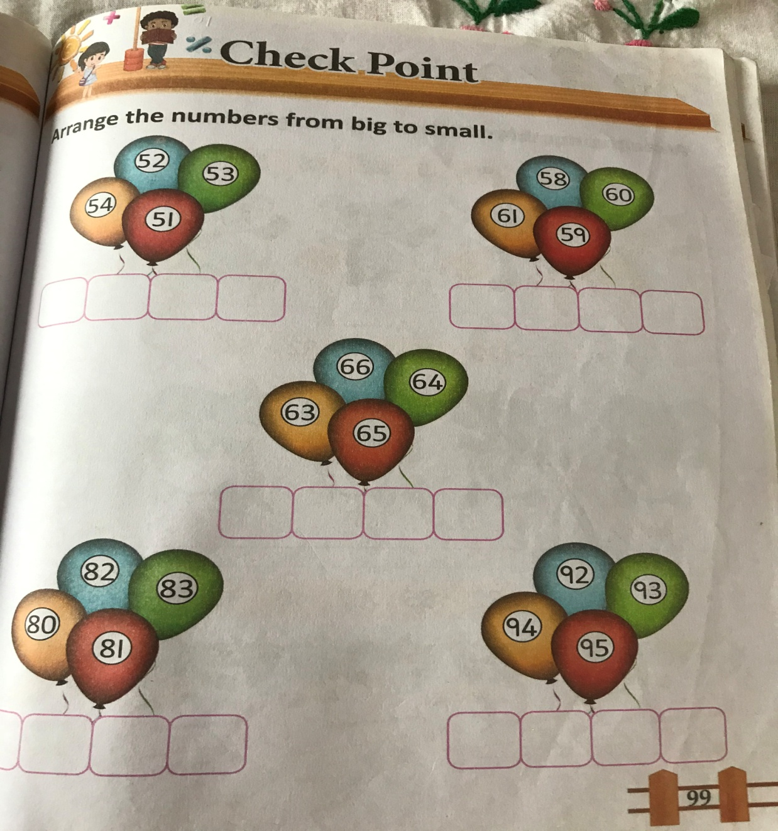
H.W
15.9.21

Slide 12
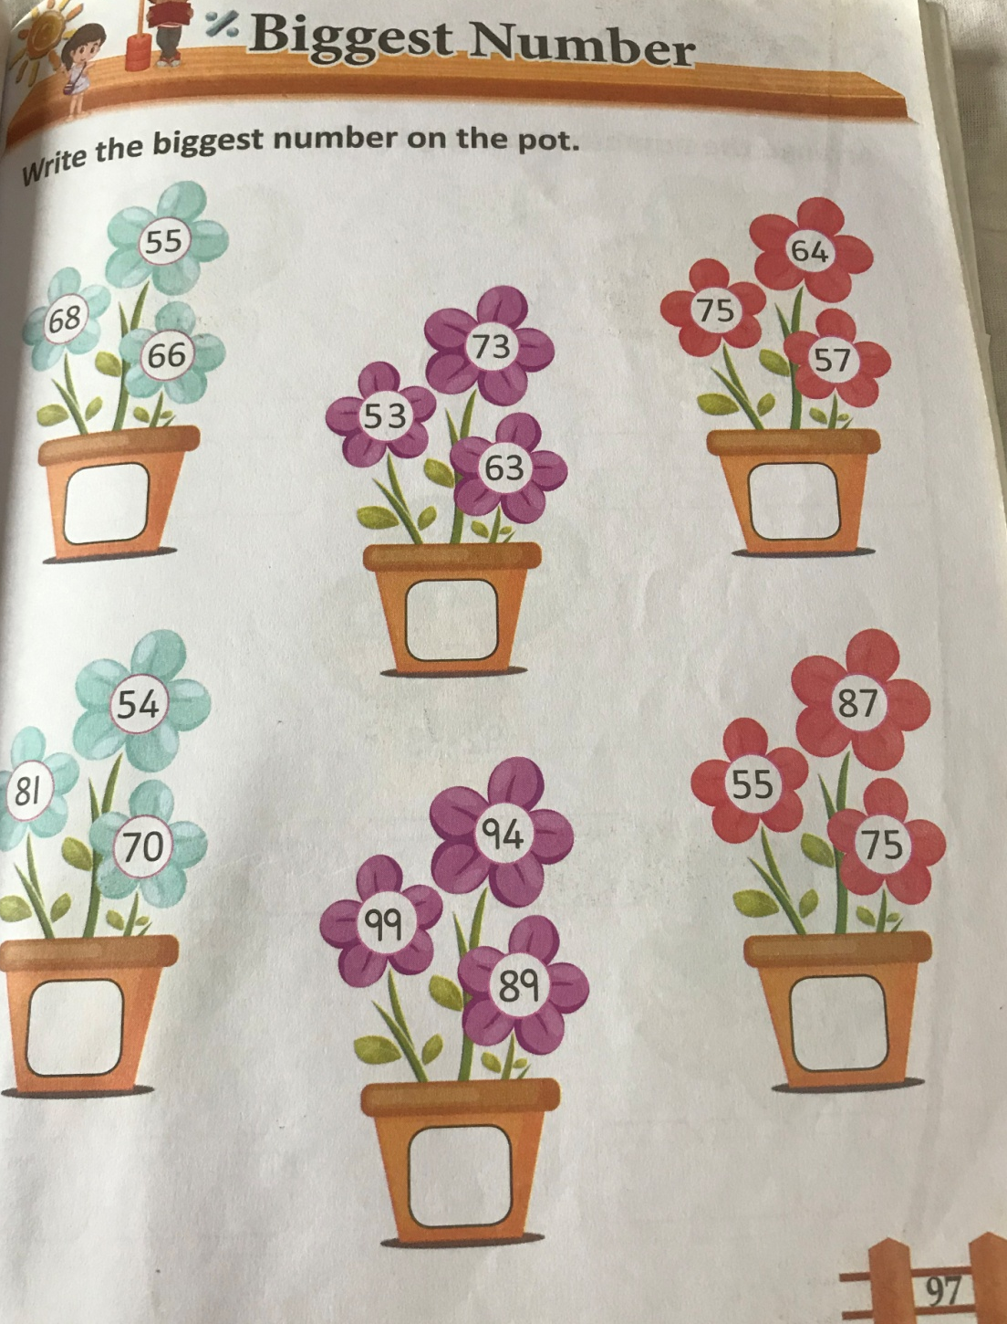
H.W
15.9.21

Slide 13

THANKING YOU
ODM EDUCATIONAL GROUP

