Slide 1

WELCOME TO ON LINE CLASS
CLASS-UKG
SUBJECT-MATHS
TOPIC-BACKWARD NUMBERS
(BKPG-92 & 93)

Slide 2
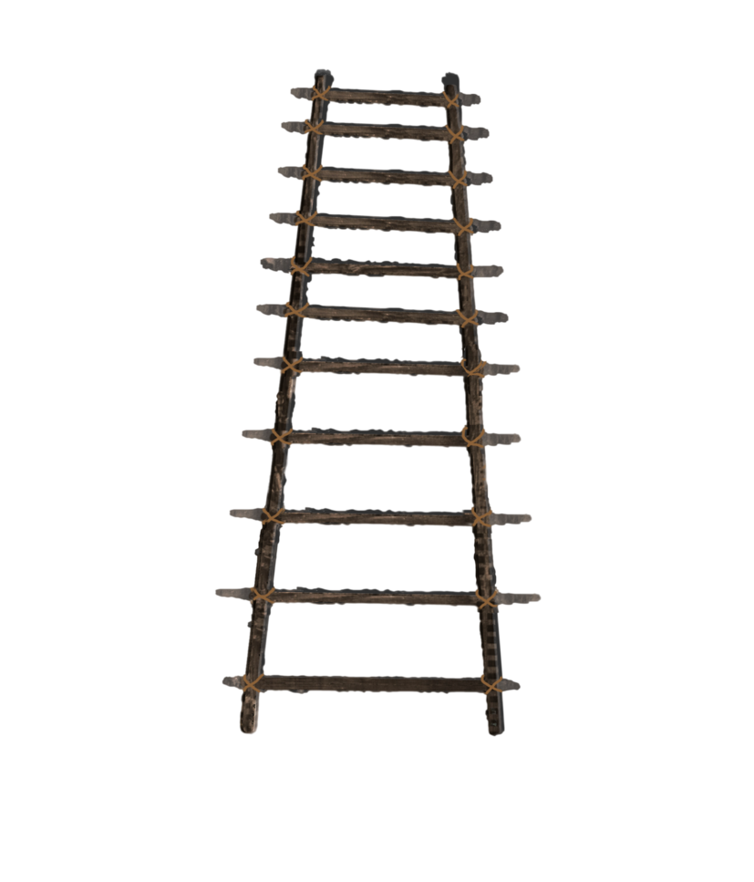
Count backward and say-
40
39
38
37
36
35
34
33
32
31

Slide 3

Count the numbers from 50-41
46
47
48
45
49
44
50
43
42
41

Slide 4
Count and say the missing
backward numbers-
35
34
33
32
31
30
29

Slide 5
See the number and say the
backward numbers-
46
47
48
49
50
36
37
38
39
40

Slide 6
50
40
45
39
49
39
44
38
48
38
43
37
47
37
42
36
46
36
41
35
45
35
40

Slide 7
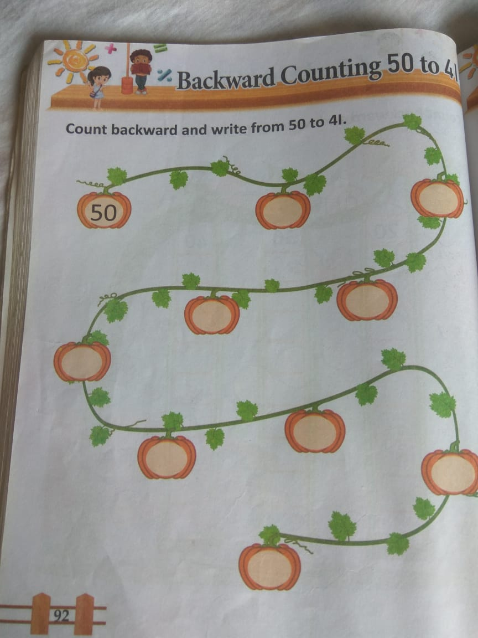
HW
8.9.21

Slide 8
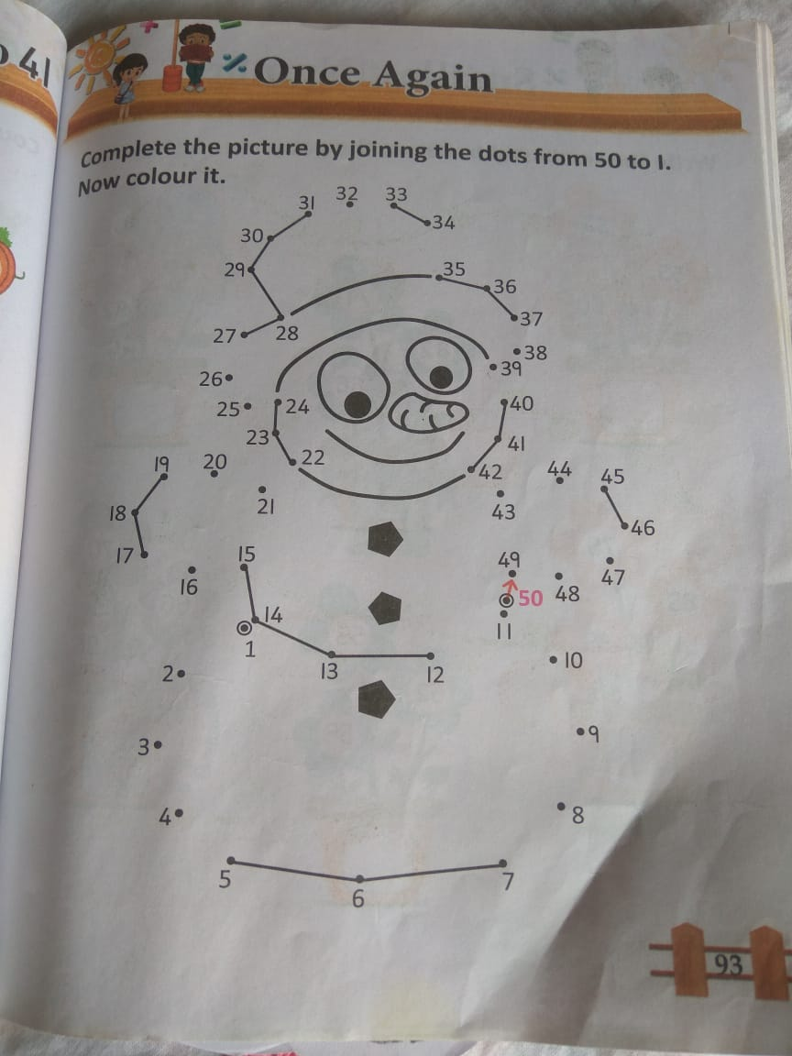
HW
8.9.21

Slide 9

THANKING YOU
ODM EDUCATIONAL GROUP

