Slide 1

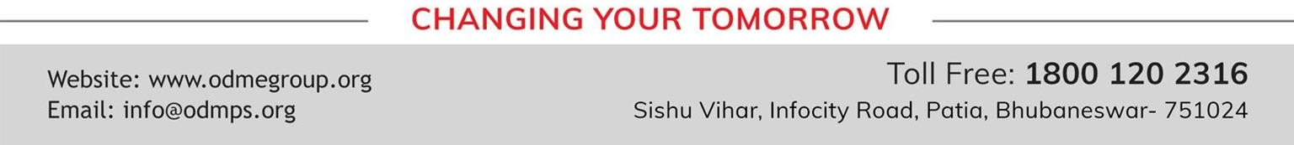
BEEHIVE
REACH FOR THE TOP-2
SUBJECT : (SUBJECT NAME) ENGLISH
CHAPTER NUMBER: 08
CHAPTER NAME : MARIA SHARAPOVA

Slide 2
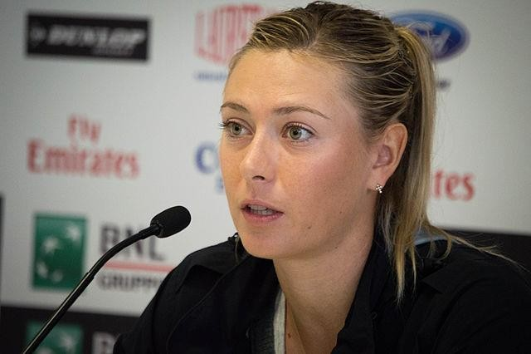
BIOSKETCH:
MARIA SHARAPOVA :
FULL NAME: Maria Yuryevna Sharapova.
Nationality: Russian
Birth: 19 April 1987 at Nyagan, Russia
Height: 1.88 m
Wimbledon: 2004
French Open: 2012, 2014
Playing preference: Right-handed( two-handed backhand)
Retired: 26 February 2020
Olympic medallist: silver medal in women’s singles at 2012 Summer
Olympics in London.
She has lived in and been a United States permanent resident
since 1994.

Slide 3
SUMMARY:
This write up about Maria Sharapova inspires us to remain determined and make sacrifices in order to fulfill our dreams. On 22nd August 2005, Maria became the top-seeded player in the world women’s tennis player rankings. She made great sacrifices to achieve her goal.
At the tender age of nine, she left her home in Siberia, Russia to get training in tennis. She went to Florida in USA with her father. Maria suffered a painful separation from her mother for a period of two years. She could not see her father too as he remained busy working, arranging funds for all her needs. She was bullied by her seniors and
being a foreigner, she had to suffer all that patiently. Maria did not feel depressed, rather she was prepared for greater insults too in order to achieve her aim.
Her mantra for success is to work hard and face the toughest competition . Although she was trained in the US, she considers herself to be a russian and is willing to represent Russia at the Olympics too.
Her favourite hobbies are fashion, singing and dancing. She loves reading novels written by Arthur Conan
Doyle. Her love for fashionable evening gowns is in contrast to her liking for pancakes with chocolate spread and
orange flavoured aerated drinks. The monetary gains and the fame incurred by Maria are well deserved.

Slide 4
STORY HIGHLIGHTS:
The humble beginning: she was born in the frozen plains of siberia.
Parents’ approach: her father worked hard to arrange funds for her training .
Will power and strong desire to succeed: “When you come from nothing and you have nothing, then it makes you
very hungry and determined.”
Evidence of mental toughness: “ Instead of letting that depress me, I became more quietly determined and mentally tough. I learnt how to take care of myself. “
Patriotism: Though Maria Sharapova speaks with a pronounced American accent, she proudly parades her Russian
nationality.

Slide 5
VOCABULARY:
Disarming: likable
At odds with : in conflict with
Poised : calm,elegant
Pinnacle: the most successful point
Ascent: growth
Endure:suffer patiently
Heart-wrenching: extremely sad
Depress: sadden
Pursue: follow
Meteoric:very rapid
Amply:plentiful in amount
Parades:displays
Pigeon-holed:categorized
Unwavering:steady,firm
Grudge:oppose, hold something against someone.

Slide 6
THANKING YOU
ODM EDUCATIONAL GROUP

