Slide 1



CLASS : NURSERY
DATE :28/07/21
SUBJECT-STORY
CHAPTER NUMBER-2
SUB-TOPIC : THE LION
AND
THE MOUSE
(sequencing)

Slide 2
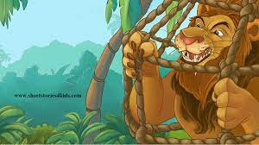
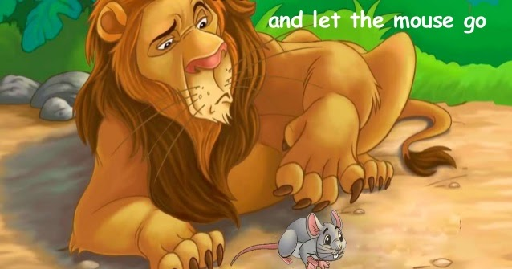

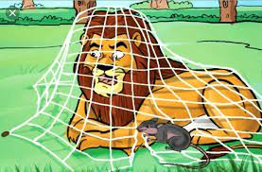
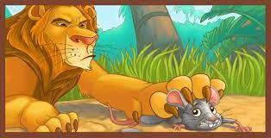
1
2
3
4
5

Slide 3
1
2
5
3
4

Slide 4
THANKING YOU
ODM EDUCATIONAL GROUP
THANKING YOU
ODM EDUCATIONAL GROUP

