Slide 1



CLASS : NURSERY
DATE :15/09/21
SUBJECT-STORY
SUB-TOPIC : THE LION
AND
THE MOUSE
(Stringing of story)

Slide 2
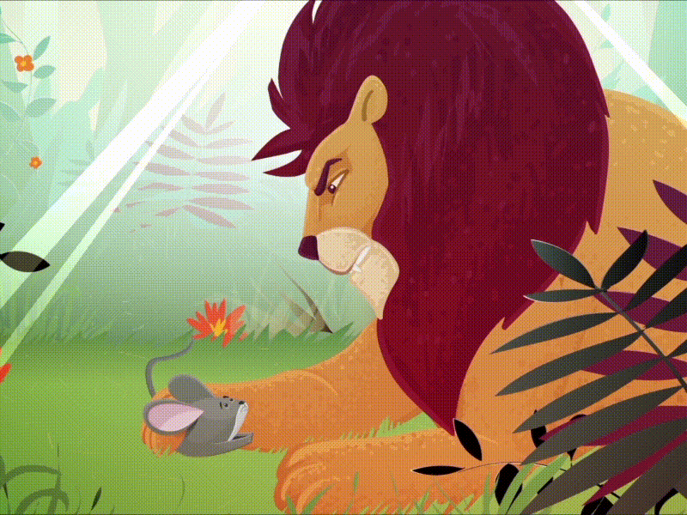

Story :The Lion and The Mouse

Slide 3
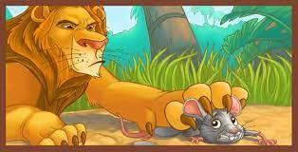
Once a lion…………..
Once a lion caught a mouse.

Slide 4
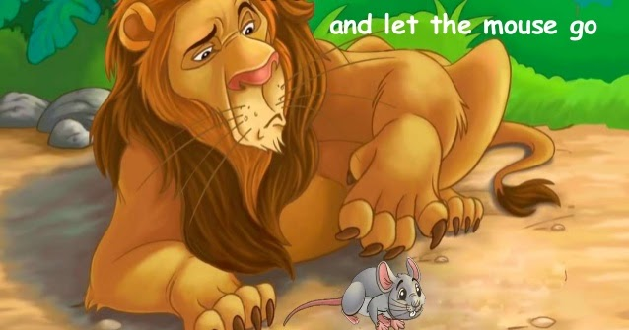
The mouse said…………
The mouse said "please don’t eat me. I will do you a favor”
So the lion let him go.

Slide 5
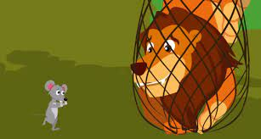
One day the lion……...
One day the lion got caught in a hunter’s net.
The mouse saw it.

Slide 6
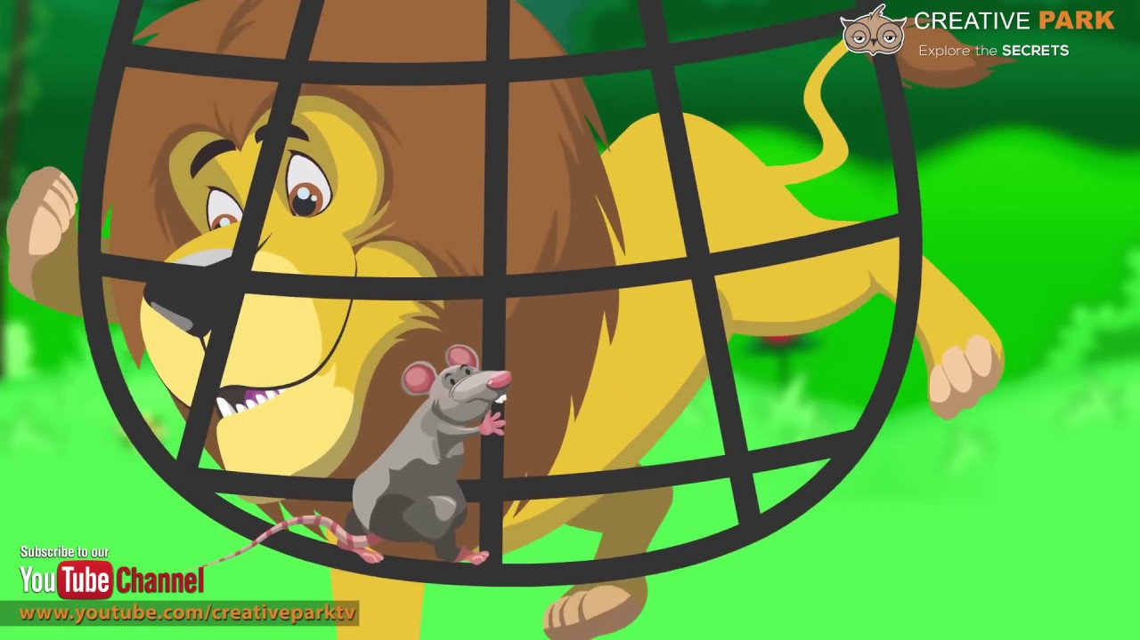
It came along ……
And let …..
It came along the net and chewed the ropes.
And let the lion loose.

Slide 7

HOME ASSIGNMENT
15.09.21
Learn the story with correct pronunciation and action

