Slide 1



CLASS : NURSERY
DATE :13/09/21
SUBJECT-STORY
CHAPTER NUMBER-2
SUB-TOPIC : THE LION
AND
THE MOUSE
(Revision)

Slide 2

Who is the king of jungle?

Slide 3
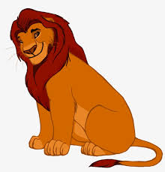

LION

Slide 4
Which animal can cut all your clothes in few minutes?

Slide 5
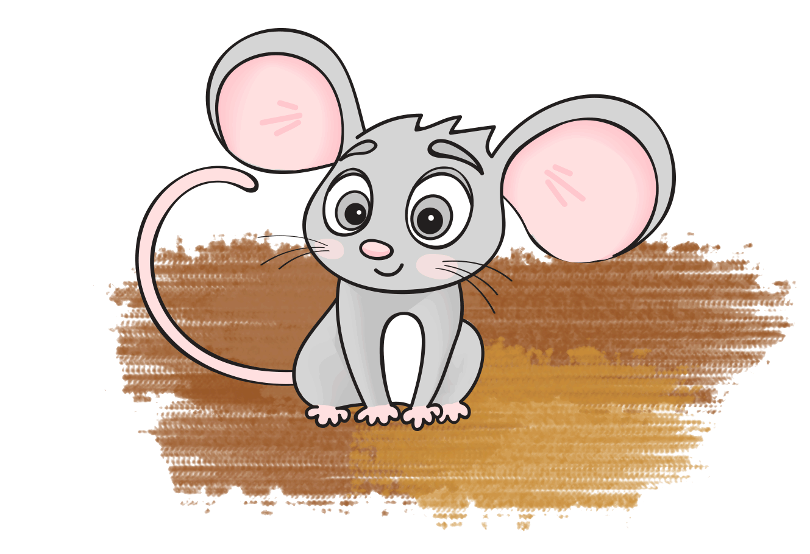
MOUSE

Slide 6
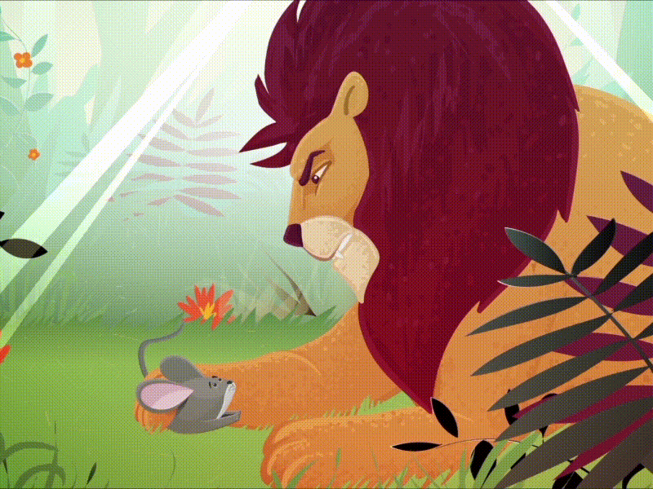
Story :The Lion and The Mouse

Slide 7
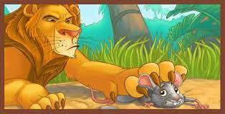
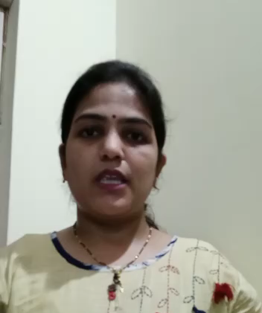
Once a lion caught a mouse.

Slide 8
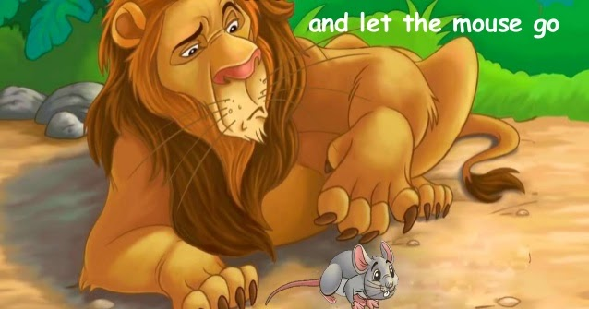
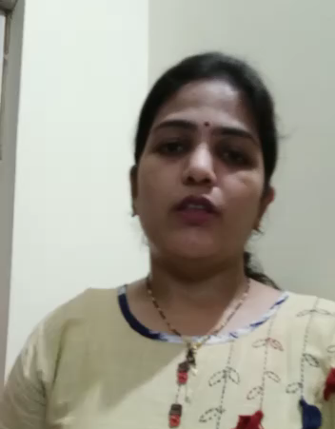
The mouse said "please don’t eat me. I will do you a favor”
So the lion let him go.

Slide 9
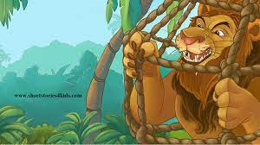
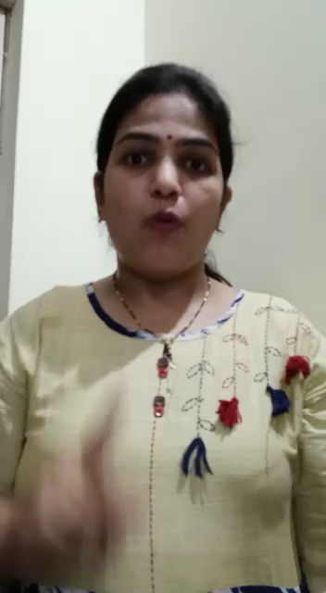
One day the lion got caught in a hunter’s net.
The mouse saw it.

Slide 10
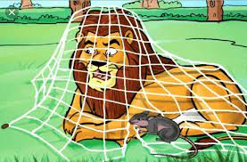
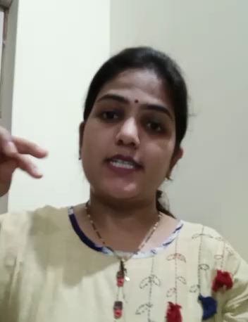
and the lion was free
It came along the net and chewed the ropes.
And let the lion loose.

Slide 11
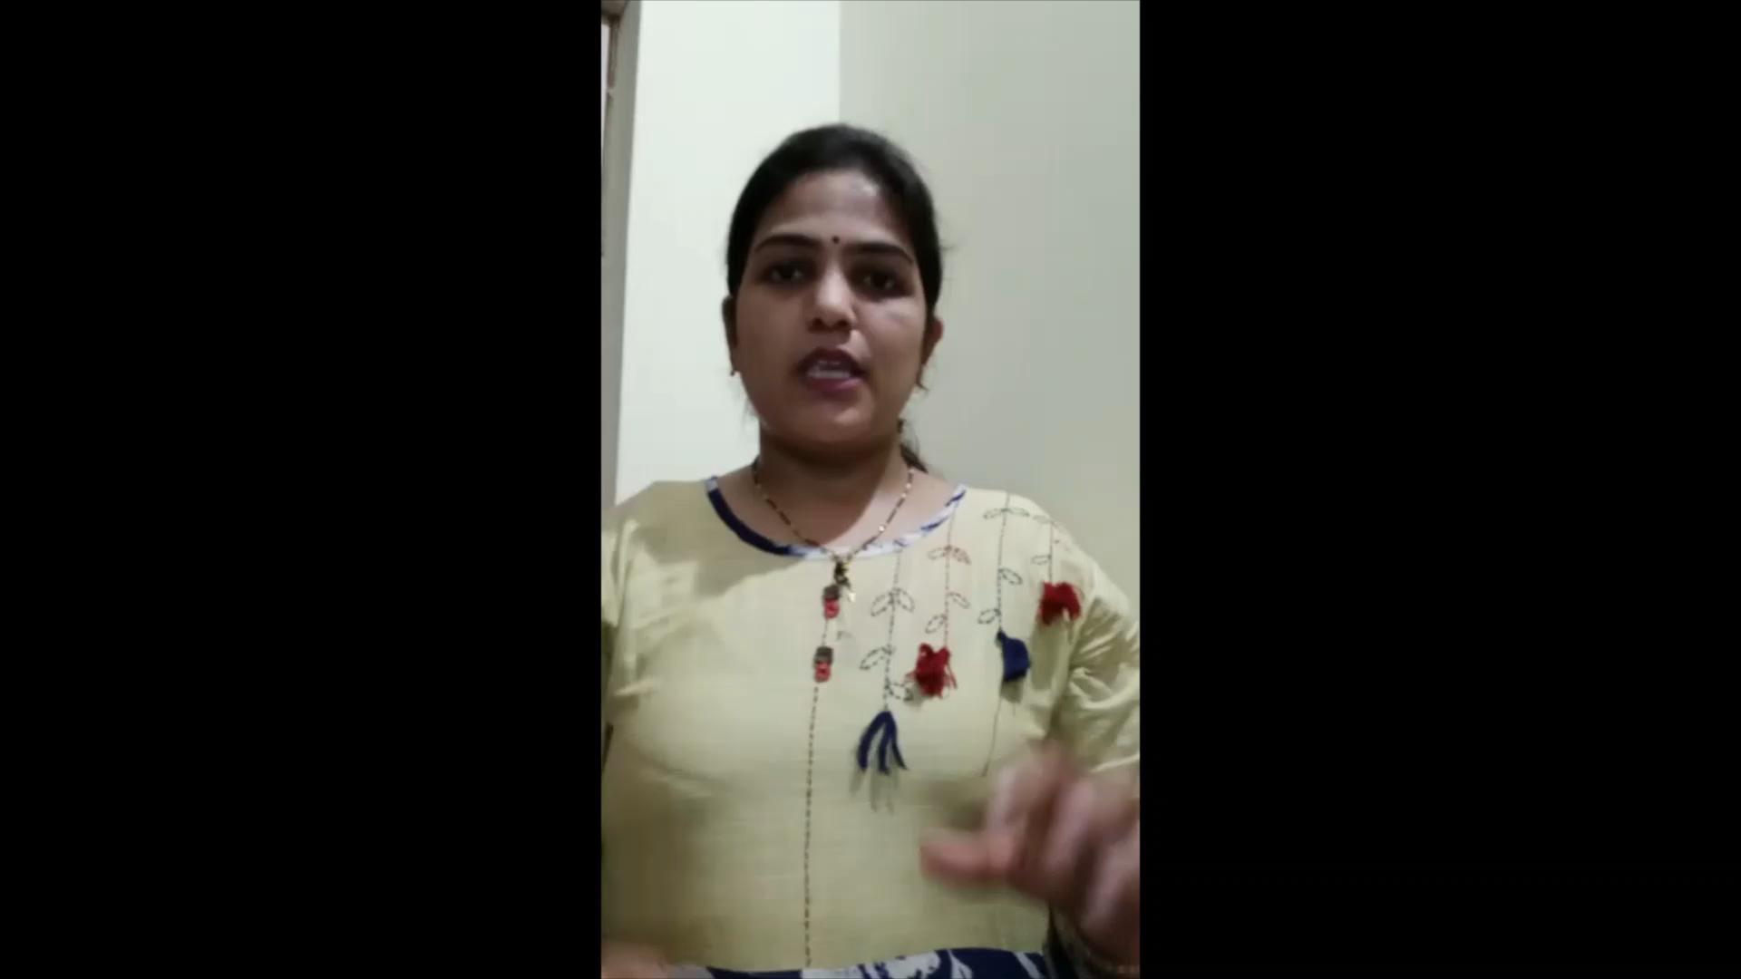

Slide 12
THANKING YOU
ODM EDUCATIONAL GROUP
THANKING YOU
ODM EDUCATIONAL GROUP

