Slide 1


THE LABURNUN TOP
TED HUGHES
SUBJECT : ENGLISH
CHAPTER NUMBER: 2
CHAPTER NAME : THE LABURNUN TOP

Slide 2
LEARNING OUTCOMES

Slide 3
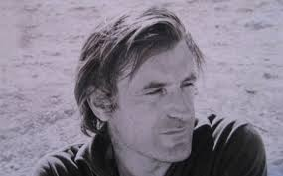
ABOUT THE POET
Ted Hughes was born in Mytholmroyd, in the West Riding district of Yorkshire, England on August 17,1930.
Ted Hughes was an English poet and Children’s writer.
Hughes graduated from Cambridge in 1954.
Married to an American Poet Sylvia Plath in 1956.
He won many literary honours and was appointed as a Poet Laureate of England in 1984.
Died in October 28,1998, England from cancer.

Slide 4
VIDEO LINKS
https://www.youtube.com/watch?v=AhQrf8sXPWs
https://www.youtube.com/watch?v=Mzv12-pmi0s
Goldfinch Feeding Babies In The Nest, (Hatching To Leaving).

Slide 5
THEME OF THE POEM
Symbol of life and its fluctuations.
Goldfinch transforms the tree and makes it come alive as the chicks of the goldfinch start to rustle and chirup on seeing her.
Once the bird leaves the tree it becomes quite and still again.
The poem symbolizes the pattern of our life in general, which is usually dull and inanimte.
Without Goldfinch, the laburnum tree is just like another tree.
In other words, it is the attitude of a person towards life that make life meaningful and worth living.

Slide 6
INTRODUCTION TO THE POEM
This poem depicts a scene the wilderness.
Laburnum tree stands there, silent and still.
It is about a repaying relationship between the Laburnum tree and the Goldfinch bird.
The tree is yellow, silent and death like and is made alive by the young ones and mother bird.
The yellow bird has her shelter on the tree where she feeds her young ones.
But soon the bird leaves to fly in the sky, the tree becomes silent and death-like again

Slide 7
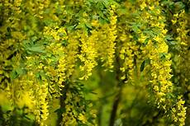
STANZA-1 ANALYSIS
The Laburnum Top is silent, quiet still
In the Afternoon yellow
September sunlight,
A few leaves yellowing, all its seeds fallen.
The poet describes a beautiful sunny autumn.
The Laburnum tree is silent and still.
It is laden with yellow leaves and yellow flowers in September.
Its leaves have turned yellow because of the autumn season and all its seeds have fallen

Slide 8
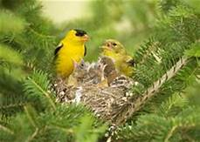
STANZA-2 ANALYSIS
Till the goldfinch comes, with a twitching chirrup
A suddenness, a startlement, at a branch end.
Then as a lizard, and alert, and abrupt,
She enters the thickness, and a machine starts up
Of chitterings, and a tremor of wings, and trillings
The whole tree trembles and thrills.
It is the engine of her family.
She stokes it full, then flirts out to a branch-end
Showing her barred face identity mask.
Just then a goldfinch alights on the laburnum tree making short, high-pitched sounds.
The goldfinch has her nest in the tree and her chicks are resting in the nest.
On the mother’s return, a sudden moment stirs the tree.
Her little ones are excited on her arrival and start chirruping.

Slide 9
EXPLANATION CONTINUES………
The cautious mother enters the tree with great care so that no predator can come to know that her babies are housed in the nest.
The poet has compared the alert, abrupt and sleek movement of the goldfinch with that of a lizard.
The goldfinch has been called the engine of her family. Just as the engine starts up the machine, her arrival in the nest has suddenly started up the silent machine i.e the young ones have started chittering and making noise.
By feeding her young ones, she has added fuel to the machine as a result the chicks now have the energy to be active.
After feeding her chicks, the goldfinch flies up and rests on the end of a branch of the tree, her identity concealed behind the yellow flowers and yellowing leaves.

Slide 10
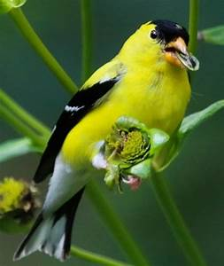
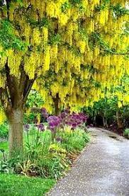
STANZA-3 ANALYSIS
Then with eerie delicate whistle-chirrup whisperings She launches away, towards the infinite And the Laburnum subsides to empty.
Explanation:
After some time, the goldfinch makes a strange short, high-pitched sound.
Then she flies away towards the infinite sky.
The Laburnum tree becomes silent again after the departure of the goldfinch and everything seems to be the same as it was before the arrival of the goldfinch.

Slide 11
Word Meanings
twitching – a small, often involuntary movement of the body chirrup – the sound made by a bird startlement – amazement sleek – smooth chittering – sound made by baby birds tremor – shaking trilling – to sing a series of quickly repeated high notes trembles and thrills – shakes violently the engine of her family – the goldfinch stokes – adds fuel (here the goldfinch is feeding her chicks) flirts – moves abruptly or jerkily with light steps barred – striped eerie – strange in a frightening or mysterious way infinite – the sky

Slide 12
Poetic Devices Used in the Poem
Simile: In this figure of speech, one thing is compared to another. An example of simile in this poem is ‘sleek as a lizard’.
Metaphor: In this figure of speech, a word/ phrase is used to represent something else. Examples of metaphor in this poem are ‘engine of her family’, where ‘engine’ represents the mother goldfinch, and ‘machine’ which represents the nest with its brood of bird chicks.
Alliteration: In this figure of speech, a number of words having the same first consonant sound occur close together in a series. Examples of alliteration in this ‘ poem are ‘September sunlight’, ‘A suddenness, a startlement’, ‘and alert and abrupt’ and ‘tree trembles and thrills’.
Onomatopoeia: In this figure of speech, a word is formed from a sound similar to it. Examples of onomatopoeia in this poem are ‘twitching chirrup’, ‘chitterings’, ‘trillings’ and ‘whistle-chirrup’.
Transferred Epithet: A transferred epithet is a 1 description which refers to a character or event but is used to describe a different situation or character ‘Her barred face identity mask’ is an example of transferred epithet in this poem. The flowers of the Laburnum tree fall like bars and, when the bird sits behind the flowers, the shadow of the flowers on her face looks like she is wearing a mask that has bars on it.

Slide 13
Questions
What do you notice about the beginning and the ending of the poem?
To what is the bird’s movement compared? What is the basis for the comparison?
Why is the image of the engine evoked by the poet?
What do you like the most about the poem?
What does the phrase “her barred face identity mask” mean?
Why is the poem named ‘The Laburnum Top’?
What is the significance of ‘yellow’ in the poem?
How is the tree transformed during the bird’s visit?
To what is the movement of the goldfinch compared? What is the basis for the comparison?
‘Then sleek as a lizard and alert and abrupt, She enters the thickness’. Explain the given line.
What is the engine of the machine? What is its fuel?

Slide 14
THANKING YOU
ODM EDUCATIONAL GROUP

