Slide 1


IMPROVEMENT IN FOOD RESOURCES
SUBJECT-BIOLOGY
CHAPTER NO- 15
Need For Increasing Food Production, Types Of Crops, Improvement in Crop Yield
PERIOD-1

Slide 2


LEARNING OBJECTIVE
Students will -
know the dependence of humans on plants and animals
know different types of crops.
understand improved agricultural activities.

Slide 3
PRE-KNOWLEDGE QUESTIONS
What does food provide?
Do you know what are the major sources of food?
Why is there a need of improvement in food production?

Slide 4
NEED FOR INCREASING FOOD PRODUCTION
We will need more than a billion tonnes of grain every year to feed this growing population.
Since increasing the area of land for cultivation is limited, it is necessary to increase the production efficiency of crops and livestock.
The production efficiency of crops and livestock can be increased by adopting scientific management practices to improve crop yield, undertaking mixed farming, intercropping, and integrated farming practices like combining agriculture with livestock, poultry, fisheries, bee-keeping etc.

Slide 5
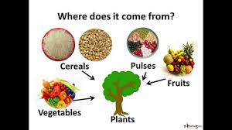
TYPES OF FOOD
1. Cereals like rice, wheat, maize, millets, sorghum etc. provide us carbohydrates.
2. Pulses like peas, beans, grams, lentils etc. provide us proteins.
3. Oil seeds like ground nut, sesame, castor, mustard, linseed, sunflower etc. provide us fats.
4. Vegetables, spices and fruits provide us vitamins and minerals along with small amounts of carbohydrates, fats and proteins.
5. Fodder crops like oats or sudan grass are grown as food for livestock.

Slide 6
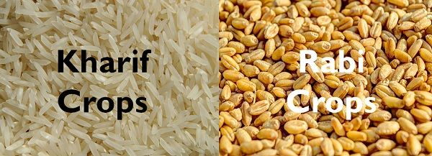
TYPES OF CROPS
Different crops require different climatic conditions, temperature and duration of sunlight (photoperiods).
A. Kharif crops :- are crops grown during the rainy season from June to October like paddy, soyabean, maize, pigeon pea, green gram, black gram, cotton etc.
B. Rabi crops :- are crops grown during winter season from November to April like wheat, gram, peas, mustard, linseed etc.

Slide 7
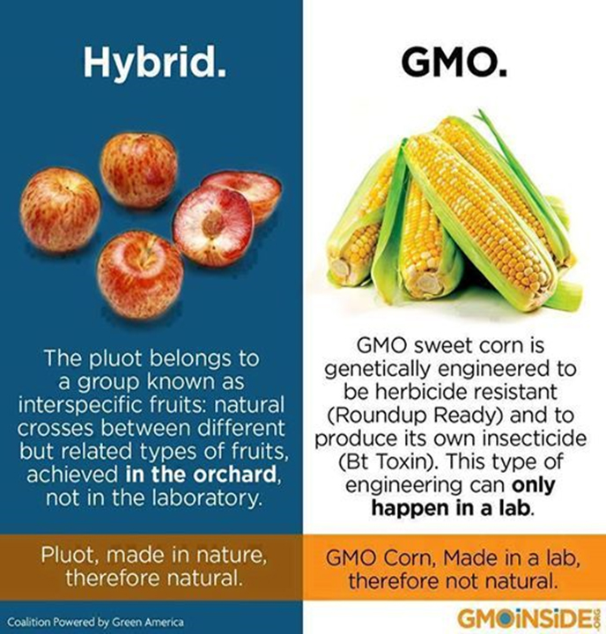
Improvement in crop yield
Crop yield can be improved by:
i) Crop variety improvement
ii) Crop production improvement
iii) Crop protection management
Crop variety improvement is done by selecting good varieties of crops. This is done by hybridisation.
Hybridisation is the crossing between genetically dissimilar plants to obtain crops having useful characteristics like disease resistance, good quality and high yields.
Hybridisation may be intervarietal (between different varieties, interspecific (between different species of the same genus) or intergeneric (between different genera).
Another way of improving crop variety is by introducing a gene to obtain the desired characteristic. This produces genetically modified crops.

Slide 8
CROP VARIETY IMPROVEMENT
Crop variety improvement is done for the following :-
i) Higher yield :- To increase productivity of crop per acre.
ii) Biotic and abiotic resistance :- To increase resistance of crops to biotic factors like insects, diseases etc. and abiotic factors like draught, salinity, heat, cold etc.
iii) Change in maturity duration :- To reduce the duration between sowing and harvesting so that farmers can grow multiple crops during the year.
iv) Wider adaptibility :- To grow crops in different climatic conditions.
v) Desirable characters :- Characters like tallness and more branching are useful for fodder crops and dwarfness (shortness) is desirable for cereal crops.

Slide 9
HOME ASSIGNMENT
Give any two reasons for the need of improvement of food resources.
Differentiate between kharif and rabi crops by giving an example of each.
Describe the method by which crop variety can be improved.
Explain any three objectives of Crop Variety Improvement.
What do you mean by Genetically Modified Crops?

Slide 10
THANKING YOU
ODM EDUCATIONAL GROUP

