Slide 1

WELCOME TO ONLINE CLASS
CLASS-UKG
SUBJECT-GK
TOPIC-FOOD
( Revision)

Slide 2
WHY DO WE NEED FOOD ?
WE NEED FOOD TO GET ENERGY.
WE NEED FOOD TO KEEP OURSELVES HEALTHY.
WE NEED FOOD TO GROW.

Slide 3
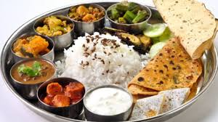
WE GET FOOD FROM
ANIMALS
PLANTS

Slide 4
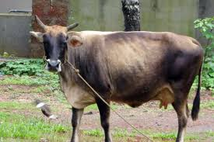
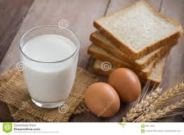
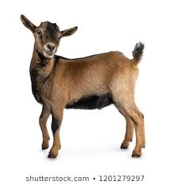
We get milk from-

Slide 5
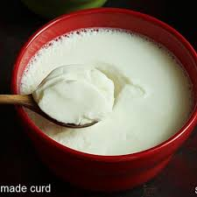
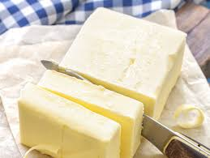
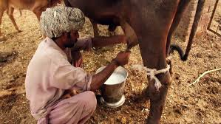
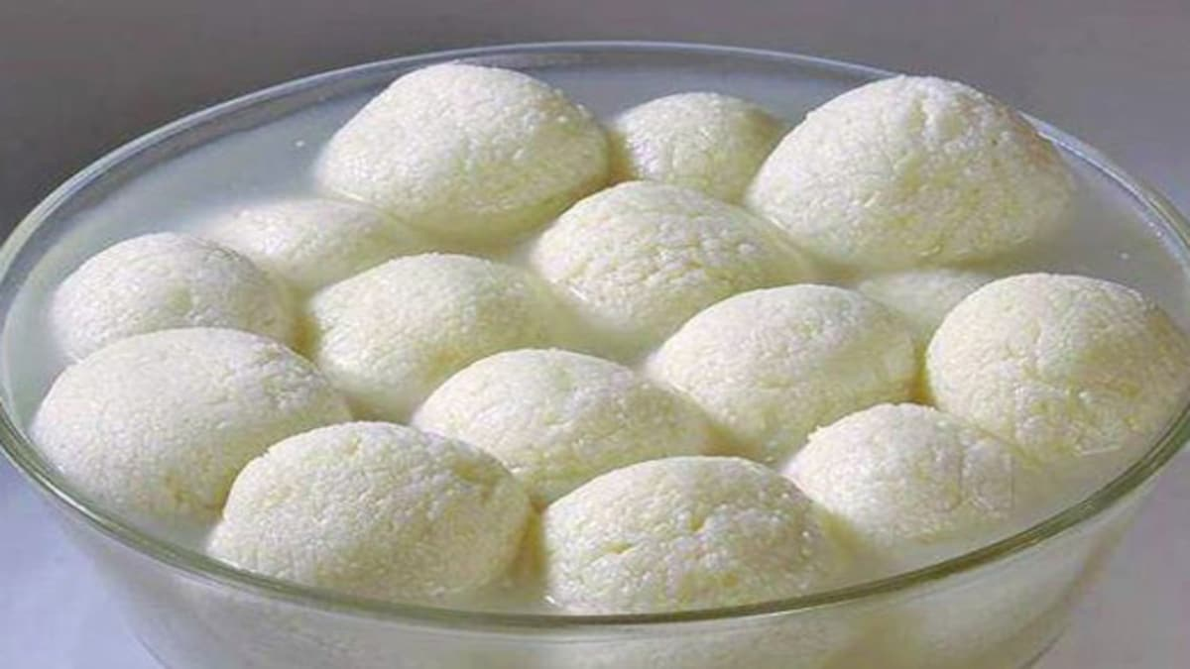
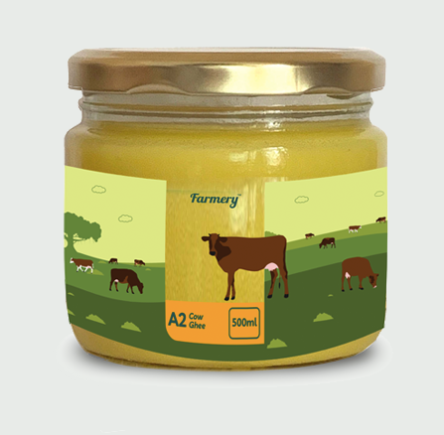
Milk products-
cheese & butter
curd
sweets
ghee

Slide 6
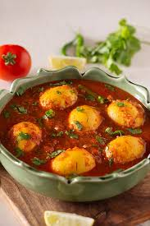
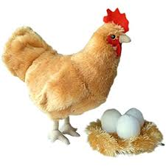
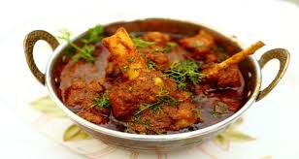
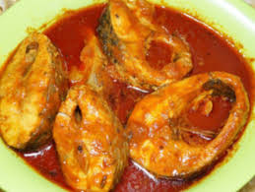
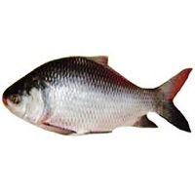
Food from animals-

Slide 7
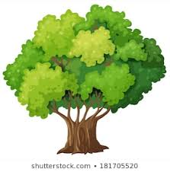
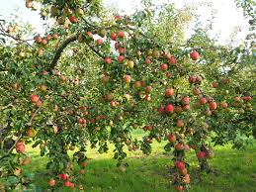
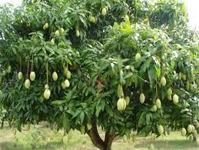
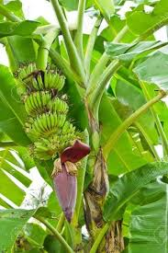
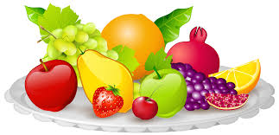
Food from plants-

Slide 8
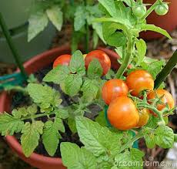
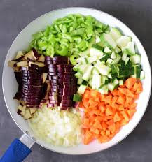
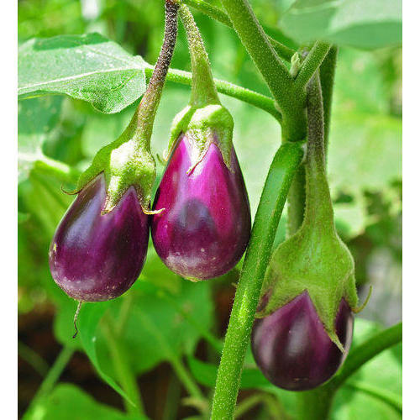
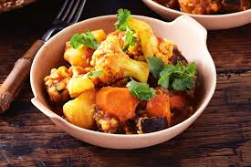
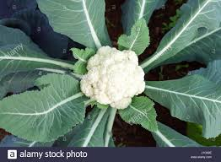

Slide 9
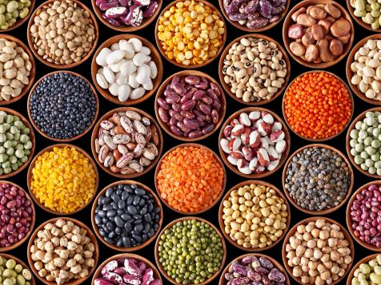
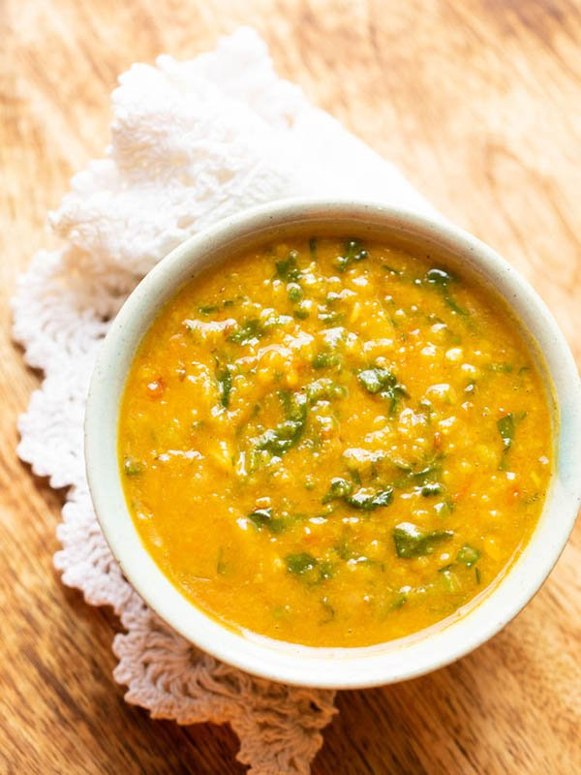

Slide 10
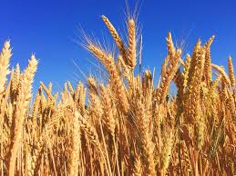
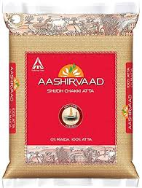
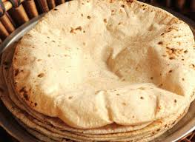

Slide 11
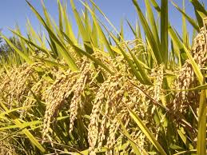
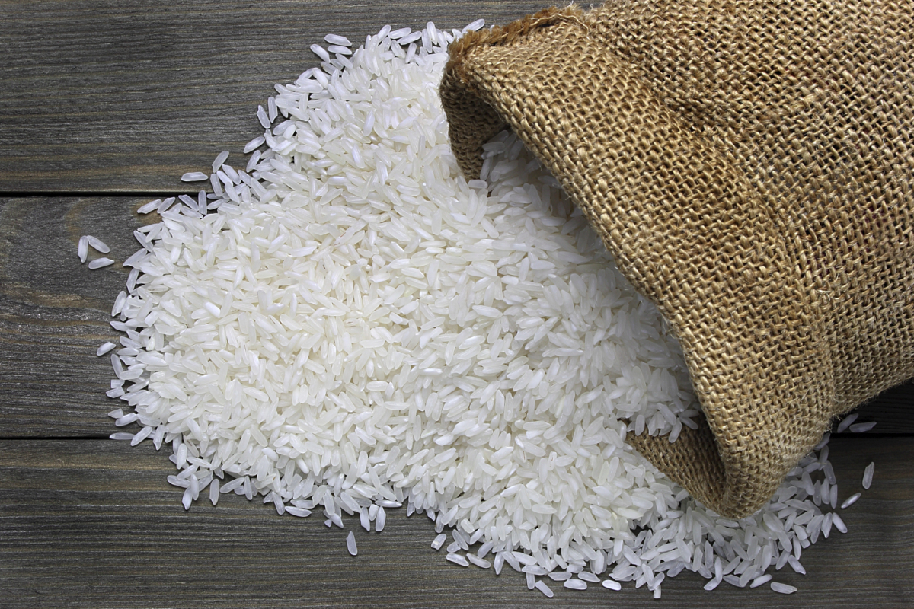
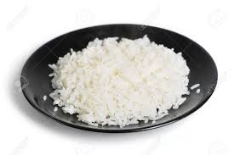

Slide 12
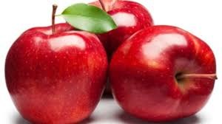
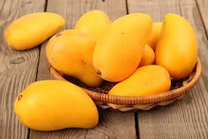
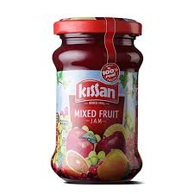
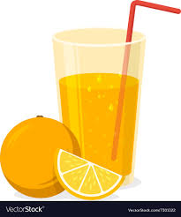
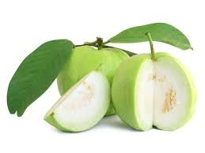
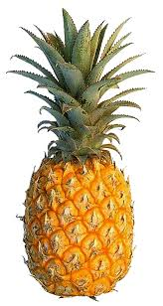

Slide 14
Can you answer ?
Name any 2 plant product .
Name any 2 milk product.
Is rice a healthy or junk food ?
Is potato a fruit or vegetable ?
Name any 2 animal product.
Which animal gives us milk ?
Name any 2 junk food.
Name the vegetable that tastes bitter.
Name any 2 food items that tastes sour.

Slide 15
In brief-
Our body needs energy to move, work and play.
We get this energy from food.
We get food from plants and animals.
We usually have three meals in a day.
Milk and water are important drinks for our health.

Slide 16
Some important good eating habits-
Wash your hands before and after meals.
Always eat fresh and clean food.
Always keep food covered.
Never waste food.
Do not eat stale or uncovered food.
Wash fruits and vegetables before eating.
Eat nutritious food.
Avoid junk food items.

Slide 17

THANKING YOU
ODM EDUCATIONAL GROUP

