Slide 1

WELCOME TO ONLINE CLASS
CLASS : UKG
SUBJECT : ENGLISH
Chapter : 5 (“oo”) sound words

Slide 2
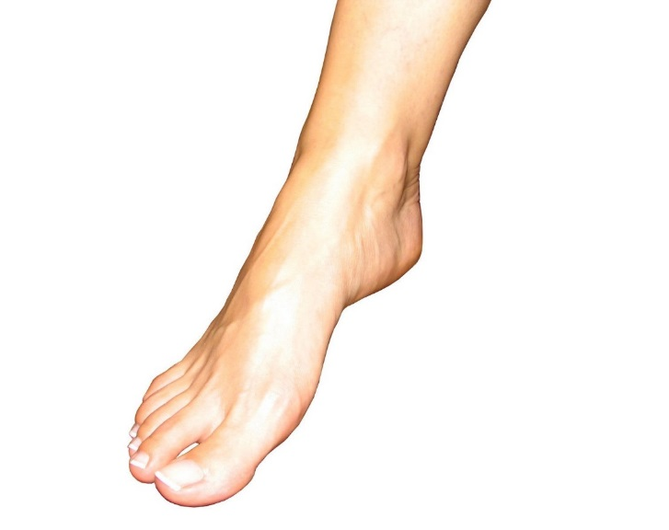

‘oo’ sound words Blending
BOOK
FOOT

Slide 3
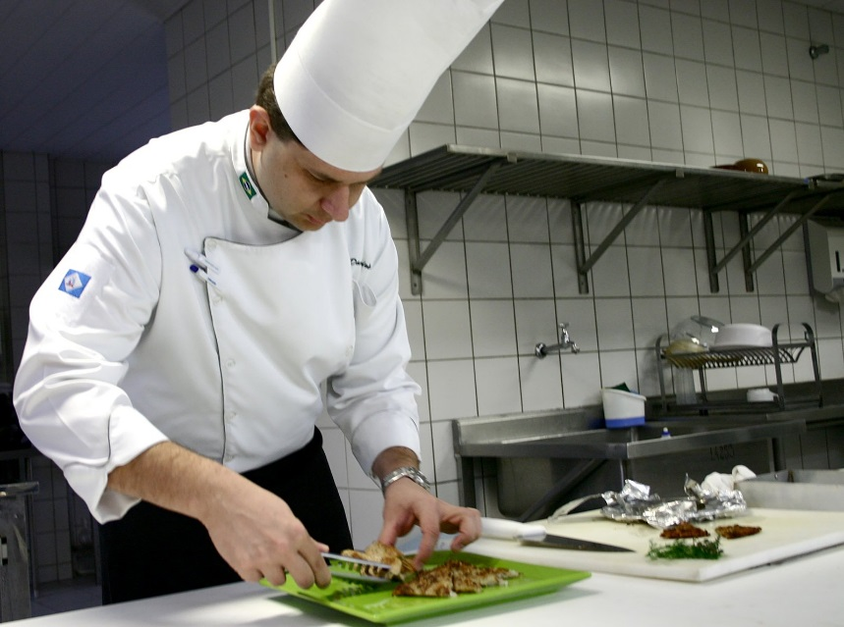

COOK
HOOK
.

Slide 4

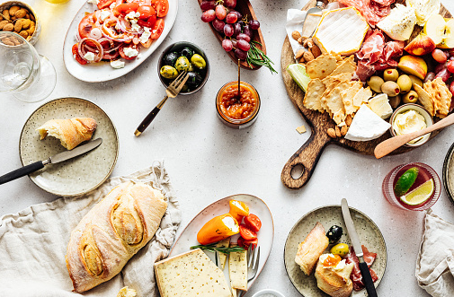
FOOD
LOOK

Slide 5
CLASS ASSIGNMENT( write each word twice in note book)
BOOK
LOOK
FOOT
HOOK
COOK

Slide 6
HOME ASSIGNMENT ( circle the “oo” sound words)
spoon girl king food
Cool cook room jug
Dad look cat bag
Book dog foot zoom

Slide 7

THANKING YOU
ODM EDUCATIONAL GROUP

