Slide 1

WELCOME TO ONLINE CLASS
CLASS : UKG
SUBJECT : ENGLISH
Chapter : 5 (“oo”) sound words

Slide 2

‘oo’ sound words
BOOK

Slide 3
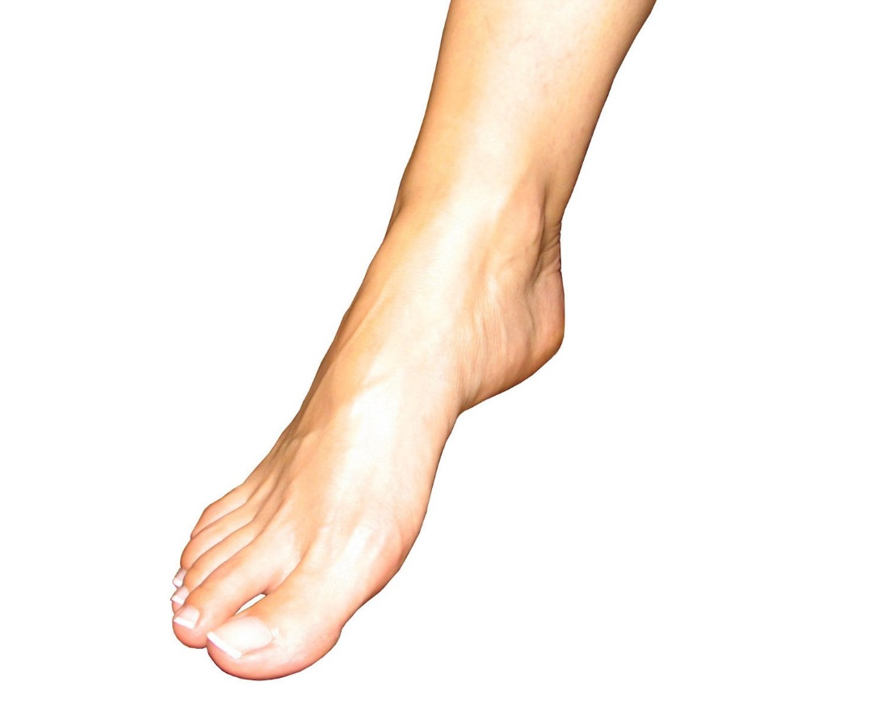
FOOT
.

Slide 4
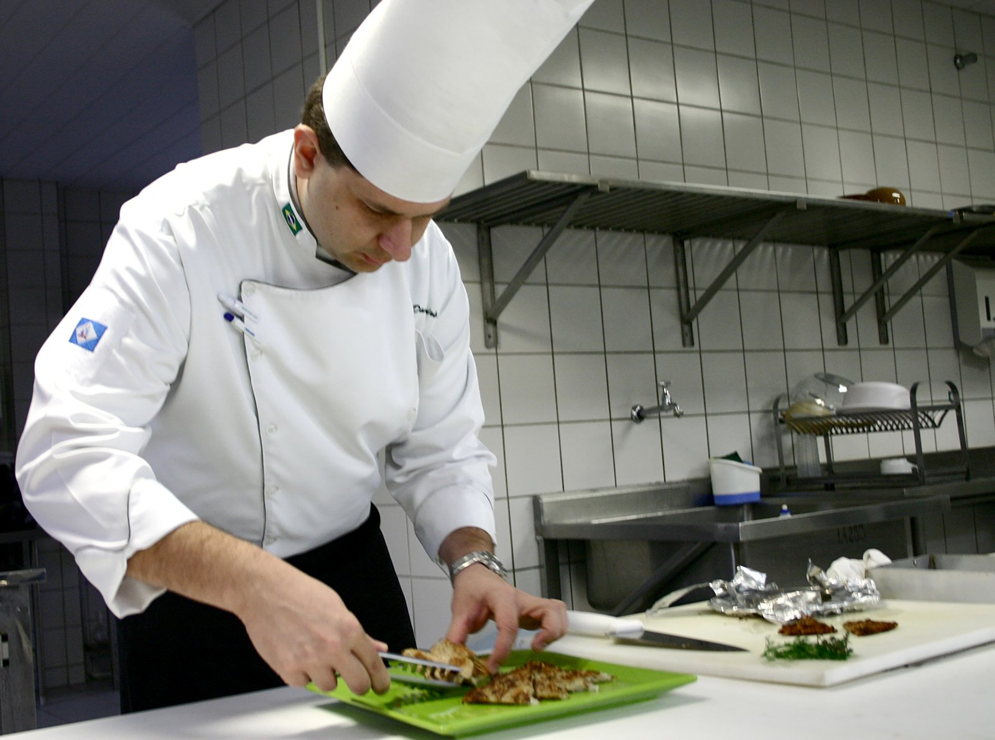
COOK
.

Slide 5

HOOK

Slide 6

LOOK

Slide 7
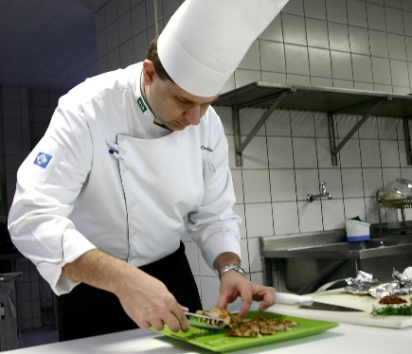
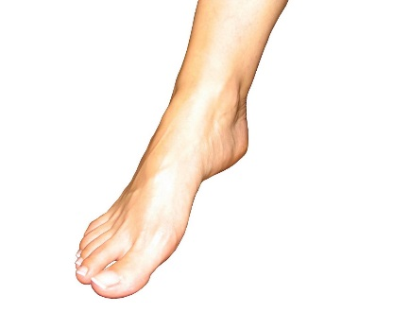
LET’S REPEAT THE WORDS Class assignment
BOOK
COOK
FOOT
LOOK
HOOK

Slide 8
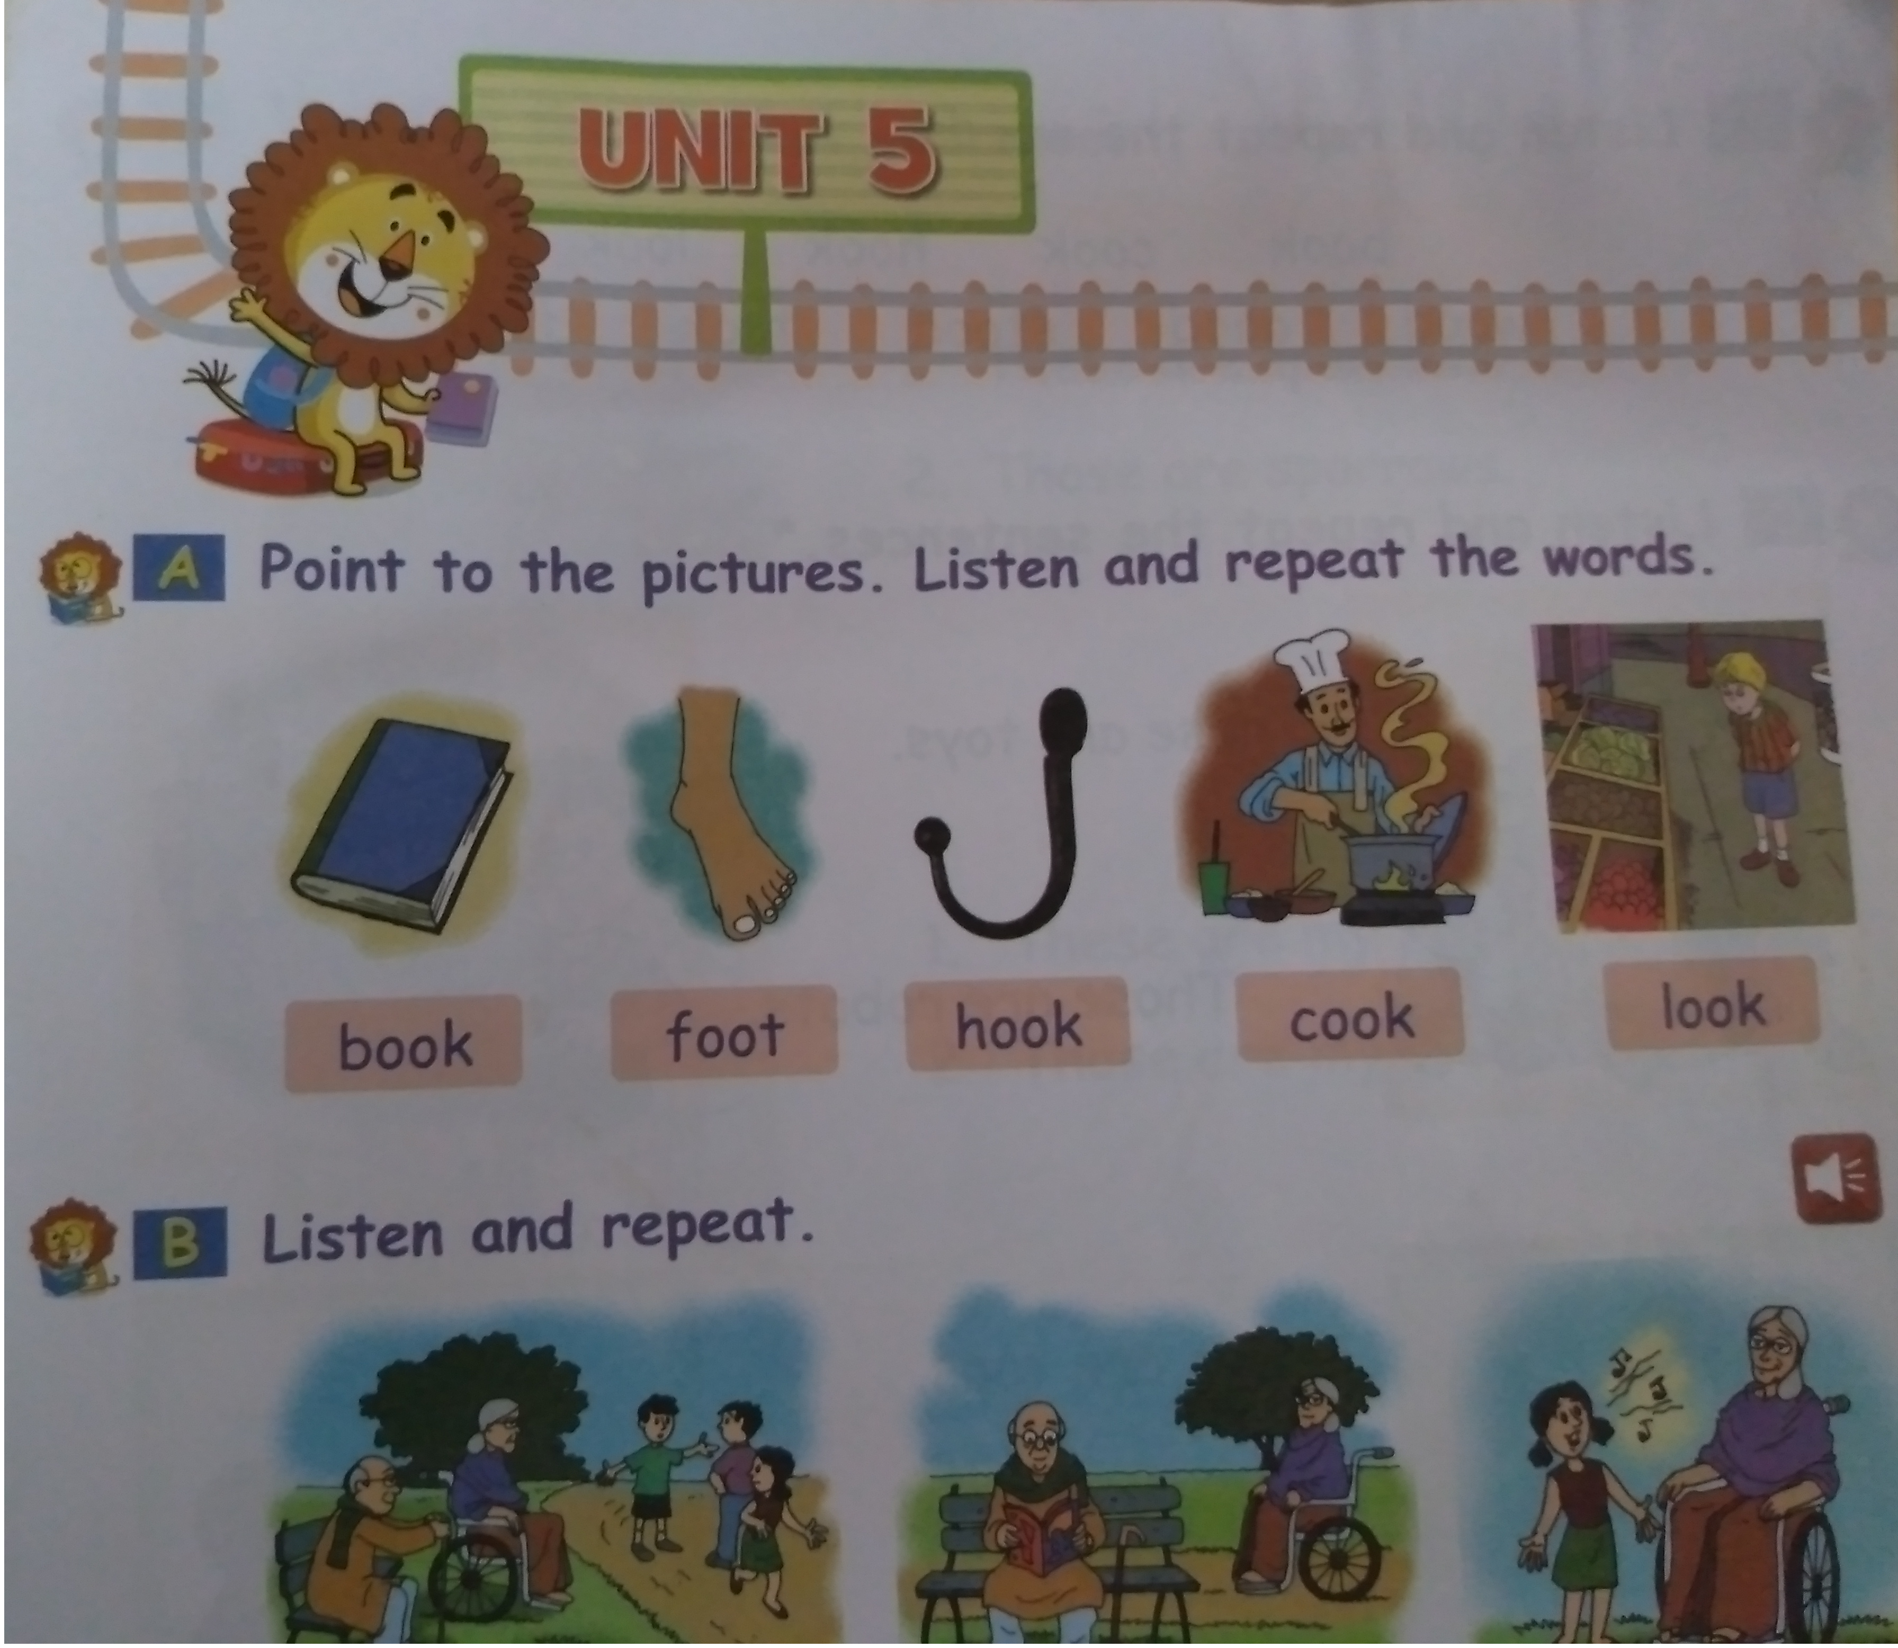
HOME ASSIGNMENT ( Read book page25)

Slide 9

THANKING YOU
ODM EDUCATIONAL GROUP

