Slide 1

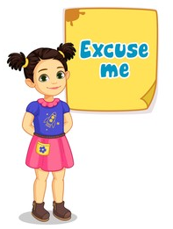
WELCOME TO ON LINE CLASS
CLASS-UKG
SUBJECT-CONVERSATION
TOPIC-''EXCUSE ME''
( let’s revise )
Lesson-6 & 15

Slide 2


MAGIC / GOLDEN WORDS

Slide 3
Excuse me
It is a polite way of trying to get someone's attention.

Slide 4

When we should say Excuse me?
When we want someone to repeat something that person has said because you could not hear it.
Trying to get someone’s attention.
Get attention and bring the audience together.
To stop talking someone.
Politely get attention.
When we cough, sneeze or yawn.
We might also say ‘’excuse me’’ if we accidentally bump into someone.
When we are about to ask a question.
To take permission & want to say something in
between the conversation.

Slide 5
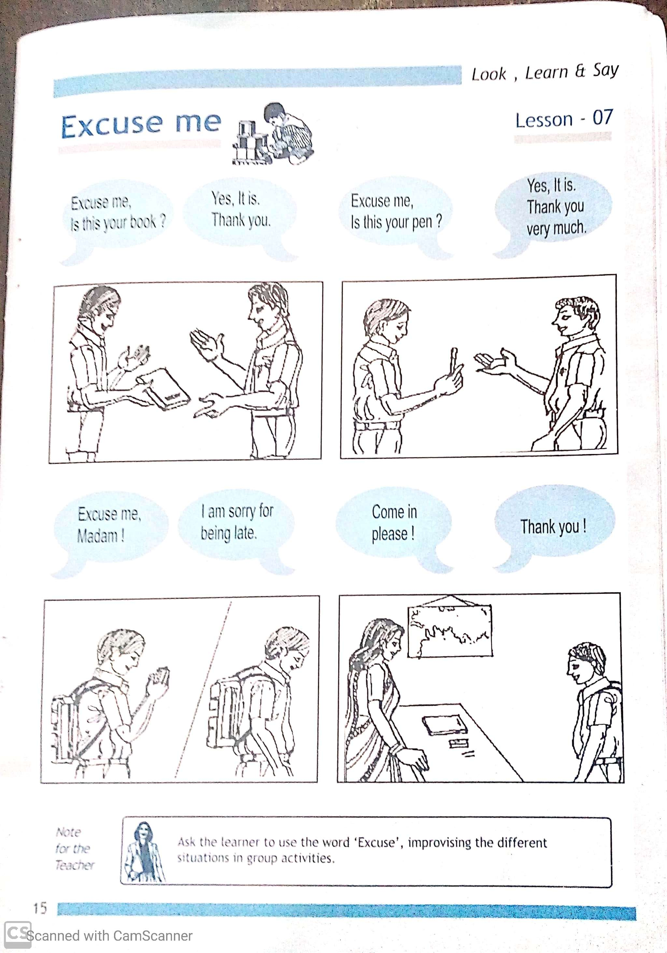

Home assignment-
Use these words in different situation or by doing some
activities with your friends/ parents/brother/sister etc.

Slide 6

THANKING YOU
ODM EDUCATIONAL GROUP

