Slide 1

WELCOME TO ON LINE CLASS
CLASS-UKG
SUBJECT-CONVERSATION
TOPIC-''EXCUSE ME''
( LESSON-7,BKPG-15)

Slide 2



SOME GOLDEN WORDS

Slide 3
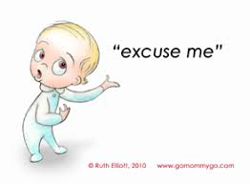


Today's topic is

Slide 4
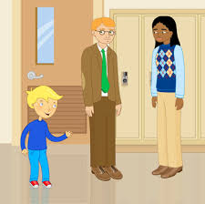
When we want the attention
of other persons we should say
''Excuse me''
Papa…papa….
listen

Slide 5
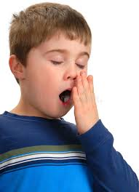
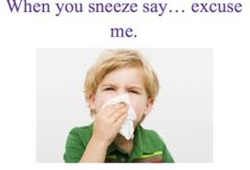

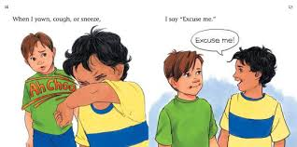
sneeze.....
cough.....
yawn.....
When we yawn,cough or sneeze
we have to say ''Excuse me''

Slide 6
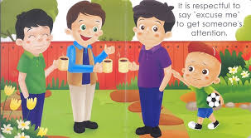
excuse me
It is good to say''excuse me‘’
to get someone's attention

Slide 7
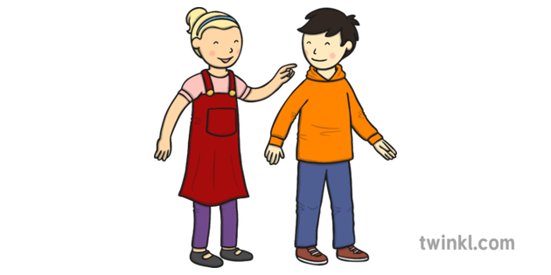
Someone is standing
in front of us,
we ask to get
aside,at that time
we must say
''Excuse me''

Slide 8
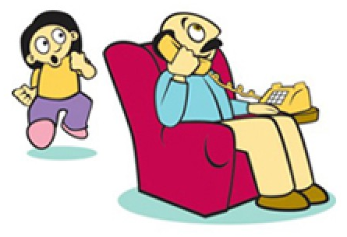
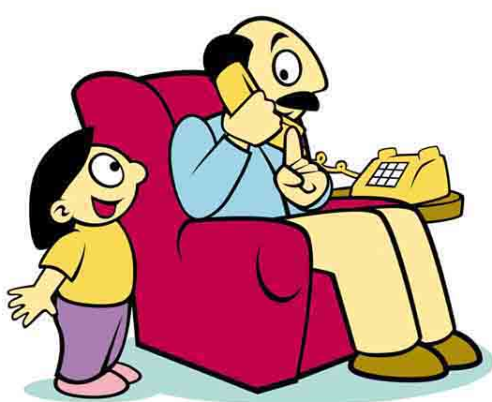
Some times we want to say some things to Daddy,but he is busy talking over the telephone. At that time we should say ''Excuse me'
and waits for the answer .

Slide 9
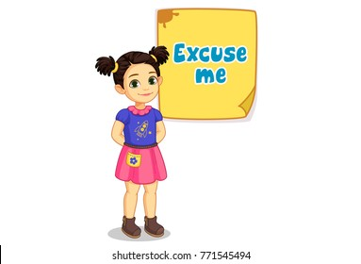

We should always
use these magic
words in our
daily life.

Slide 10
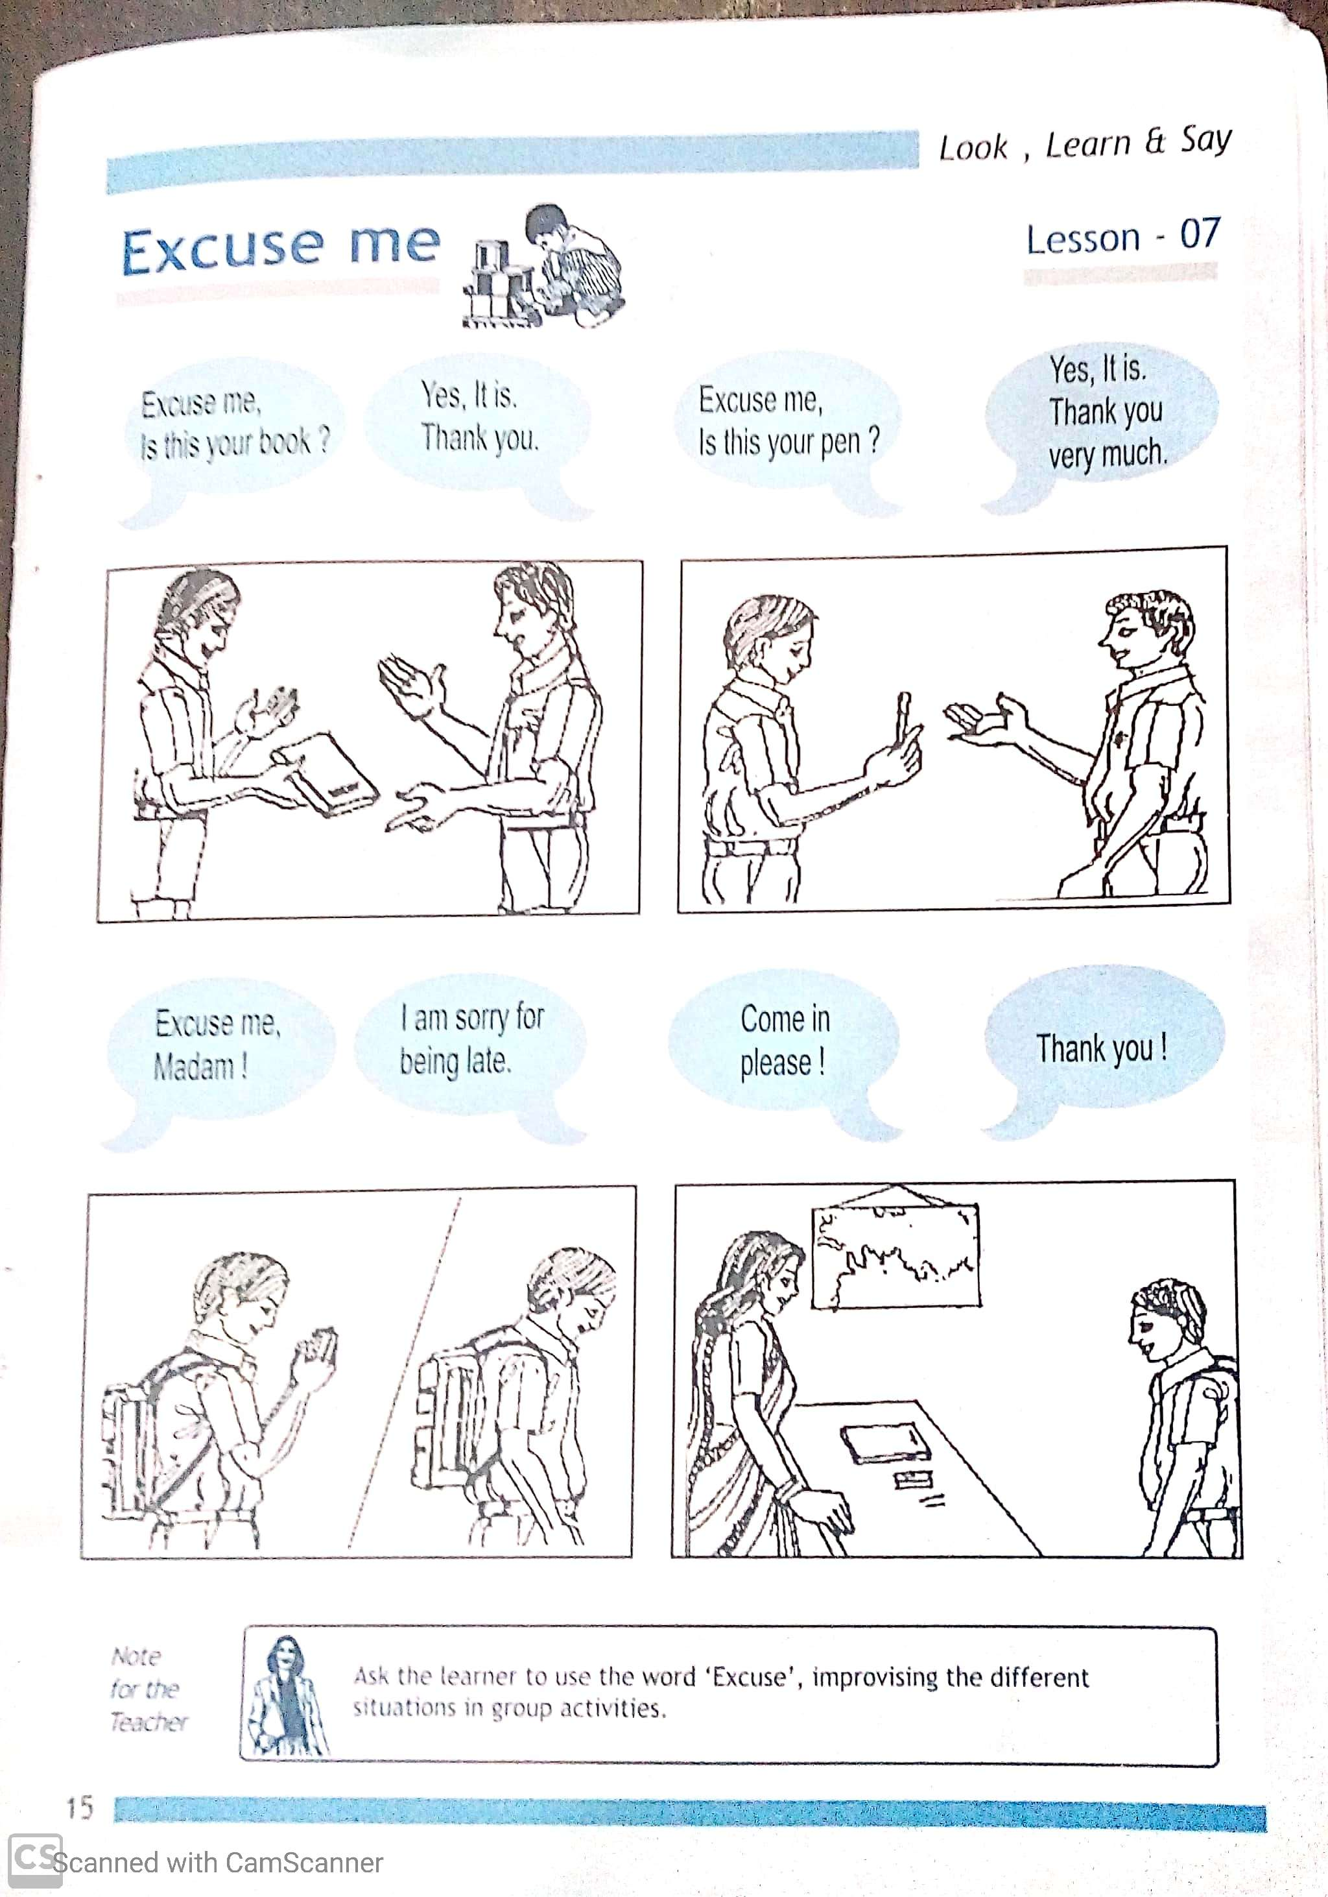

Slide 11

THANKING YOU
ODM EDUCATIONAL GROUP

