Slide 1


CLASS : UKG
SUBJECT :MATHS
CHAPTER : 5
CHAPTER NAME- WHAT DO YOU DO AT HOME
TOPIC- WHAT DO YOU DO AT HOME

Slide 2
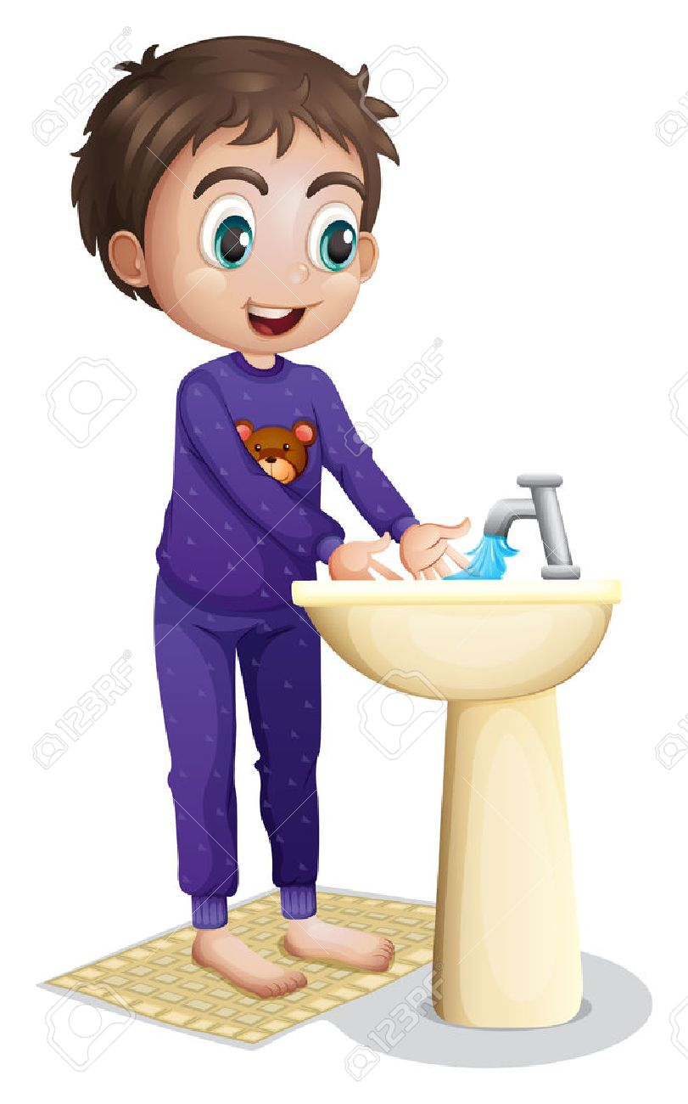
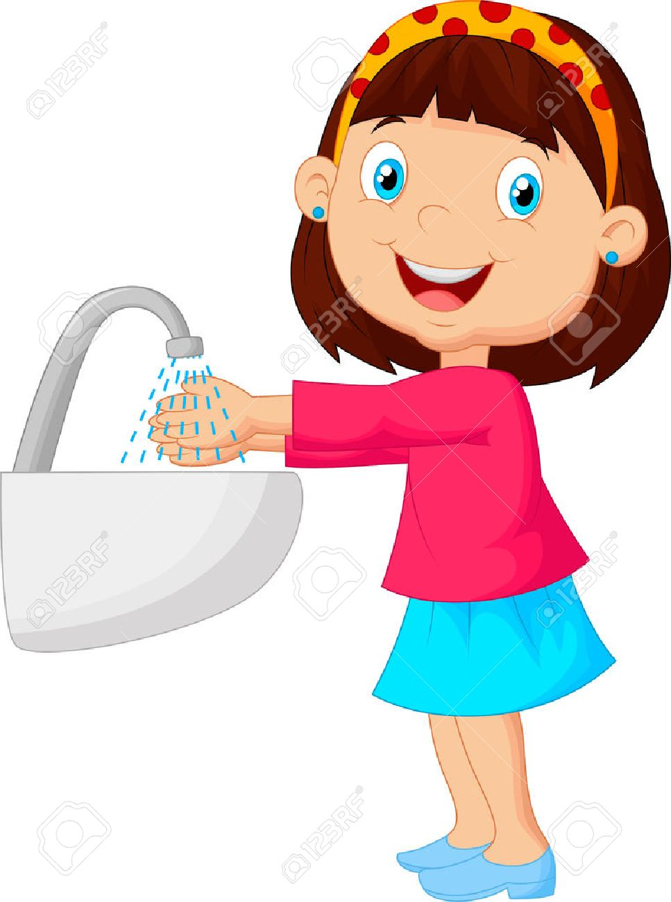
We should wash our face in the
wash basin.

Slide 3
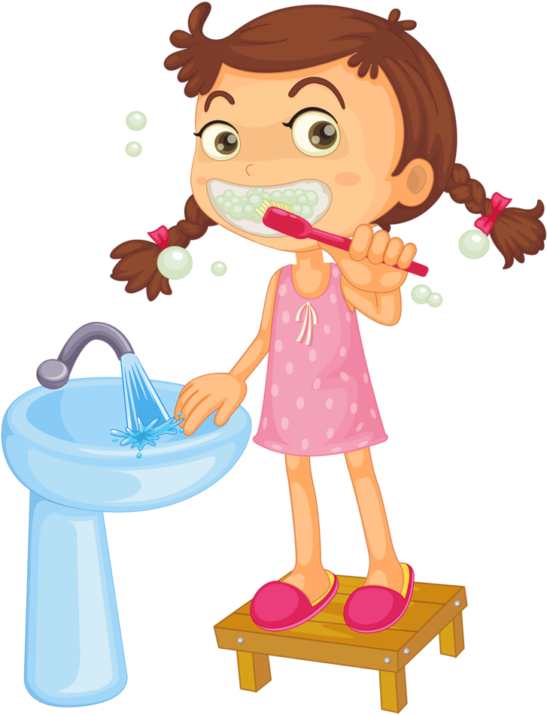

We should brush our
teeth in the wash basin.

Slide 4
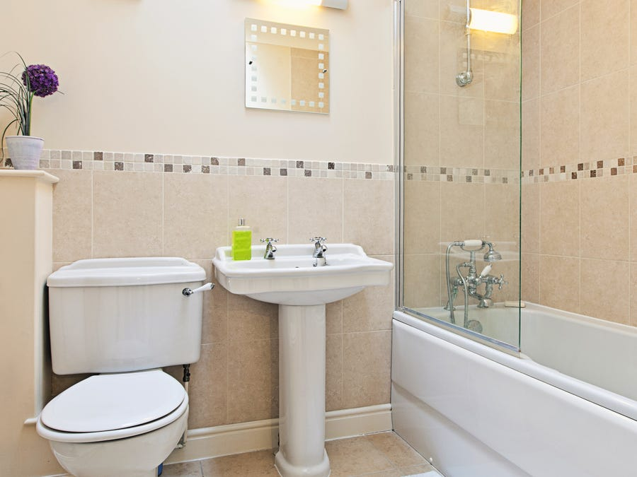
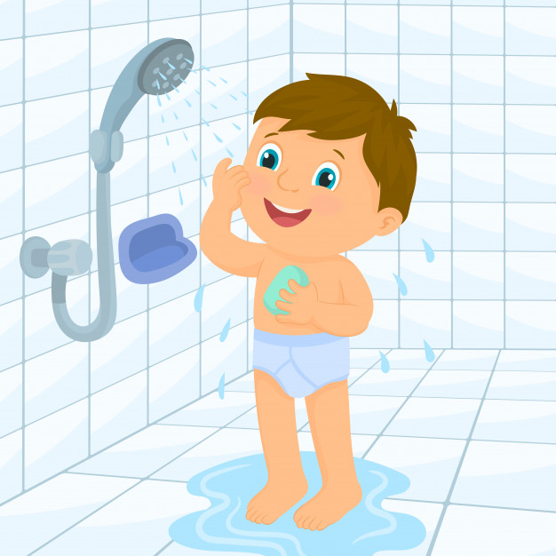
We should take our bath in
the wash room.

Slide 5

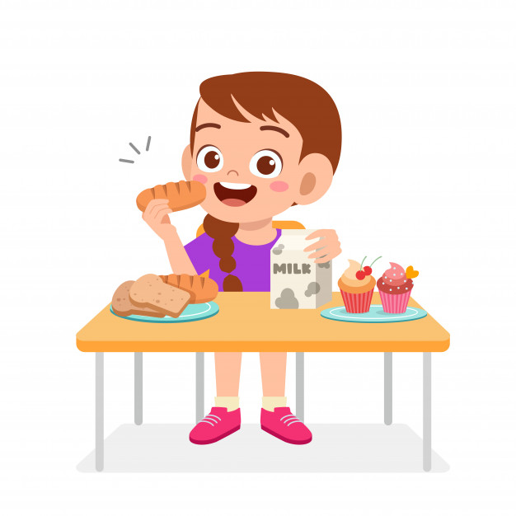
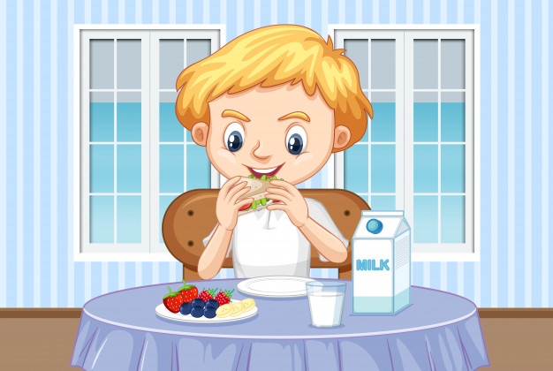
We should take our breakfast
on the dinning table.

Slide 6
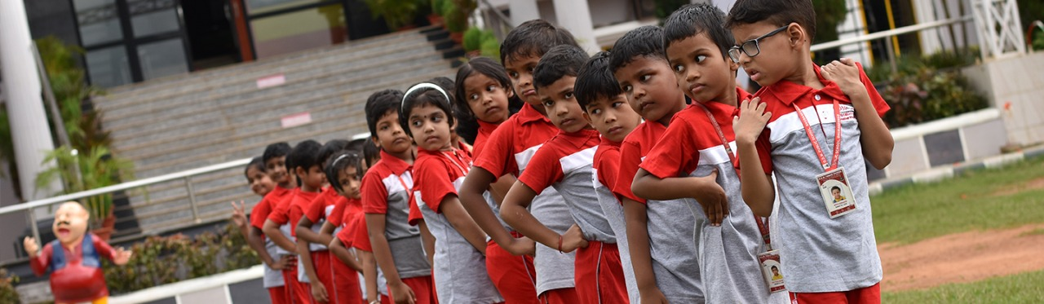
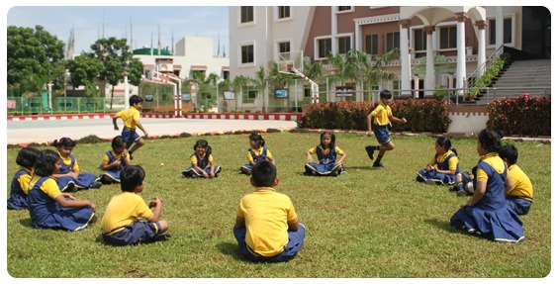
We should wear school uniform
When we are coming to school.

Slide 7
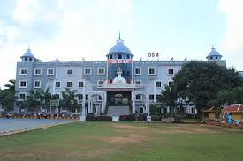
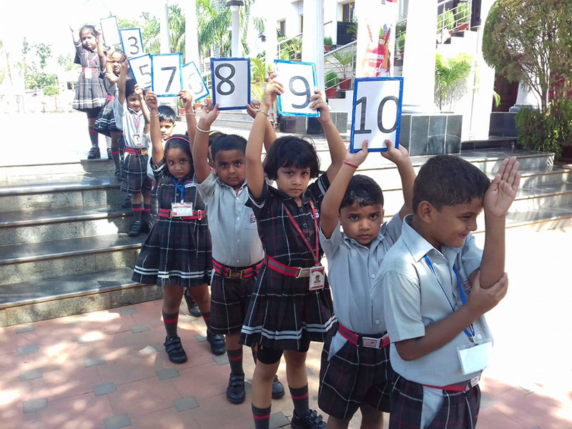
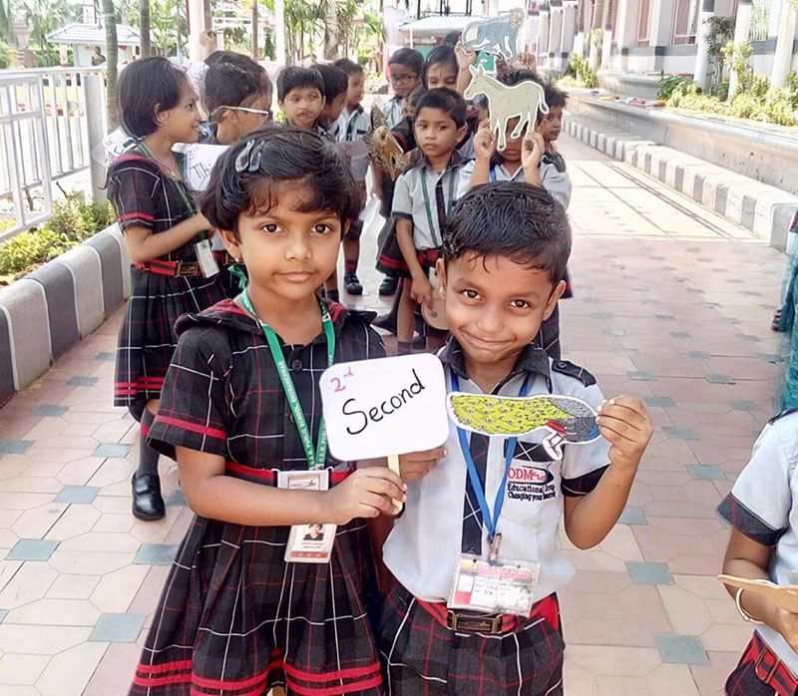

Slide 8
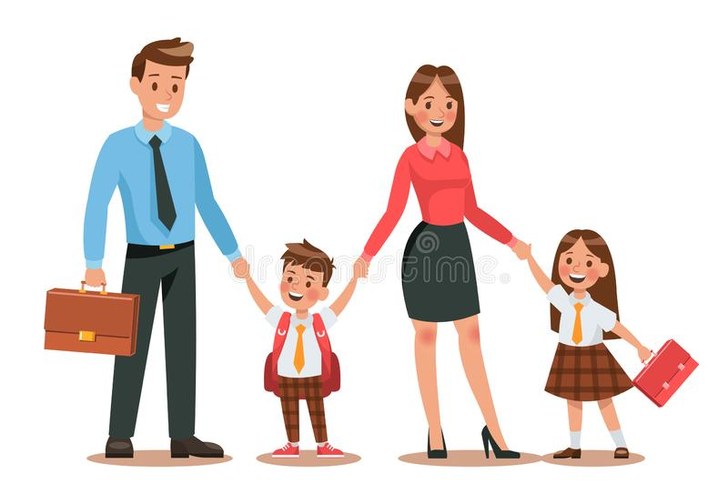

We go to school
with our parents.

Slide 9
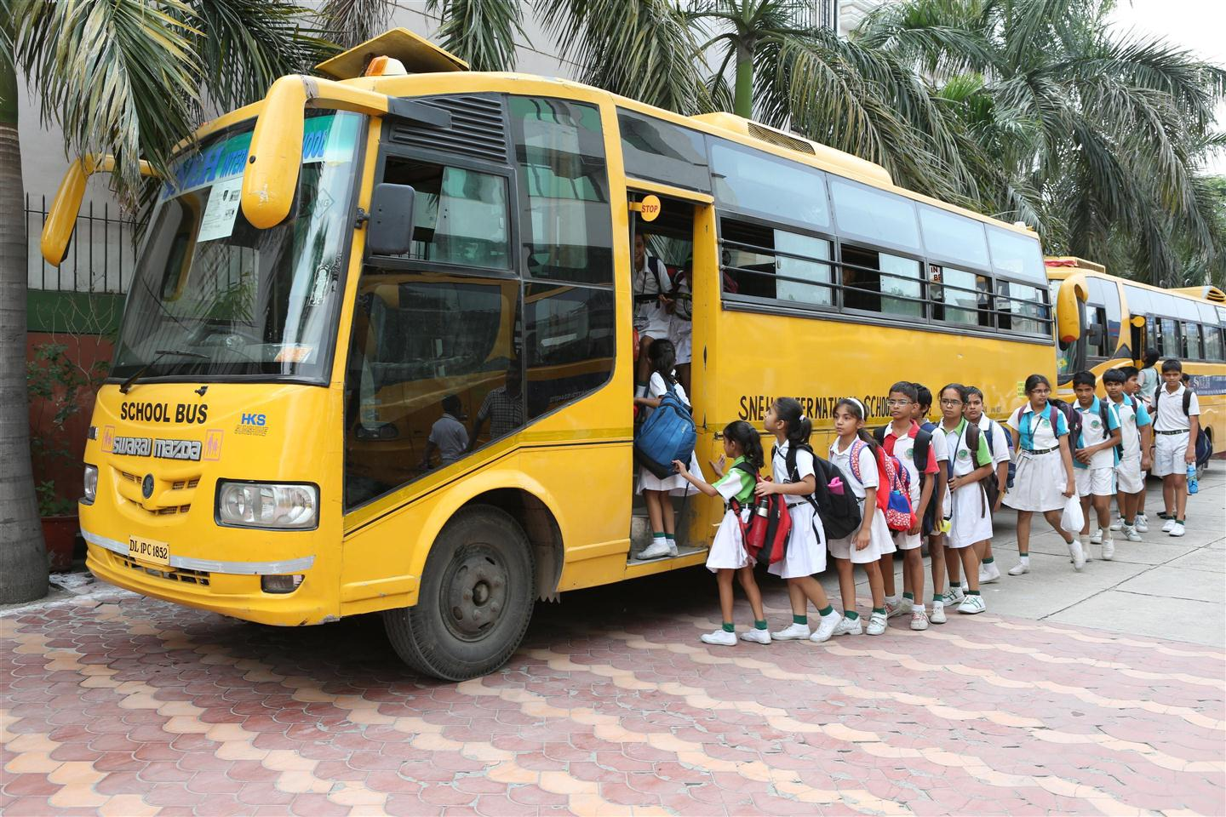
We come to school
in a school bus.

Slide 10
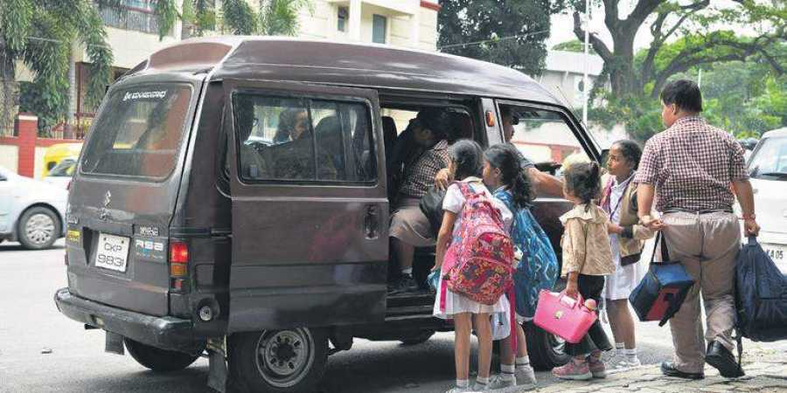
We come to school in a van.

Slide 11
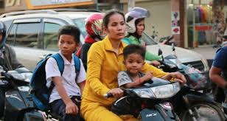
We come to school in a scooter.

Slide 12
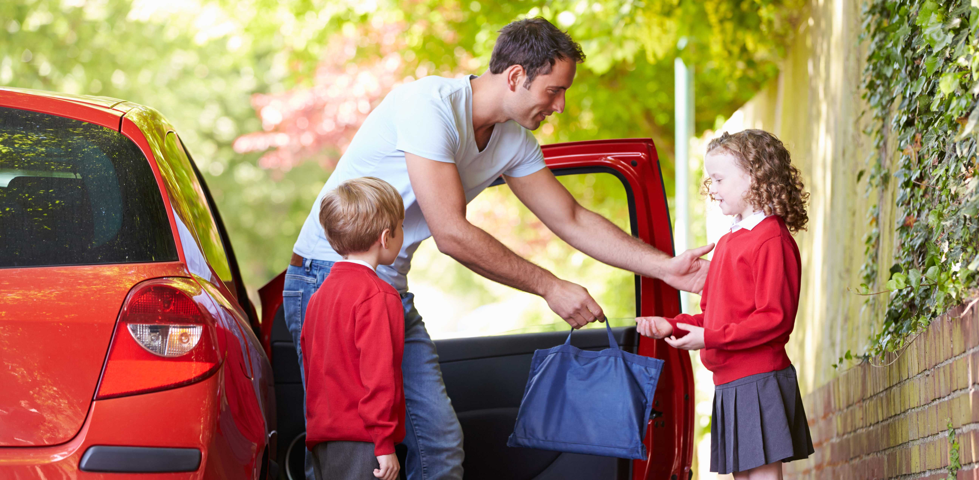
We come to school in a car .

Slide 13
THINGS TO LEARN
WHAT DO YOU DO AT HOME ?
1) Where do you wash your face?
2) When do you wash your face ?
3) How do you wash your face ?
4) When do you brush your teeth?
5) Where do you brush your teeth?
6) How do you brush your teeth ?
7) When do you take your bath ?
8) Where do you take your bath ?
9) How do you take your bath ?

Slide 14
10) When do you take your breakfast ?
11) What do you take in your breakfast ?
12) When do wear your school uniform ?
13) What do you wear when you come to school ?
14) When do you come to school ?
15) With whom do you come to school ?
16) How do you come to school ?

Slide 15
THANKING YOU
ODM EDUCATIONAL GROUP

