Slide 1


CLASS : UKG
SUBJECT :GK
CHAPTER : 7
CHAPTER NAME- OUR HELPERS
TOPIC : INTRODUCTION

Slide 2
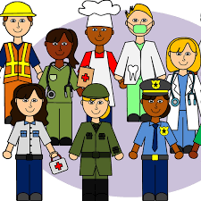
COMMUNITY HELPER
We cannot do everything ourselves. So we need some people to help us in day-to-day life.
The people who help us are called Community Helpers. These community helpers help us in our daily activities.
Community helpers are people who live and work in the community. They work to make our life easier, safe and more fun.

Slide 3
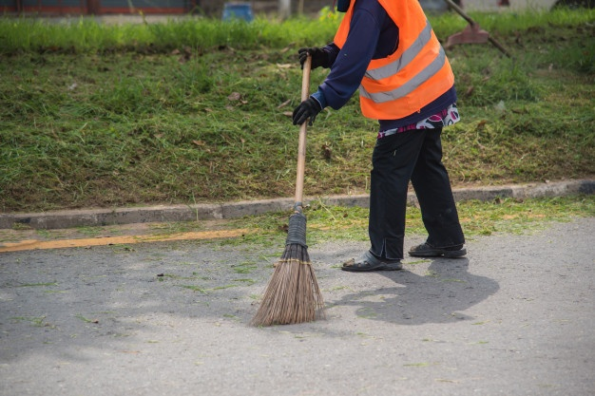
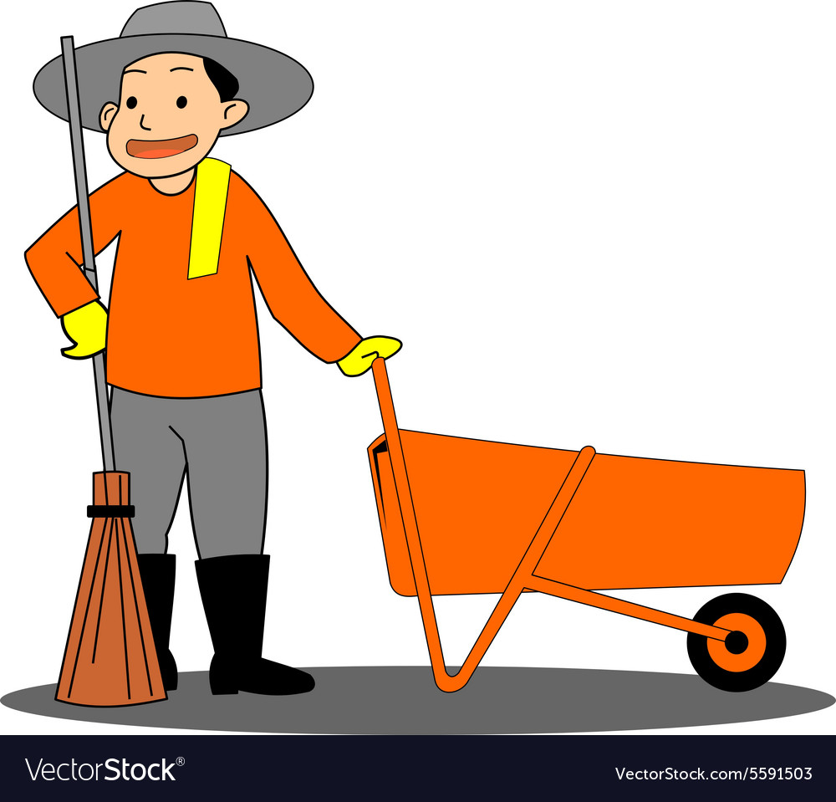
A SWEEPER helps to keep our school, society, road ,park etc. clean. He uses a broom to sweep dust, dry leaves etc.

Slide 4
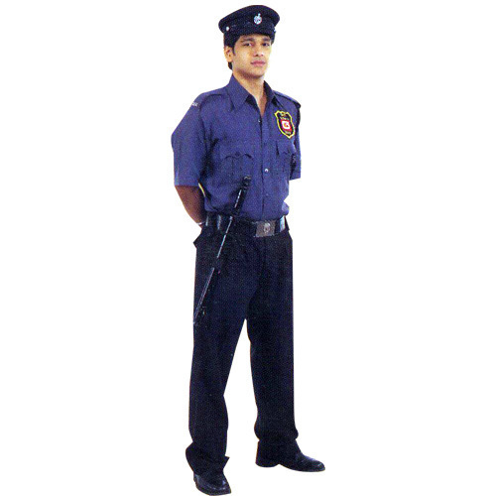
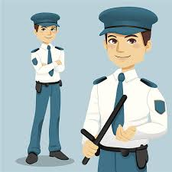
The SECURITY GUARDS keeps us safe. They guard our house and society.

Slide 5
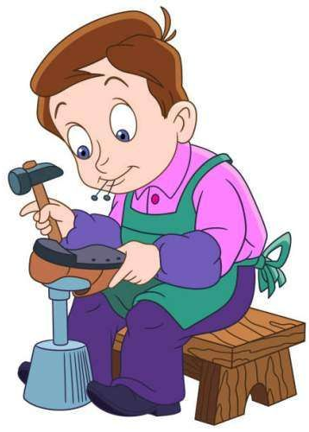
A COBBLER mends our shoes.
He uses needle and thread for this.

Slide 6
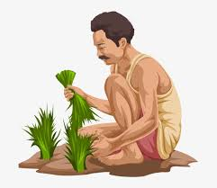
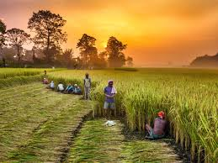
A FARMER grows food for us like rice, wheat, vegetables, fruits etc.

Slide 7



A teacher help children in reading, writing and spelling.

Slide 8
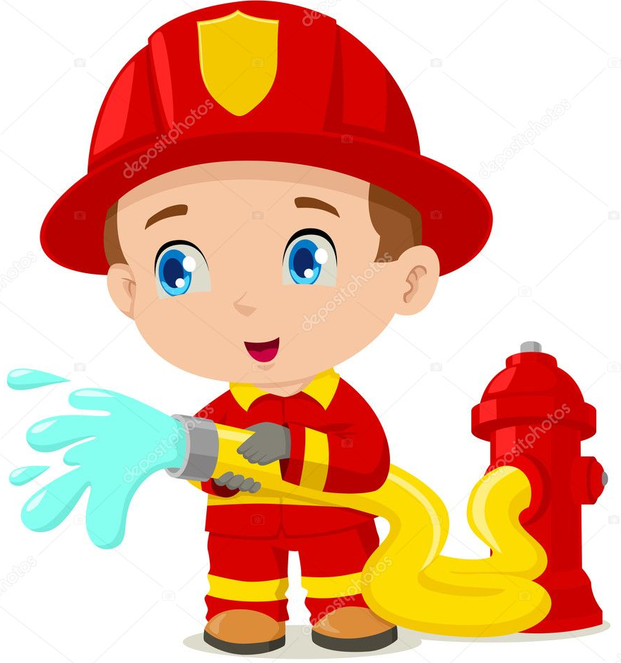
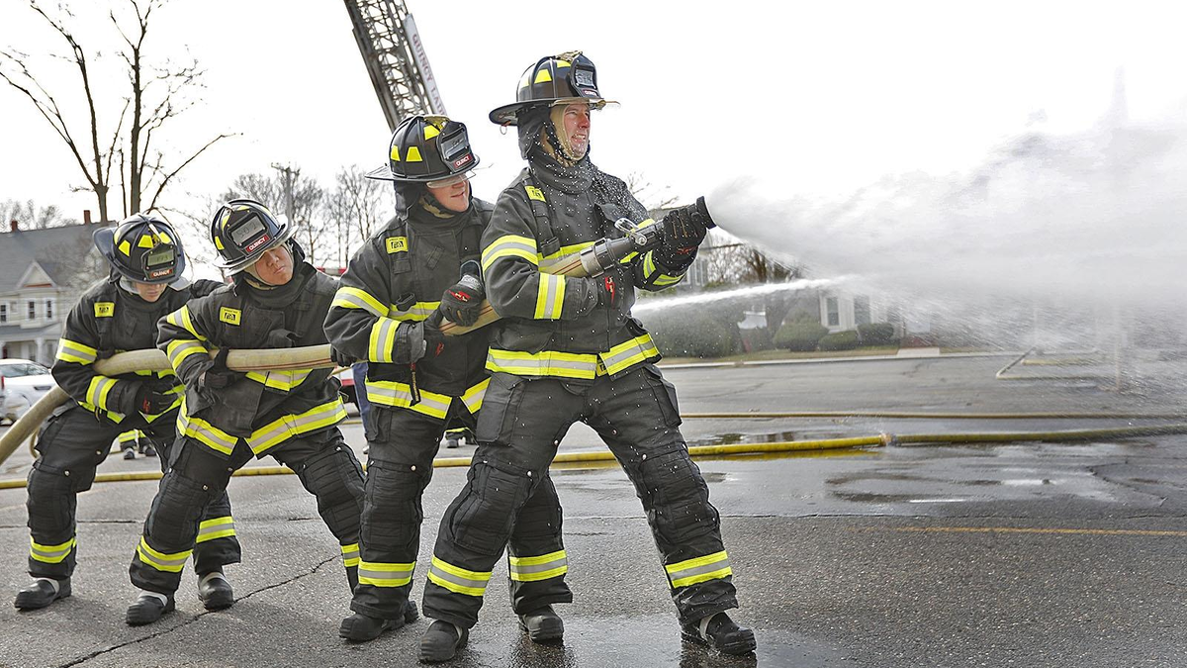
A FIREMAN fights with fire. They help our community by saving people from dangerous fire accidents.

Slide 9
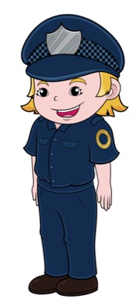
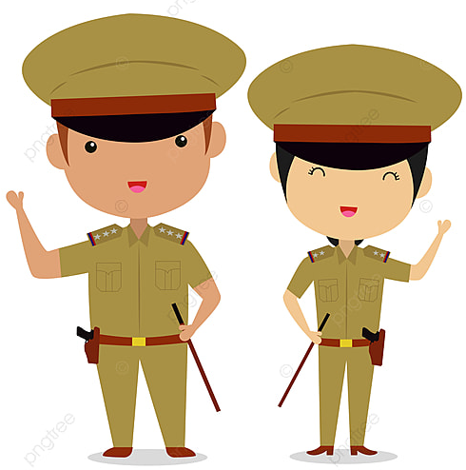
A POLICE MAN work to keep us safe. They put bad people in the jail. They also maintain law and order in the city.

Slide 10
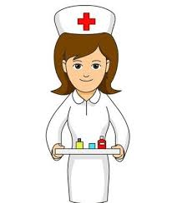
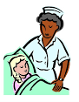
A NURSE helps people when they are sick or hurt. They administer injections and medicines.

Slide 11

A DOCTOR takes care of peoples’ health. They help sick and injured patients.

Slide 12
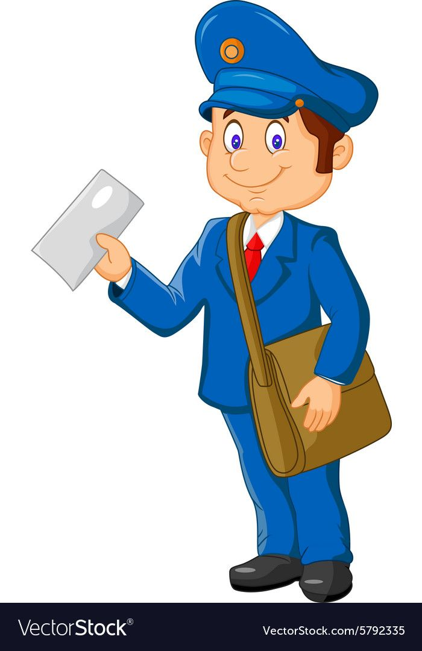
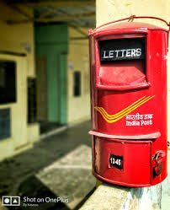
A POSTMAN delivers important letters and cards to people.
They wear an uniform and carry mail in the bag.

Slide 13
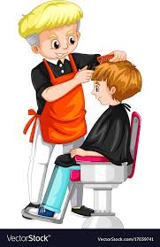
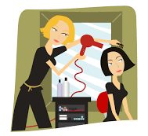
A BARBER helps us to manage our hair. He gives us a hair cut, styles and dresses our hair for us.

Slide 14


A CHEF cooks delicious food for other people.

Slide 15
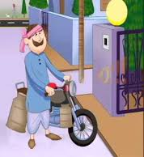
A MILKMAN supplies milk to us.

Slide 16
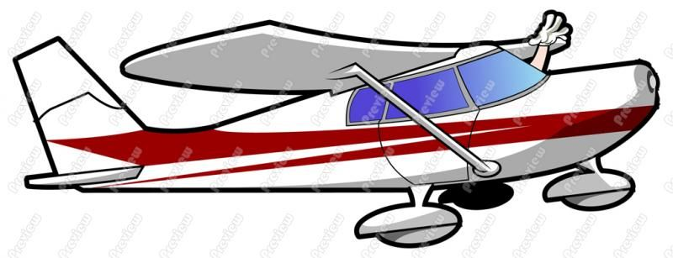
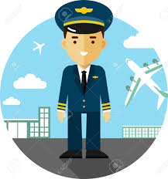
A PILOT can fly you to places far away.
They fly airplanes, jet planes, etc

Slide 17
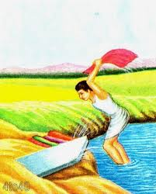
A WASHERMAN washes and irons our dirty clothes.

Slide 18

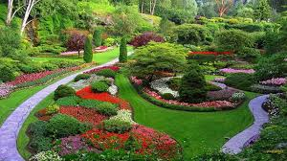
A GARDENER works in garden. They grow plants and water them with loving care.
There would be no flowers without them.

Slide 19

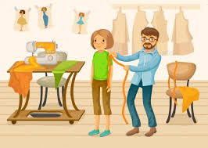
A TAILOR stitches new clothes for us.

Slide 20
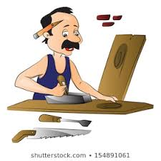

A CARPENTER makes and repair furniture for us.

Slide 21

A TRAFFIC POLICE OFFICER helps to be safe on the road.

Slide 22
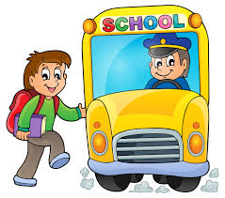
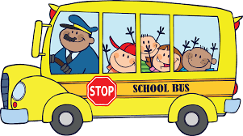
DRIVER is a person who drives a vehicle.

Slide 23
SOLDIERS are the part of an army who saves our country.

Slide 24
THANKING YOU
ODM EDUCATIONAL GROUP

