Slide 1


ROLE OF GOVT IN THE DEVT OF THE COUNTRY
SOCIAL SECTOR
SUBJECT : CIVICS CHAPTER NUMBER:8
CHAPTER NAME :ROLE OF GOVT IN THE DEVT OF THE COUNTRY

Slide 2
ROLE OF GOVT IN THE DEVT OF THE COUNTRY SOCIAL SECTOR
SESSION-5
Social Sector
The social sector refers to all those non-profit motivated activities which attempt to improve the quality of life of the people by providing better access to education, health, drinking water and basic sanitation.
India’s industrial and agricultural output is growing but so is its population. While this has certainly led to economic prosperity., it has also created a sharp increase in our demand for basic amenities like drinkable water, sanitation, shelter and access to educational and medical facilities.
Drinkable water.
Only 1 % of the water is drinkable and a sizable portion of this limited supply of water has been contaminated by sewage and industrial pollutants .
Across the world more than one million children under the age of five die each year due to water- borne diseases. So our Govt has taken several projects to bring clean drinking water to the people Multi- purpose projects have been started and water from dams is supplied to cities, towns and villages, Hand pumps have been installed.

Slide 3

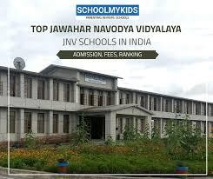
ROLE OF THE GOVT IN THE DEVT OF THE COUNTRY SOCIAL SECTOR
EDUCATION.
The Govt of India has played an important role in the spread of Education in post – independence India , The important steps are
Each state govt was given the responsibility to develop education within the state.
The state govt started schools where nominal fees were charged.
Various schemes were started to encourage parents to send their children to school especially girls
Started Sarva Shiksha Abhiyan to improve quality of learning
Started Navodaya Vidyalaya in 20 districts having concentration of scheduled castes and scheduled tribes.

Slide 4
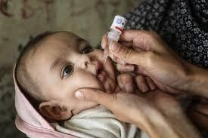

ROLE OF THE GOVT IN THE DEVT OF THE COUNTRY SOCIAL SECTOR
HEALTH.
Maintaining public health is one of the most vital roles of the Govt. Though public health in India has seen and in fact mortality rates have declined, rural
health care is still a neglected area.
The WHO with the Indian Government, addressed children’s health and reduced infant mortality, indirectly contributing to population growth.
Availability of primary healthcare facilities and other basic necessities has been
provided.
The Eleventh Five Year Plans have allocated funds for Eradication of Polio, small pox and other communicable diseases, rural health schemes and improved
hospital facilities

Slide 5
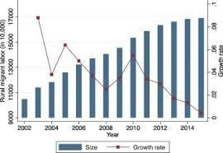

ROLE OF THE GOVT IN THE DEVT OF THE COUNTRY SOCIAL SECTOR
THE PATH AHEAD
The important challenges are
1. Increasing growth of population.
2. Poverty
3. Rural indebtedness
4. Un employment
5. Un equal economic growth and of sustainable development
6. Migration of rural people to metropolitan cities

Slide 6
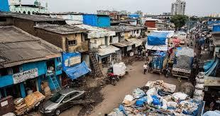
ROLE OF THE GOVT IN THE DEVT OF THE COUNTRY SOCIAL SECTOR
7. The growth of slums is an important manifestation of uncontrolled urbanization.
The key lies in developing the basic infrastructure providing civic amenities and concentrating on education and rural development programmes.Only then can think of a developed India. With the right spirit and a judicious mix of private and public initiative, India can rank among the most developed nations of the world.
.
.

Slide 7
THANKING YOU
ODM EDUCATIONAL GROUP

